Slide 1
П р о е к т
13.08.2017
SPASCHARM project at U70 in Protvino
A.N. Vasiliev

Slide 2
Executive Summary
At the largest accelerator in Russia, the U-70 in the National Research Center Kurchatov Institute (NRC KI) - IHEP, Protvino, a significant base for conducting world-class research in the fixed target SPASCHARM experiment (SPin ASymmetry in CHARMonia) has been created.
The project is aimed at studying the spin structure of the nucleon and the spin dependence of the strong interaction of antimatter and matter with matter at energies up to 50 GeV.
It is proposed to form polarized beams of protons and antiprotons at the accelerator U-70. Calculations of their parameters have been carried out. The intensity of the antiproton beam with energy of 15 GeV can reach 10⁶ antiprotons per accelerator cycle (10¹⁰ antiprotons per day) for the 10¹³ primary protons from the U-70 to a primary target. The polarized antiproton beam will be obtained by selecting antiprotons from the weak decay of anti-Λ hyperons, produced in the primary target by the 60 GeV/c U70 extarcted proton beam. The polarized antiproton beam can be reached in 2022, and will certainly be a unique beam in the world. The intensity of a polarized proton beam with energies of 10-45 GeV will be 20-30 times bigger. The mean polarization value for the both beams is 45%. Polarized antiprotons could add an entirely new research field to the SPASCHRM programme.
2

Slide 3
Content
1. Essence of spin
2. What is single-spin asymmetry ?
3. The main polarization results obtained by us at U70 in the past
4. Model of Chromagnetic Polarization of Quarks (CPQ-model)
5. Strategy of SPASCHARM project
6. Phase 1 - existing beam line and pilot setup
7. Phase 2 - new polarized antiproton (and proton) beam line
and full setup
8. SPASCHARM Collaboration
9. Conclusion
3

Slide 4
Essence of spin
Spin is a very nontrivial component of the total angular momentum with specific properties, and its nature still - almost 100 years after the discovery - remains a mystery.
(the experiment of Stern and Gerlach in 1922 and the subsequent introduction of the spin by Goudsmit and Uhlenbeck in 1925 to describe atomic spectra)
Spin s in quantum mechanics is the intrinsic angular momentum of a particle. Unlike the orbital angular momentum, the spin is not associated with the particle rotation in space, but it is an intrinsic quantum characteristic, like a mass or a charge. Furthermore, the spin is quantized, meaning that only certain discrete spins are allowed. The spin, like the angular momentum, is represented by an axial vector.

Slide 5
Why are the polarization studies in strong interactions so important?
Interest to the spin dependence of the strong interactions is associated with the possibility to study their dynamics and the spin structure of hadrons, as particles, consisting of partons with a nonzero spin. Dependence of interactions on spin is the essence of polarization phenomena.
In order to carry out polarization studies it is necessary to create beams of polarized particles and / or to use the technique of polarized targets. In recent years, there has been noticeable progress in the experimental study of spin effects at high energies. The overwhelming majority of experiments were carried out in the kinematic field of nonperturbative quantum chromodynamics (QCD), with moderate transverse momenta.
A theoretical interpretation of spin effects develops. However, today there is no theory claiming a complete description of all the observed polarization effects.
New experimental results in this area of nonperturbative QCD, that are difficult for understanding, are important for the development of a theory (model) for describing all the spin effects.

Slide 6
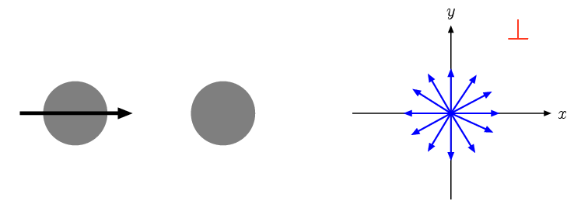
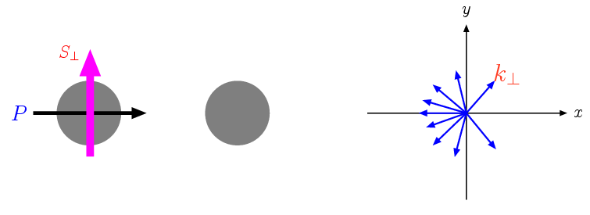
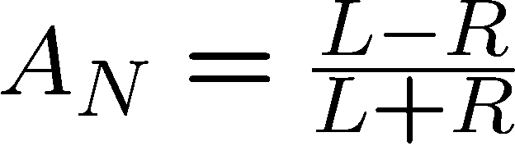
The appearance of transverse single-spin asymmetry
The transverse plane
Secondary particles have
azimuthal symmetry
Azimuthal asymmetry appears

Slide 7
Transverse Single Spin Asymmetries
where p is the 4-momentum of a particle (hadron, jet, photon, etc...)
Definition:
Experimentally, there are a variety of (~equivalent) ways this can be measured.
1. Yield difference between up/down proton in a single detector
This is susceptible to Rel. Luminosity differences
Left
Right
2. Or, take the left-right difference between 2 detectors
This is susceptible to detector Relative Acceptance differences
3. Or, take the cross geometric mean (square-root formula)
Mostly insensitive to Relative Luminosity and Detector Acceptance differences

Slide 8
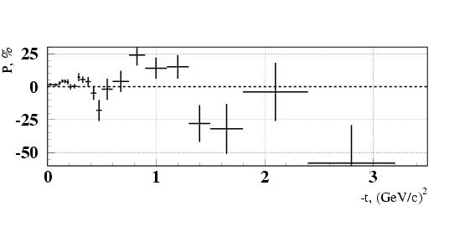
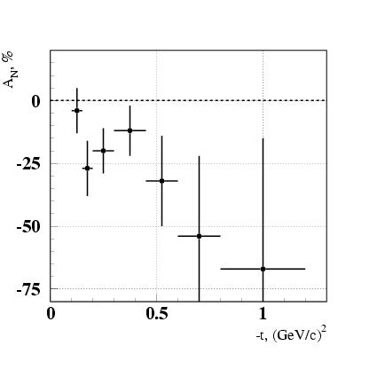
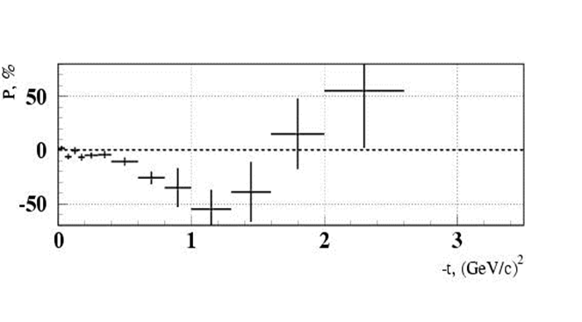
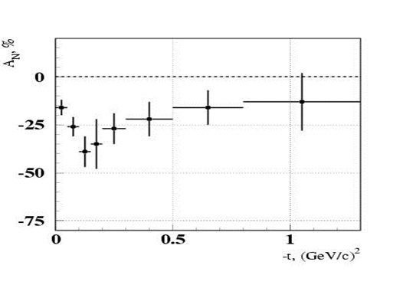
Old polarization experiment for exclusive reactions in Protvino
Polarization effects in exclusive charge-exchange reactions on a polarized target: 1) large values of the polarization and 2) their oscillations in exclusive recharges into neutral mesons π⁻ p↑ → π⁰, η, η’(958), ω(783), f₂(1270)
π⁻p↑→π⁰n
π⁻р↑→ ω(782)n
π⁻p↑→ηn
π⁻p↑→f₂(1270)n

Slide 9
New polarization experiment for exclusive reactions - SPASCHARM
Study with the use of the SPASCHARM setup will make it possible to significantly increase the precision of measurements in such exclusive reactions as π⁻p↑→ ω(782)n, π⁻p↑ →η/(958)n, π⁻p↑→ f₂(1270)n, π⁻p↑→ a₂(1320)n and others, when the resonances decay into charged and neutral particles. Previously, these reactions were investigated by us at the PROZA setup with their decays only into π⁰-mesons and γ-quanta, which significantly limited the collected statistics.
At the SPASCHARM setup, due to the availability to detect also charged particles, an increase in the statistics with respect to the previous PROZA experiment is expected to be approximately an order of magnitude in the reactions π⁻p↑→ ω(782)n and π⁻p↑ →η/(958)n, and also in 3-4 times in the reactions π⁻p↑→ f₂(1270)n and π⁻p↑→ a₂(1320)n.
It should be noted that for the first time an asymmetry will be measured in the reaction π⁻p↑→ a₀(980)n, when a₀(980) decays into η(550) and π⁰. It is expected to get a single-spin asymmetry value of more than 50% in this reaction according to the paper by N.N. Achasov.

Slide 10
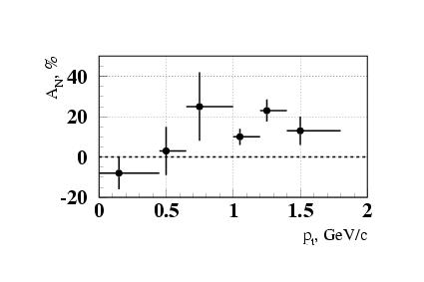
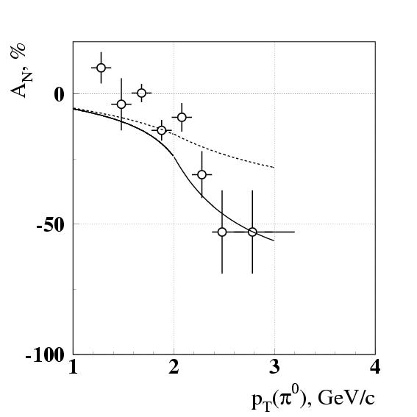
Old polarization experiments for inclusive reactions in Protvino
Beam fragmentation region
At small transverse momenta p_{T} transverse single-spin asymmetry A_{N} is zero. A noticeable asymmetry appears at p_{T} ~ 1 GeV/с and higher even in the unpolarized beam fragmentation region.
In reaction π⁻d↑→π⁰X at 40 GeV/c A_{N} = (16±5)% at p_{T} =(0.7-1.8) GeV/c and at x_{F}>0.7
Central region
Transverse single-spin symmetry is big in the reactions π⁻p(d)↑→π⁰(η)X in the central region (x_{F} =0) and does not depend on target material.

Slide 11
New polarization experiments for inclusive reactions in Protvino
Our previous experiments using π-meson beam revealed a significant non-zero transverse single-spin asymmetry, both in the central region and in the fragmentation region of the π-meson beam at moderate transverse momenta.
Significant spin effects can be expected near the boundary of the phase volume, since large effects are observed in the corresponding exclusive charge-exchange reactions.
Motivation: there is reason to believe that for a wide range of reactions available in the SPASCHARM setup for meson beams (phase 1), there will also be a significant transverse single-spin asymmetry of hadron production (A_{N})
11

Slide 12
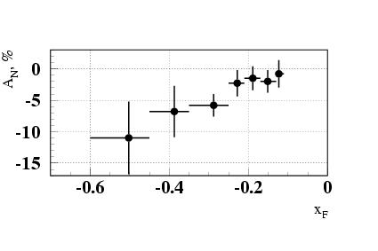
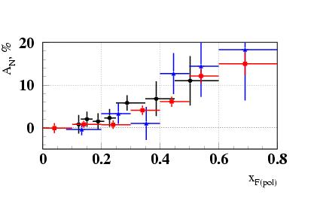
Old polarization experiment for inclusive reactions in the polarized target fragmentation region in Protvino
←A_{N} in inclusive production of π⁰ -meson at 50 GeV in the polarized particle fragmentation region at 0.25<x_{F}<0.6 is (6.2±1.5)% (black points below) → coincides with the results of other measurements:
A_{N} in the reaction π⁻p↑→π⁰X at 40 GeV (6.9±2.8)% (blue points below) and 2) with the Fermilab E704 results at 200 GeV (6.3±0.7)% (red points below)
All three results are shown below:
Conclusion: Transverse single-spin asymmetry A_{N} in inclusive production of π⁰ – meson in the fragmentation range of polarized proton behaves in a similar manner at beam energies of 40-200 GeV, and its behavior is practically independent of the type of the beam particle (40, 50, and 200 GeV)

Slide 13
SPIN is the gravedigger of theories
Experiments with spin have killed more theories than any other physical parameter.
(Elliot Leader, Cambridge Univ.)
Polarization data has often been the graveyard of fashionable theories. If theorists had their way they might well ban such measurements altogether out of self-protection.
(James Bjorken, Fermilab)
13

Slide 14
Model of chromagnetic polarization of quarks (CPQ)
(CPQ model by V.V. Abramov)
A phenomenological model of the chromomagnetic polarization of quarks was proposed to explain, in the framework of one mechanism, polarization phenomena for a large number of inclusive reactions. The model is based on the hypothesis of the formation of an effective transverse circular chromomagnetic field Bª in the hadron interaction region.
Fig. 1. Schematic representation of the interaction region of hadrons in the cms. An effective circular transverse chromomagnetic field, formed by relativistic spectator quarks, deflects quark probes with spin directed upwards or downwards in different directions. The interaction region can be regarded as a microscopic Stern-Gerlach device. This dependence of the force acting on the quark on the direction of its spin leads to polarization effects, such as the transverse single-spin asymmetry A_{N}.
Another important phenomenon within the framework of the CPQ model that affects the measured transverse single-spin asymmetry of A_{N} is the spin precession of the quark probe in the color field, which changes the direction of its spin, the magnitude of the Stern-Gerlach force, and, consequently, the final transverse single-spin asymmetry.

Slide 15
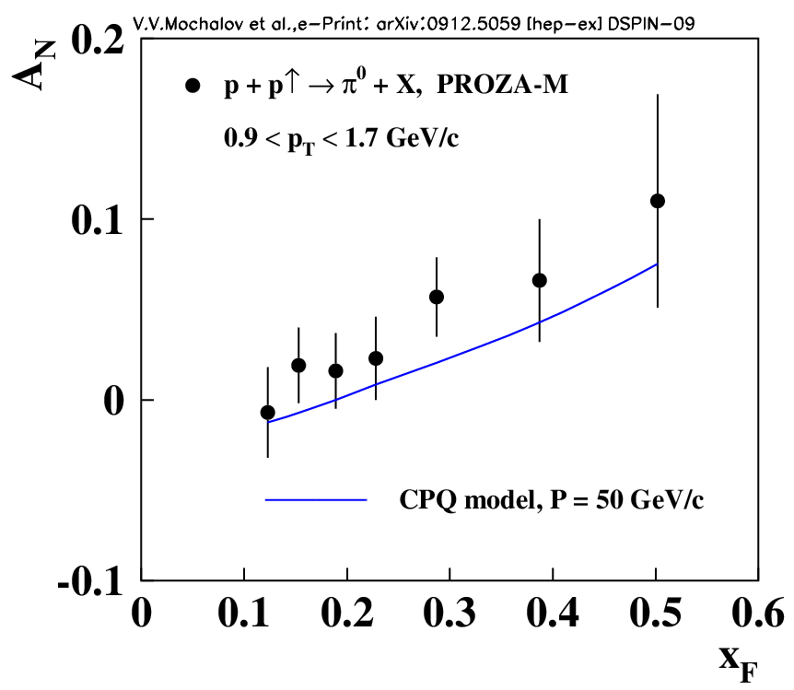
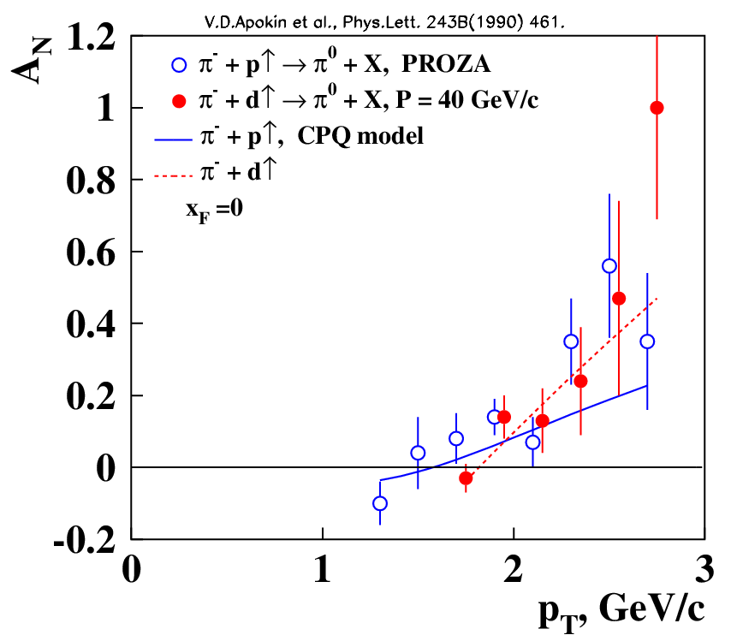
Examples of the results of the CPQ model calculations

Slide 16
Strategy of SPASCHARM experiment
2017 - 2021 phase 1 Existing beam line 14 at accelerator U70 and existing pilot version of the SPASCHARM set-up. Polarization study with pion (kaon, antiproton) beams on transversely polarized target. First data taking run will be in Spring 2018.
Since 2022 phase 2 New beam line 24A with polarized antiproton and proton beams will be built. The SPASCHARM set-up year by year will be enriched by new detectors.
We can start with single-spin asymmetry study in the polarized antiproton beam fragmentation region. First data taking run is anticipated in 2023.
We will move to the full SPASCHARM set-up, including longitudinally polarized target in the solenoid. Some year we’ll start to measure longitudinal double-spin asymmetry A_{LL} in a variety of reactions sensitive to gluon polarization through charmonia production.
16

Slide 17
Phase 1
The SPASCHARM experiment on the systematic study of polarization phenomena in exclusive and inclusive hadronic reactions in the energy range of the IHEP accelerator will be operated at the phase 1 (2017-2021 years). The main objective is a detailed study of various polarization effects in the processes of particle formation and resonances consisting of u, d and s-quarks.
The created setup will detect dozens of different resonances and stable particles, produced on the existing transversely polarized proton target.
Measurements are planned on different types of beams (pions, kaons, protons, antiprotons).
In parallel with transverse single-spin asymmetry A_{N} the polarization of hyperons and the elements of the spin matrix of the density of vector mesons will be measured.
17

Slide 18
Phase 1: Physics program at the existing beam line # 14
38 reactions π⁻p -> «particle» + Х at 34 GeV
№ | частица | N_{EV} | S/B | № | частица | N_{EV} | S/B
1 | π⁺ | 4.2·10⁹ |  | 20 | η→ π⁺ π⁻ π⁰ | 5.3·10⁶ | 5
2 | π– | 8.7·10⁹ |  | 21 | ω(782) → π⁺ π⁻ π⁰ | 3.5·10⁷ | 4
3 | K⁺ | 6.7·10⁸ |  | 22 | ω(782)→ γ π⁰ | 3.8·10⁷ | 0.5
4 | K– | 9.0·10⁸ |  | 23 | φ(1020)→ K⁺ K⁻ | 4.3·10⁶ | 3.3
5 | p | 9.2·10⁷ |  | 24 | ρ⁺(770)→ π⁺ π⁰ | 2.9·10⁸ | 0.17
6 | p̃ | 2.6·10⁸ |  | 25 | ρ–(770)→ π⁻ π⁰ | 7.5·10⁸ | 0.33
7 | n | 3.2·10⁸ |  | 26 | K⁰_{S}→ π⁰ π⁰ | 1.7·10⁷ | 0.29
8 | ñ | 8.0·10⁷ |  | 27 | a₀(980)→ η π⁰ | 1.8·10⁷ | 0.11
9 | K⁰_{L} | 1.0·10⁸ |  | 28 | Λ→ p π⁻ | 1.4·10⁶ | 10
10 | π⁰→γγ | 4.3·10⁹ | 10 | 29 | Λ̃→ p̃ π⁺ | 1.1·10⁶ | 20
11 | η →γγ | 4.2·10⁸ | 2 | 30 | Λ→ n π⁰ | 1.8·10⁶ | 0.33
12 | η'→ π⁺ π⁻ η | 8.3·10⁵ | 20 | 31 | Λ̃→ ñ π⁰ | 7.7·10⁵ | 2.2
13 | K⁰_{S}→ π⁺ π⁻ | 1.3·10⁷ | 3.3 | 32 | Δ⁺⁺→ p π⁺ | 9.3·10⁶ | 0.5
14 | ρ⁰(770)→ π⁺ π⁻ | 4.2·10⁸ | 0.4 | 33 | Δ⁻⁻→ p̃ π⁻ | 2.5·10⁷ | 0.18
15 | K^{0*}(892)→ K⁺ π⁻ | 1.1·10⁸ | 1.4 | 34 | Ξ⁻→ Λ π⁻ | 1.9·10⁶ | 10
16 | K̃^{0*}(892)→ K– π⁺ | 4.3·10⁷ | 0.5 | 35 | Ξ̃⁺→ Λ̃ π⁺ | 1.6·10⁶ | 10
17 | K^{+*}(892)→ K⁺ π⁰ | 1.9·10⁷ | 0.38 | 36 | Σ⁰→ Λ γ | 1.2·10⁶ | 2
18 | K̃–*(892)→ K– π⁰ | 3.8·10⁷ | 0.77 | 37 | Σ⁰(1385)→ Λ π⁰ | 3.9·10⁶ | 5
19 | ω(782)→ e⁺ e⁻ | 1.7·10⁵ | 2 | 38 | ρ⁰(770)→ μ⁺ μ⁻ | 9.7·10⁴ | 1.43
Anticipated number of events N_{EV} for a few tens of inclusive reactions and ratio Signal/Background S/B for π⁻- beam(6·10¹⁰ interactions – or about 50 days of data taking with an efficiency of 70%).
18

Slide 19
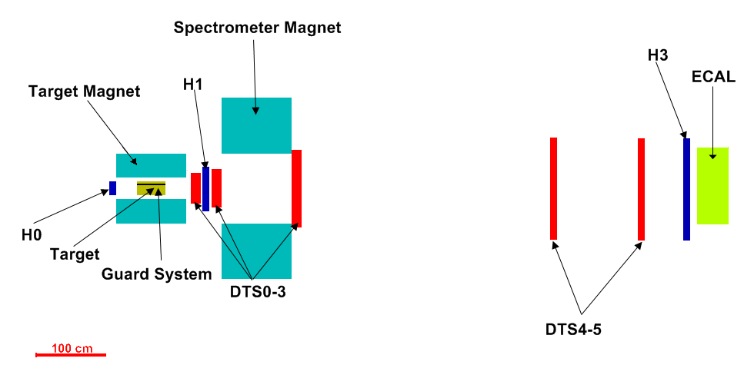
Phase 1 SPASCHARM pilot version in Spring 2018
19

Slide 20
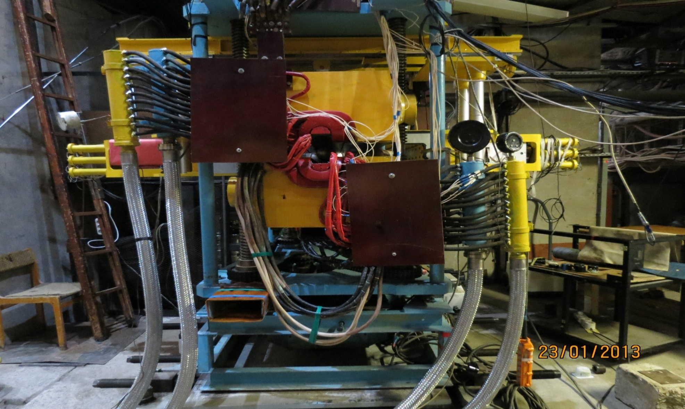
Phase 1 Magnet of the SPASCHARM polarized target
20

Slide 21
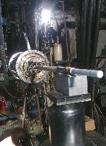
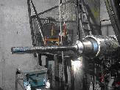
Phase 1 The cryostat of the polarized target
.
The working temperature of the target is 30-40 mK. Dipole magnet is used for a transversely polarized frozen target, which has a solid angle of ± 250 mrad in the vertical direction.
The main parameters of the polarized target: chemical composition - pentanol C₅H₁₂O with TEMPO radical.
The working volume of the target: length: 200 mm, diameter: 20 mm. Polarization value up to 75%.
Dilution factor (ratio of the number of all nucleons to the number of polarized protons) 7.3. The amount of matter in the target corresponds to ~ 10% of the interaction length for π-mesons with an energy of 28 GeV.
A veto system is located around the target to highlight exclusive reactions (see next slide).
21

Slide 22
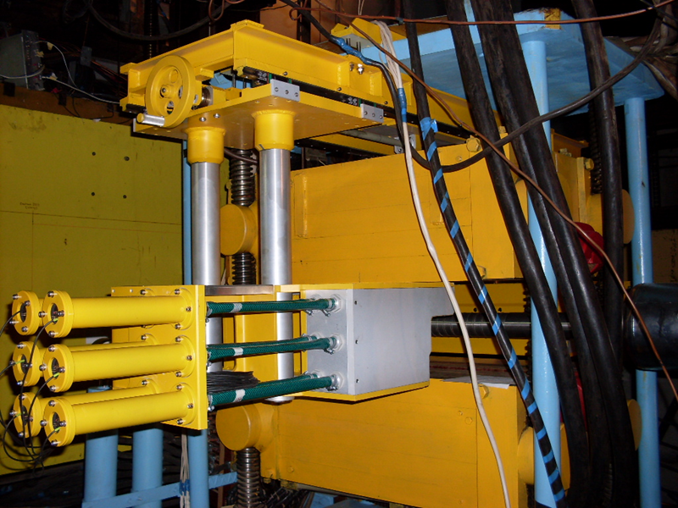
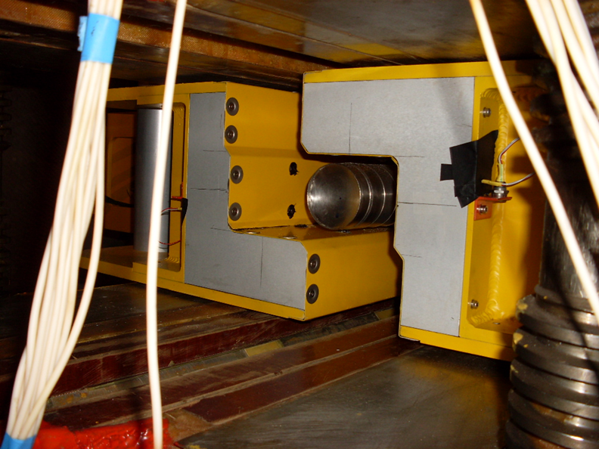
Phase 1 The veto system around the polarized target
22

Slide 23
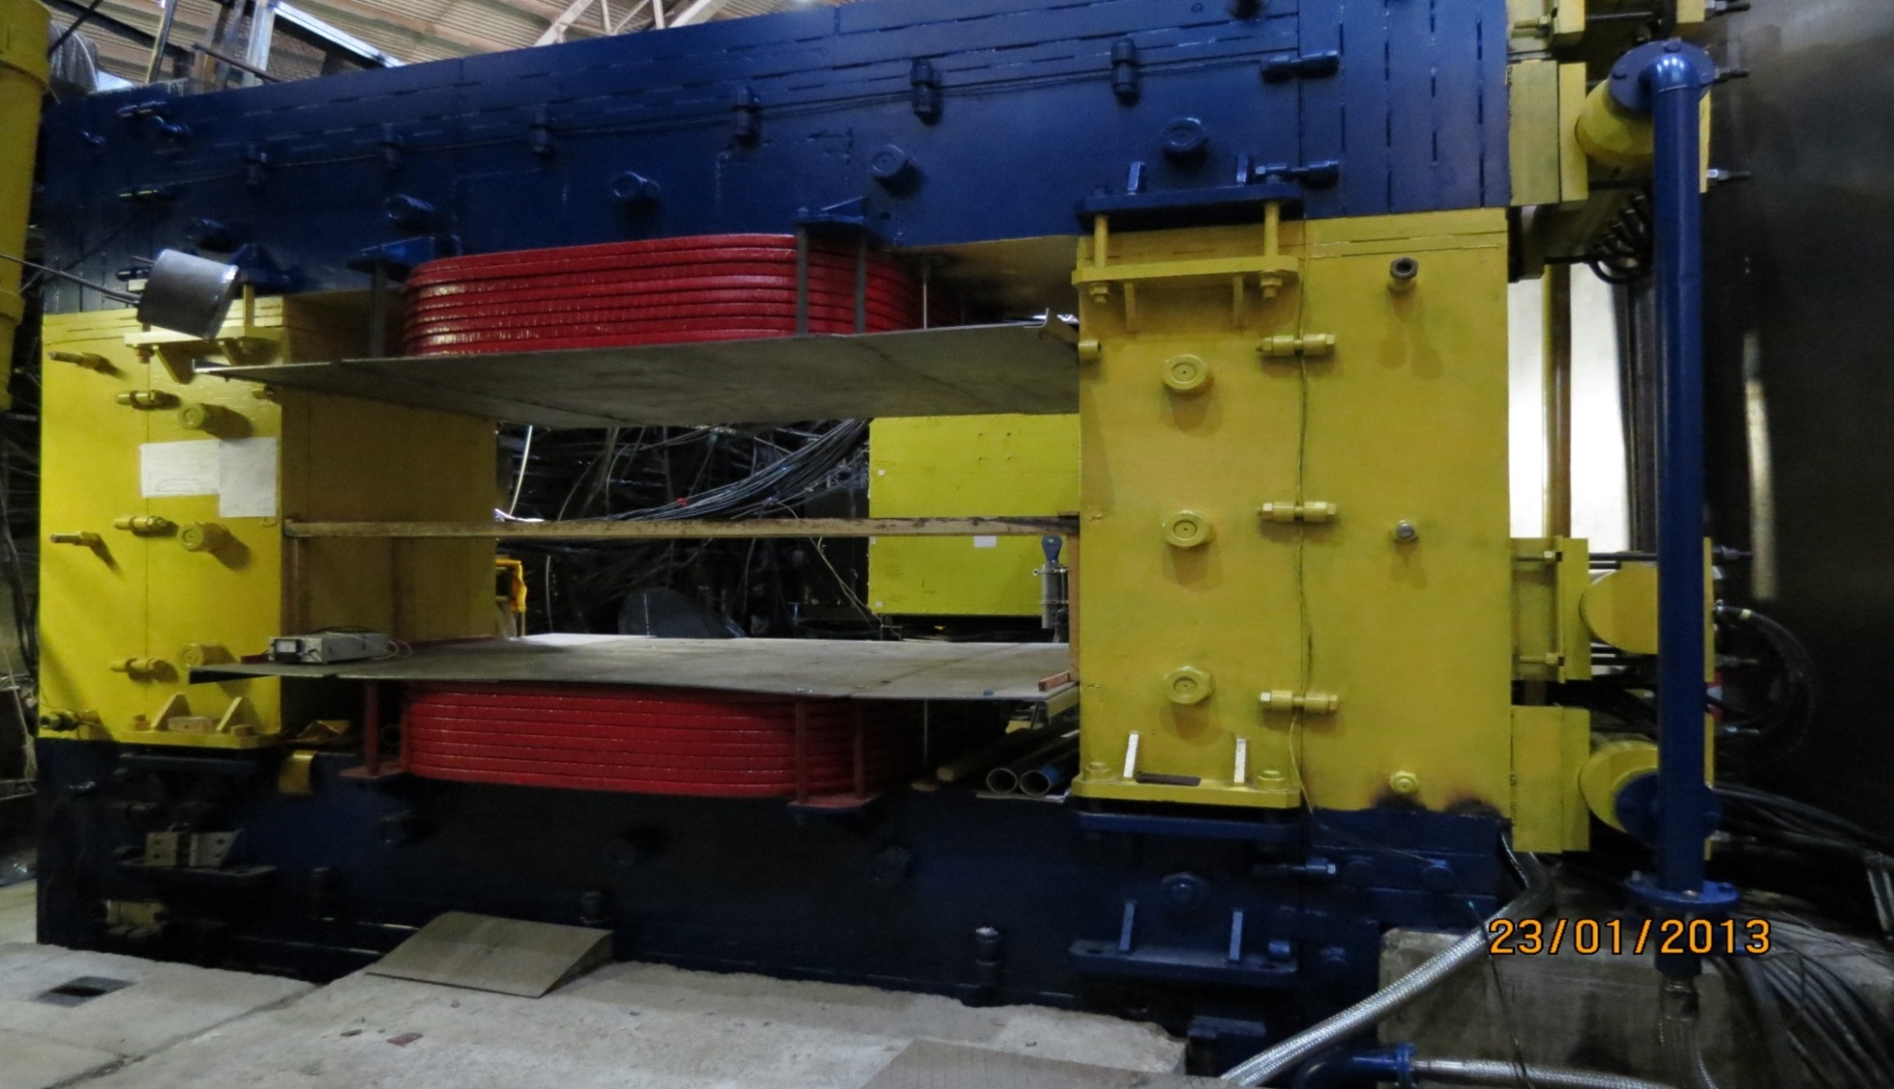
Phase 1 Spectrometer magnet
23

Slide 24
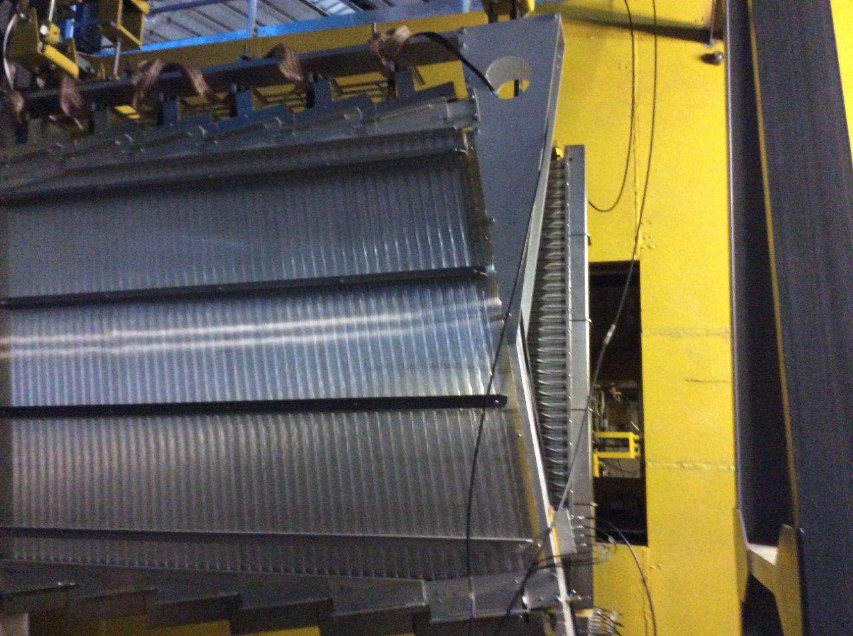
Phase 1 Drift tube station # 3 (just after the magnet)
24

Slide 25
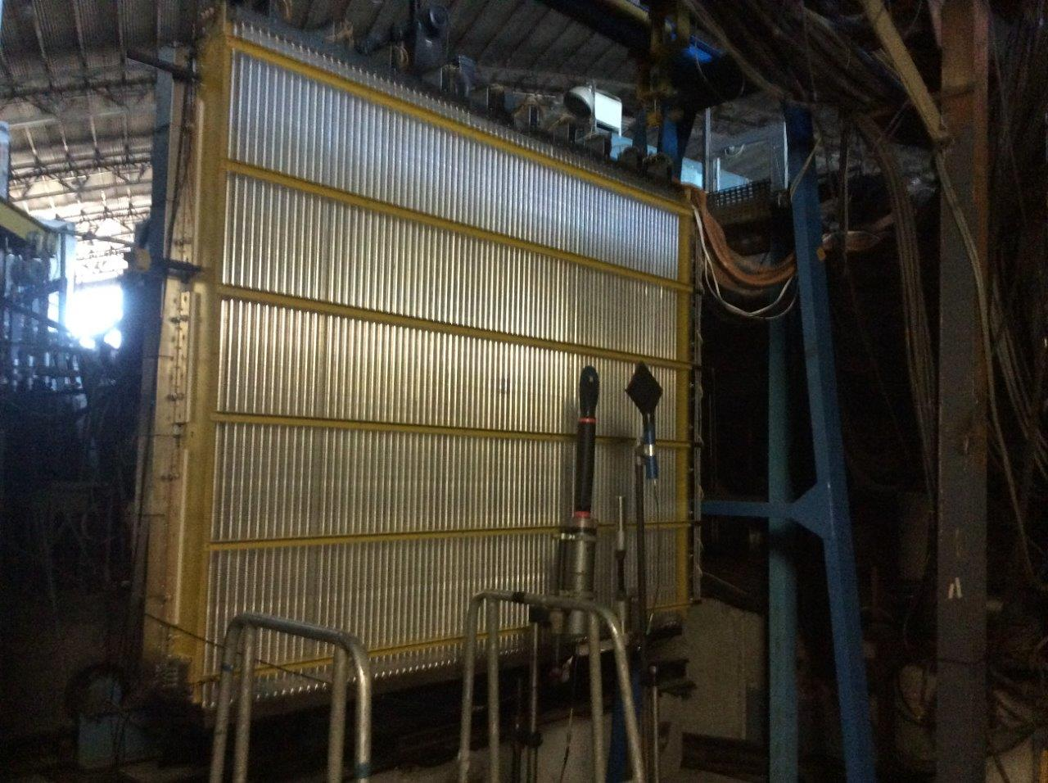
Phase 1 Drift tube station # 4
25

Slide 26
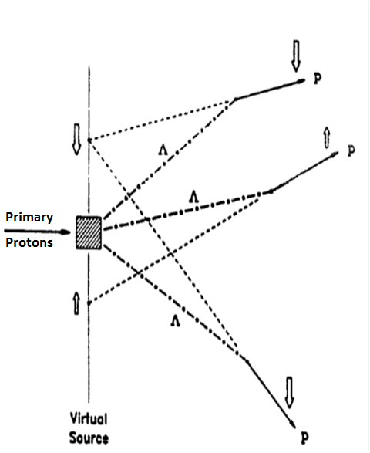
Phase 2 Proton polarization in Λ-decays
The method exploits the parity-violating decays of is schematically illustrated in Fig. In the Λ-hyperon rest frame, the protons from the pariry-violating decay Λ→pπ⁻ are longitudinally polarized with the helicity equal to α=0.642. After the Lorenz boost into the laboratory frame, they obtain a transverse polarization which grows up as the decay angle increases. In other terms, the transverse polarization correlates with the position of crossing points of proton trajectories back to the virtual source plane at the center of the primary target.
The transverse polarization, averaged over all decay protons, is zero. But it is possible to select samples of nonzero transverse polarization by sorting out the decay proton’s trajectories by their decay angles or, which is almost the same, by the trajectorie’s crossing position back to the virtual source plane.
26

Slide 27
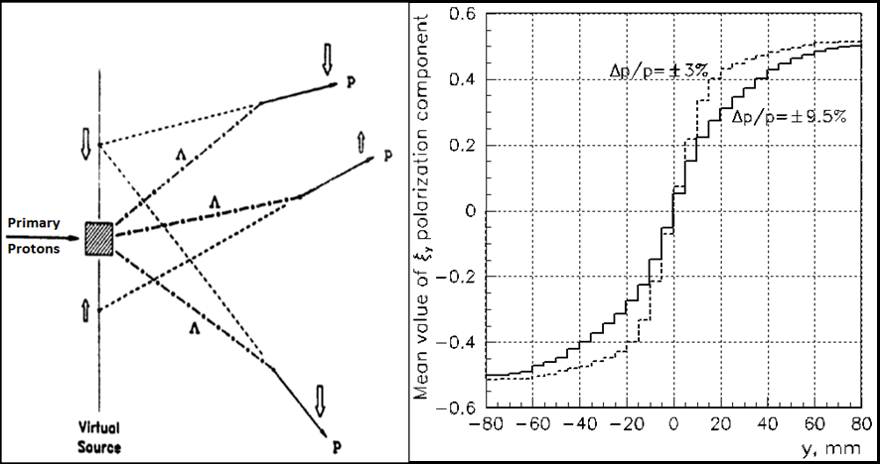
Phase 2 Correlation of beam polarization and position
Proton polarization in Λ-decays (left frame) and the correlations of the proton vertical polarization component y to the vertical position of proton trajectory at the intermediate focus (right frame).
27

Slide 28
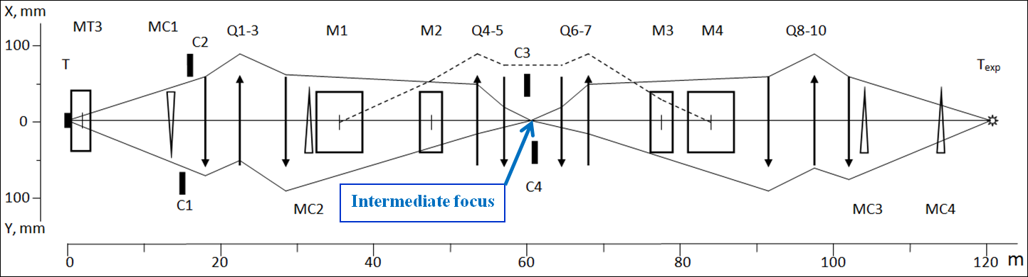
Phase 2 Polarized beam line 24A
The full length of the beam line is ~ 160 m. The main part is:
Polarization tagging station is in the intermediate focus.
“Snake magnets” before the target of the experiment.
Extracted 60 GeV primary beam will have the intensity up to 10¹³ protons per 9 second cycle of the U70 accelerator (beam plateau is up to 3 sec.)
28

Slide 29
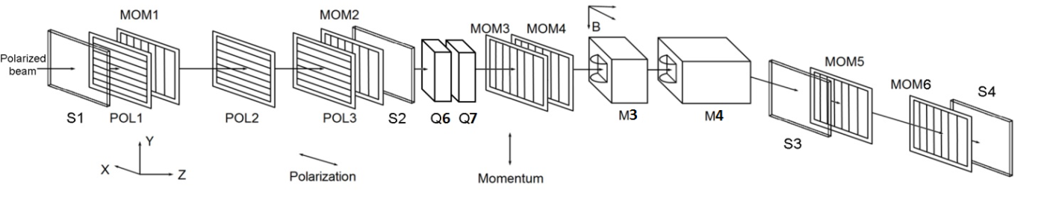
Phase 2 Tagging station
Schematic view of the tagging station for the beam facility 24A
The particle momentum is measured in the horizontal plane by means of the “momentum hodoscopes” MOM1-MOM6 and the magnets M3 + M4. The particle polarization is determined by measuring its momentum and vertical y-coordinate by “polarization hodoscopes” POL1-POL3. S1-S4 – scintillation counters of full flow. The intermediate vertical focus for the central momentum is in the plane of the hodoscope POL2..
29

Slide 30
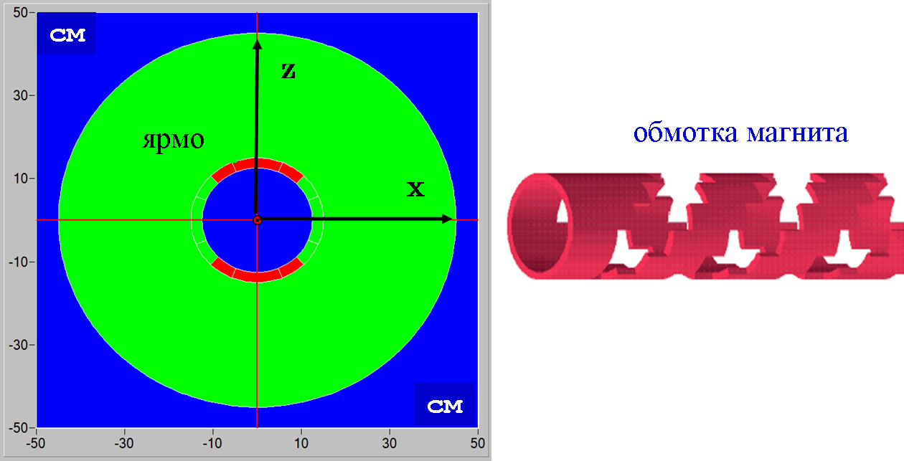
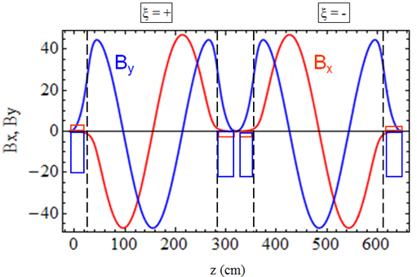
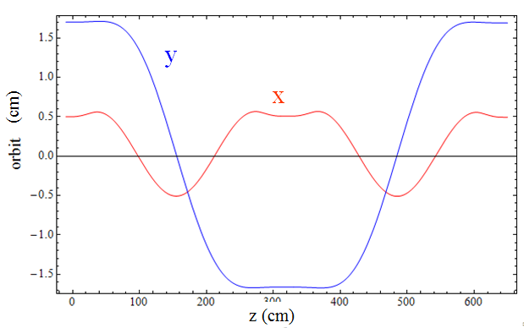
Phase 2 Snake magnets
← Design of a yoke and a coil of one helical magnet
The magnetic field of two helical magnets and the trajectory of particles inside the snake (unit matrix).
30

Slide 31
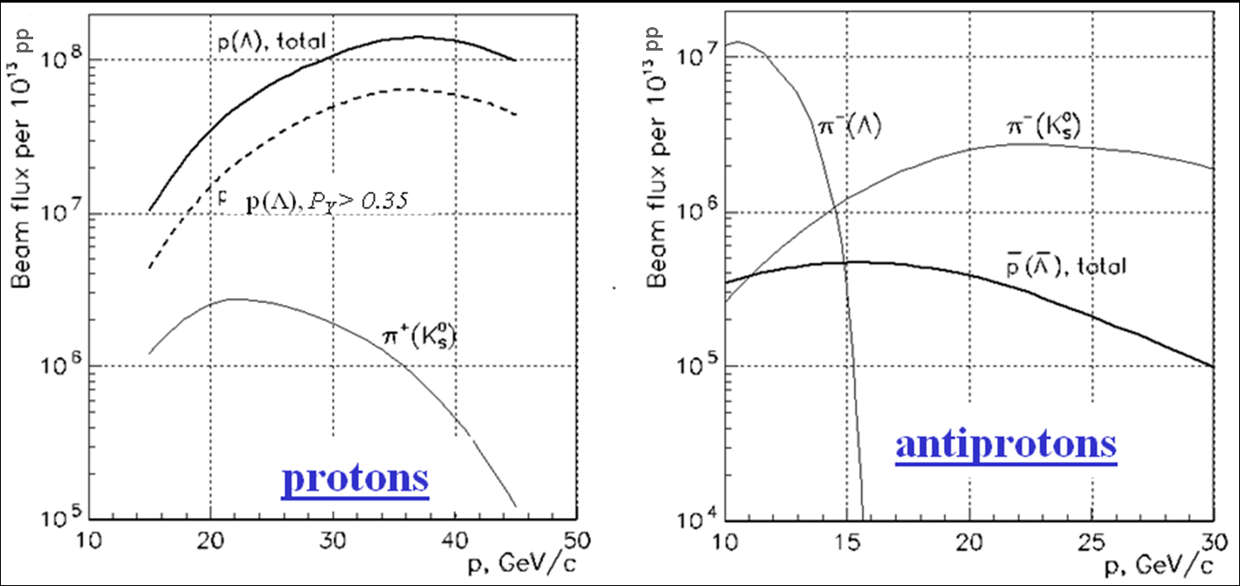
Phase 2 Polarized beam parameters
The intensity of polarized proton (left frame) and antiproton (right frame) beams, with the maximum Δp/p, per 10¹³ of 60 GeV primary protons (pp), along with the estimated π-meson backgrounds from K_{S}⁰ → π⁺ π⁻ decays. In the left frame, the dashed line shows the intensity of proton samples with the polarization value cut P_{Y} > 35%.
31

Slide 32
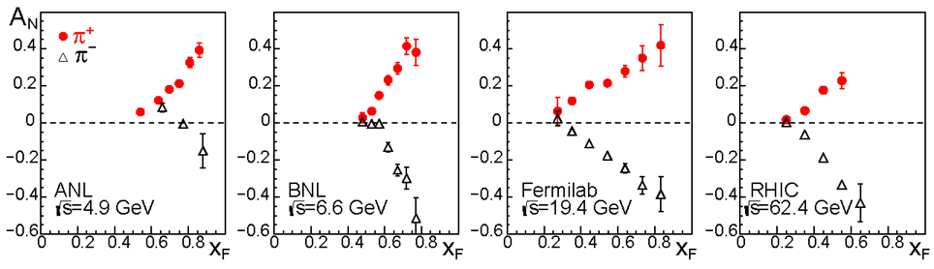
Phase 2 (PHYSICS since the year of 2022)
We’ll start with measuring transverse single-spin asymmetries in tens of reactions in the polarized antiproton (proton) beam fragmentation region.
Fig. A_{N} for reactions p↑p→π± +X at different energies.
Experimental studies at various accelerators have shown that the single-spin asymmetry in inclusive pion production in the fragmentation region of a polarized proton, and the polarization of Λ-hyperons do not decrease with energy growth in a wide energy range in the laboratory system from ~ 10 GeV to 20 TeV. This observation might spread to a big number of other processes. Conclusion: not only energy is important in polarization studies - the statistical and systematic accuracy of the results is critically important.
32

Slide 33
Phase 2 A-dependence of A_{N} for many reactions with polarized antiproton and proton beams
PHENIX at RHIC: The existing theoretical framework that was successful in describing the single-spin asymmetry in p↑+p collisions predicts only a moderate atomic-mass-number (A) dependence. In contrast, the asymmetries observed at RHIC in p↑+A collisions showed a surprisingly strong A dependence in inclusive forward neutron production. The observed asymmetry in p↑+p collisions is -8%, in p↑+Al collisions is -1.5%, while the asymmetry in p↑+Au collisions is +18%.
We might start with the measurements of forward transverse single-spin asymmetry A_{N} with the use of the polarized antiproton and proton beams on a hydrogen target and then on a Pb-target. If we get “surprisingly strong A-dependence” of A_{N} (change of sign) for some stable particles or resonances, we can measure A-dependence for them more precisely with miscellaneous nuclear targets between hydrogen and lead.
33

Slide 34
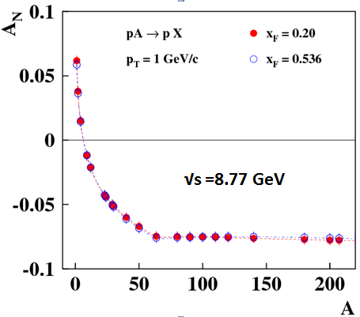
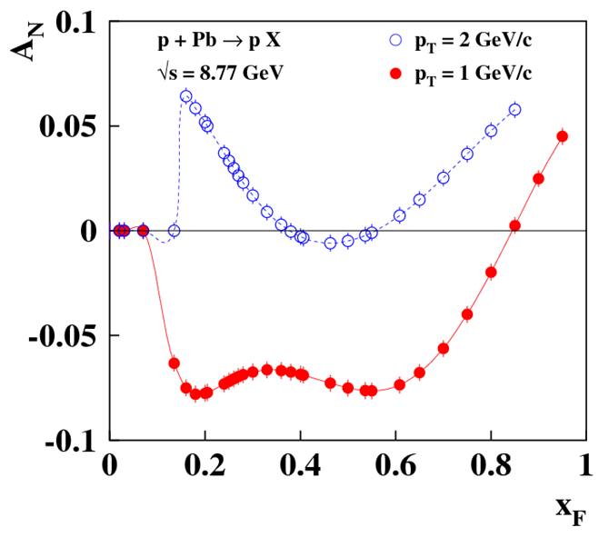
Phase 2 A-dependence of A_{N} in CPQ model by V.V. Abramov
Predictions of A_{N} in the frame of the Chromomagnetic Polarization of Quarks model
34

Slide 35
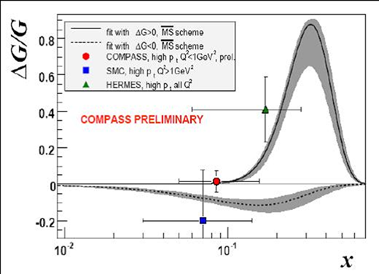
Phase 2 – Gluon polarization
In the COMPASS experiment at CERN, as a result of the DIS global fit of the existing data, an indication was obtained that the contribution of gluons to the proton spin (gluon polarization) is significant at x_{B} near 0.3. This is the most effective region in SPASCHARM from “the geometry and the detection point of view” !!
By measuring longitudinal double-spin asymmetry A_{LL} in the process
p_{↑ +} p_{↑ → χ2} (3555) + X,
where
_{χ2} (3555) → J/ᴪ (3100) + γ,
one can extract ΔG/G for gluons The beam and the target are longitudinally polarized
(see details in SPASCHARM CDR).
35

Slide 36
Phase 2 – What else can be studied with polarized antiprotons ?
The presence of polarized both protons and antiprotons in the CP neutral -system potentially opens up opportunities for studying and comparing CP conjugate reactions with one another. This allows us to look at CP invariance in a new perspective, inaccessible to collisions of unpolarized particles. Carrying out such measurements in the future will most likely require some modification of the experimental setup, in particular, the extension of its acceptance to the rear hemisphere in the collision center-of-mass system.
In any process at high energy involving the annihilation of spin - ½ particles into vector intermediate states, a reaction with initial particles having like helicities is almost completely suppressed relative to the rate for the same reaction in a state of opposite helicities.
Can polarized antiprotons help in Partial Wave Analysis ?
Can polarized antiprotons help in measuring the amplitudes and relative phase of the electrical and magnetic proton form factors in the time-like region ??
36

Slide 37
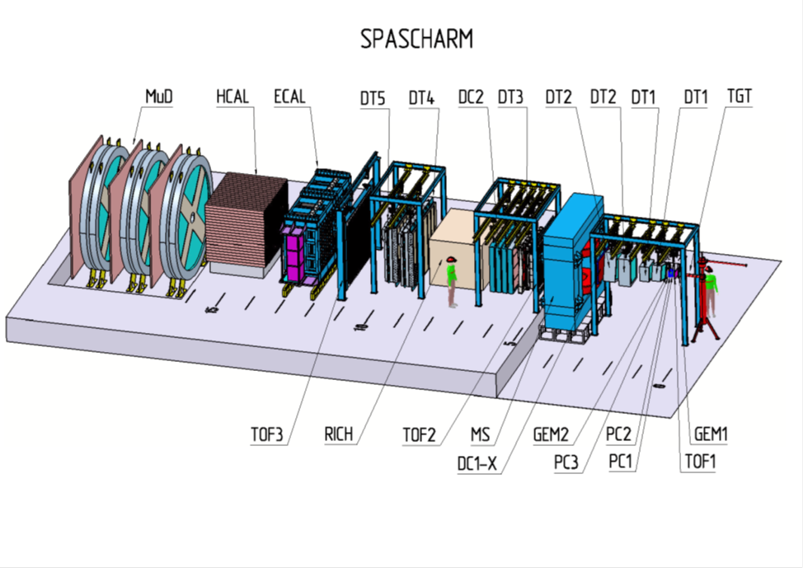
Phase 2 SPASCHARM setup at new polarized beam line
The setup which is being built will simultaneously detect tens of miscellaneous resonances and stable particles produced in spin-nuclear(un polarized) or spin-spin interactions.
The measurements are being planned at different beams
(polarized anti-p ↑ and p↑ -beams, and also π±, K±).

Slide 38
Phase 2 Peculiar properties of the setup in the “spin world”
Unlike most polarization fixed-target experiments, in the SPASCHARM wide-aperture precision spectrometer, the full azimuthal angle geometry will be realized, which is extremely important in spin physics and will allow us to investigate many new processes with extremely low errors (systematic errors will be negligible).
The combination of a wide range of beams and targets with the possibility of simultaneous detection of charged and neutral particles in the final state, distinguishes this project from other polarization projects built for a limited number of reactions under study. Measurement of spin effects in a large kinematic range and comparison of spin effects in various reactions, including resonances and stable particle production in the antimatter-matter and matter-matter interactions, is of fundamental importance for revealing the mechanism of particle interaction.
38

Slide 39
Phase 2 Dependence of spin effects on multiplicity
A new phenomenon observed a few years ago at the RHIC collider (the BRAHMS experiment) is the dependence of the inclusive pion single-spin asymmetry on the multiplicity of charged hadrons in the event.
We plan to continue these investigations for all the studied inclusive reactions in order to try to find may be some universal regularities. For these measurements, hodoscopes of multiplicity are being designed and then created.
39

Slide 40
SPASCHARM Collaboration
V.V. Abramov, I.L. Azhgirei, N.I. Belikov, A.A. Borisov, S.I. Bukreeva, A.N. Vasiliev, V.I. Garkusha, Yu.M. Goncharenko, A.M. Davidenko, A.A. Derevschikov, V.N. Zapolskii, V.G. Zarucheiskii, V.A. Kachanov, A.S. Kozhin, V.A. Kormilitsin, A.K. Likhoded, V.A. Maisheev, Yu.M. Melnik, A.P. Meschanin, N.G. Minaev,V.V. Moiseev, V.V. Mochalov, D.A. Morozov, L.V. Nogach, S.B. Nurushev, V.S. Petrov, I.S. Plotnikov, V.V.Poslavskii, A.F. Prudkoglyad, S.V. Ryzhikov, A.V. Ryazantsev, P.A. Semenov, V.A. Senko, M.M. Soldatov, L.F. Soloviev, A.V. Uzunian, R.M. Fakhrutdinov, N.A. Shalanda, V.I. Yakimchuk, A.E. Yakutin
(National Research Centre Kurchatov Institute – IHEP, Protvino)
N.A. Bazhanov, N.S. Borisov, I.S. Gorodnov, A.B. Lazarev, A.B. Neganov, Yu.A. Plis, O.N. Schevelev, Yu.A. Usov
(Joint Institute of Nuclear Research – JINR, Dubna)
E.A. Atkin, A.A. Bogdanov, A.V. Klepikov, M.V. Nurusheva, V.A. Okorokov, M.F. Runtzo, V.L. Rykov, V.M. Samsonov, M.N. Strikhanov
(National Research Nuclear University – MEPhI, Moscow)
In process of joining : National Research Centre Kurchatov Institute – ITEP, Moscow
and National Research Centre Kurchatov Institute – PNPI, Gatchina
40

Slide 41
Main Advantages of the SPASCHARM experiment
1) Broad physical programme and systematic study of polarization phenomena (like the Periodic Table of elements).
2) Variety of beams: polarized p, p᷉, unpolarized π±, K±, p, p᷉, d, C.
3) Study of Tens of miscellaneous reactions simultaneously.
4) Polarized (transverse and longitudinal) and nuclear targets.
5) Several spin observables: A_{N}, P_{N}, A_{NN}, A_{LL}, D_{NN}, ρ_{ik}, …
6) Many variables to study polarization phenomena: √s, P_{T}, X_{F}, Atomic weight, Multiplicity, reaction type.
7) Full azimuthal coverage to minimize systematic uncertainties.
8) Detection and identification of secondary particles, neutral and charged, including γ, π⁰, π±, K±, p, p᷉, d, and resonances.
9) Spin rotator to have both the transverse and longitudinal beam polarizations.
10) Fast data acquisition system to collect large statistics of data.
41

Slide 42
Conclusion
The design and optimization of parameters of the 24A beam facility for U-70 accelerator of IHEP, Protvino, is currently at its final stage. The new polarized proton and antiproton beam line 24A will provide an opportunity for unique systematic studies of spin phenomena for a wide range of inclusive and exclusive reactions in collisions of high-energy polarized hadrons in the QCD non-perturbative region with the multipurpose large acceptance SPASCHARM spectrometer.
The polarized beams is being participated to start its operation since the year of 2022 (Phase 2).
Before it, in the nearest years (2018-2021) the SPASCHARM Collaboration will carry out polarization program with the existing pion beam at 28 (34) GeV and existing transversely polarized proton target (Phase 1) and continue to build the full SPASCHARM setup.
42

