Slide 1
Direct reconstruction of the
pp- elastic scattering amplitudes at U70
M.B. Nurusheva¹, A.A. Bogdanov¹, V.A.Chetvertkova⁴, A.V. Kozelov²,
V.P. Ladygin³, V.V.Mochalov^{1,2},
V.A. Okorokov¹, A.N.Vasiliev^{1,2},
¹National Research Nuclear University (Moscow Engineering Physics Institute), Moscow, 115409, Russia
²NRC «Kurchatov Institute» - IHEP, Protvino, Moscow region, 142281, Russia
³ Joint Institute for Nuclear Research, Dubna, Moscow region, 141980,Russia
⁴GSI, Plankstrasse 1, 64291, Darmstadt, Germany

Slide 2
Introdaction
Newly developing SPASCHARM (SPin Asymmetry in CHARMonia) experiment at U-70 accelerator will give the unique possibility to measure spin effects with the use of polarized proton and antiproton beams and polarized targets. The SPASCHARM experiment also requires polarimetry [1] to verify beam polarization, which will help to study spin effects in elastic processes, since the detectors are the same in both cases.
Here we suggest to carry out the direct reconstruction of pp elastic scattering amplitudes (DRSA)
[1] A A Bogdanov et al 2016 J. Phys.: Conf. Ser. 678 012034

Slide 3
Motivation
The scattering matrix concept presented by theorists is convenient for describing the interaction in all its aspects, but, unfortunately, is not available for direct measurement. Therefore, it is necessary to determine a set of observables that allows the direct reconstruction of the scattering matrix.
DRSA is a fully model-independent analysis using only fundamental conservation lows.

Slide 4
The status of the DRSA is as follows:
The first DRSA analysis was carried out using the 0.429 GeV at the Chicago University (1968) [2]
Then before 1975, the direct reconstruction was only possible for pp elastic scattering at 90^{о} (CM) at a few energies [3].
The first direct reconstruction over a large angular region was carried out using the 0.59 GeV PSI data and was reported in ( 1981) [4]. The PSI data below 0.59GeV (1990) [5]

Slide 5
Similar reconstructions have been subsequently performed using LAMPF data at 0.73 GeV (1989) [6], and LAMPF data at 0.80 GeV (1985) [7].
The SATURNE II data have also allowed a DRSA analysis at 11 energies between 0.83 and 2.70GeV (1990) [8].
Finally, at higher energy, an amplitude analysis was performed using the 6 GeV/c ANL-ZGS data (1985-1986) [9,10].
[2] P. Lemon, et al., Phys. Rev. 169 (1968) 1026.
[3] C. Lechanoine-Leluc and F. Lehar, Rev. Mod. Phys. 65,47 (1993)
[4]. E. Aprile,, et al., Phys. Rev. Lett. 46, 1047 (1981) [5]. M.W. McNaughtonet al., Phys. Rev. C 41, 2809 (1990)
[6]. R Hausammann, et al., Phys. Rev. D 40, 22 (1989) [7]. F. Arash, F., et al., Phys. Rev. D 32, 74 (1985)
[8] C.D. Lac, J. Ball, J. Bystricky, et al. Journal de Physique, 1990, 51 (23), pp.2689-2716I
[9]. M. Matsuda, H. Suemitsu, M. Yonezawa, Phys. Rev. D 33, 2563 (1986)
[10].P. Auer, J. Chalmers, E. Colton, R Giese, H. Halpern, et al., Phys. Rev. 032 1609 (1985)

Slide 6
We suggest to carry out the measurements of the pp and p(bar)p elastic scattering spin observables at 16 GeV/с (direct reconstruction of elastic pp and p(bar)p elastic scattering amplitudes at SPASCHARM experiment). To date the direct reconstruction of amplitudes for pp elastic scattering has performed up to 6 GeV/c [1,2] only, while there is no available data for p(bar)p elastics scattering.
New measurements at SPASCHARM will significantly extend the energy range of the spin studies and will give unique possibility to compare elastic pp and p(bar)p scattering.
To date the direct reconstruction of amplitudes for pp elastic scattering has performed up to 6 GeV/c [1,2] only, while there is no available data for p(bar)p elastics scattering.
Thus, up to now, direct reconstration of amplitudes for pp-elastic scattering has been performed only less then 6 GeV/c, while there is no data available for p (bar) p-elastic scattering..

Slide 7
Notation
To discuss the completed experiment, we need to introduce some notation.
We denote a general scattering observable by Xsrbt
where the indices denote the spin direction of the particles:
s = scattered, r = recoil
b = beam, t = target,
Xsrbt = σXsrbt
J. Bystricky, F. Lehar, P. Winternitz. Journal de Physique,
1978, 39 (1), pp.1-32.

Slide 8
Assuming parity conservation, time reversal and isospin invariance, the scattering matrix is written in terms of complex amplitudes а, b, с, d and е

Slide 9
Formalism and observables.
The initial conditions are the following. There is a possibility to have polarized proton beam oriented in all 3 directions and vertically and longitudinally
polarized targets.
Therefore, the SPASCHARM configuration allow us to measure the following non-vanishing observables:
Aoono - beam analyzing power,
Aooon - target analyzing power,
Aoonn, Aooll, Aooml - spin correlations.

Slide 10
Next step is to measure the polaization of the recoil particle due to possibility to provide suitable figure of merit for the large aperture of the polarimeter:
Ponoo = Aoono = Aooon - the polarization of the recoil proton Ponoo is the same as analyzing power.
Konno, Kommo, Komlo - 3 polarization transfer coefficients from the beam to the recoil particle in c.m.s
Donon, Domol - 2 depolarization coefficients for the target in c.m.s
Nonll, Nonml, Nomnl, Nomln, Nommn - 5 polarizations of the recoil particle with polarized beam and target in c.m.s
Therefore, 15 deferent observables in total can be measured at U70.

Slide 11
We express the measured observables in terms of scattering amplitudes as follows:
Measuring the cross section of Aoonn, Konno and Donon, allows us to reconstruct the following amplitudes or their combinations :

Slide 12

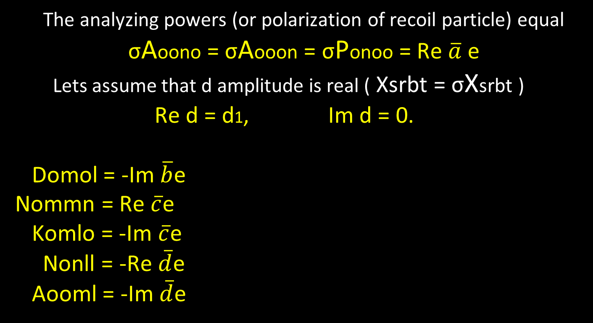
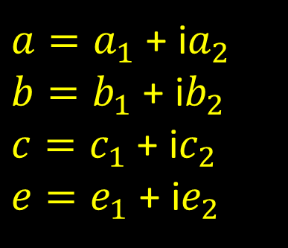
The analyzing powers (or polarization of recoil particle) equal σAoono = σAooon = σPonoo = Re $\overline{a}$ e
Lets assume that d amplitude is real ( Xsrbt = σXsrbt )
Re d = d1, Im d = 0.
Domol = -Im $\overline{b}$e
Nommn = Re $\overline{c}$e
Komlo = -Im $\overline{c}$e
Nonll = -Re $\overline{d}$e
Aooml = -Im $\overline{d}$e
Kommo = Re( $\overline{a}$c + $\overline{b}$d )
Nomln = Im( $\overline{a}$c - $\overline{b}$d )
Nomnl = Im( $\overline{a}$b - $\overline{c}$d )
Nonml = Im($\overline{ a}$d + $\overline{b}$c )
Aooll = -Re($\overline{ a}$d - $\overline{b}$c )
$a=a_{1}$ + i$a_{2}$
$b=b_{1}$ + i$b_{2}$
$c=c_{1}$ + i$c_{2}$
$e=e_{1}$ + i$e_{2}$
We choose the amplitude d to be real and positive and introduce the
notations for the real and imaginary parts of each amplitudes

Slide 13




Relation between observables and the real and imaginary parts of each anplitudes
(1)
(2)
(3)
(4)

Slide 14
(5)
(6)
(7)
(8)
(9)
(10)
(11)
(12)
(13)
(14)
We express c and e from the equations (7), (8), (9), (10) :

Slide 15




Manipulating these expressions we obtain c(d1) and e(d1) :

Slide 16




Manipulating the expressions (5), (6), (11), (12)
we obtain a and b as

Slide 17


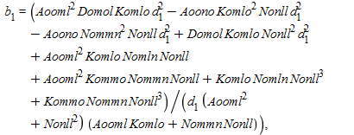
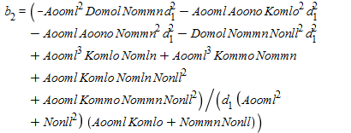
From equations for c(d1) and e(d1) we obtain a(d1) and b(d1):

Slide 18
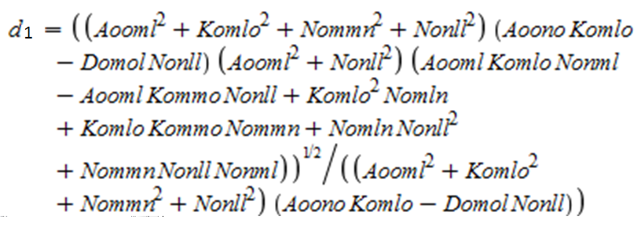
To express d1 we substitute the found a, b, c, vs d1 into the equation
Too complicated !!!

Slide 19
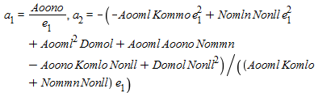
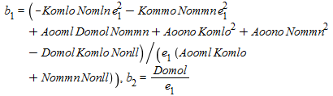


When we choose the amplitude e to be real and positive, we get the following equation for amplitudes:

Slide 20
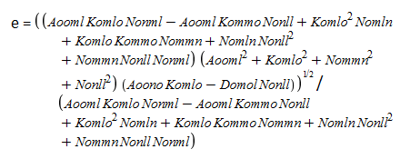
Equation for e and minimal set of observables
Aoono, Aooml, Komlo, Kommo, Domol,
Nomln, Nonml, Nommn, Nonll = 9 spin observables + cross-section

Slide 21
SPASCHARM set up possibility
The use of elastic processes to determine the absolute value of polarization makes it possible to measure the polarization of protons and (anti) protons for any particle energy. But the high pion background to antiprotons from Λ(bar) → p(bar)π⁻ decays might make it not feasible operating antiproton beam at momenta below 16 GeV/c.

Slide 22
The intensity of polarized proton (left frame) and antiproton (right frame) beams with the maximum ∆p/p per 10¹³ of 60 GeV primary protons
V.V. Abramov et al Nuclear Inst. and Methods in Physics Research, A 901 (2018) 62–68

Slide 23
The criteria to select elastic processes
After the Lorentz boost into the laboratory frame transversely polarized portions of the total beam are selected, using the particle’s trajectory tagging or collimation.
Tagging system allows for each particle to measure position in both directions (X and Y) in intermediate focus and momentum with an accuracy better than 1%
So we can select the events as elastic on the dual criteria of coplanarity and agreement to the scattering angles with kinematics .

Slide 24
The criteria to select elastic processes
To estimate the S / (S + B) ratio, 10⁶ events were simulated using the PYTHIA 6.3 generator. The signal is elastic pp scattering. Background - diffraction processes as A + B → X + B, A + B → A + X in which only two charged particles enter the detector. The geometry and resolution of the detector were taken into account In the simulation. Separation was carried out using the two-dimensional distribution tg1 * tg2 of the difference in angles (phi1-phi2).

Slide 25
The momentum of the incident protons from 16 GeV/c
Fig.4. Momentum distribution of incident protons.
The momentum distribution of incident protons of the order of 2% was also taken into account.

Slide 26
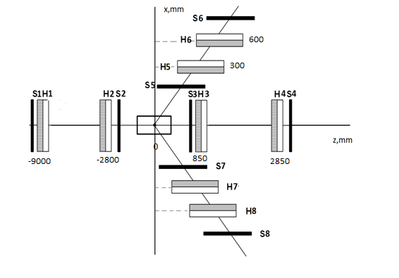
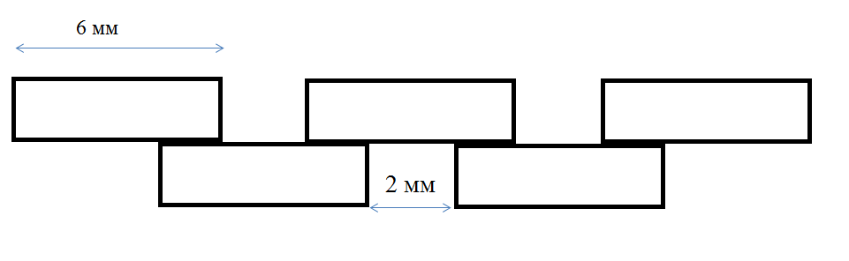
Estimating the size of the detector
Fig. 6. The overlapping scintillator design of the hodoscope .
The hodoscopes are made of scintillators that are located “comb”, and although the width of each scintillator is 6 mm, this arrangement allows us to know the coordinate of the particle’s impact with an accuracy of 2 mm
Fig.5 . Scheme of the detector for measuring the elastic processes
The detector was chosen based on the characteristics of the one presented at [11] that was modeled for registering the elastic processes in scattering of 45 GeV/c protons
[11] V V Abramov et al 2017 J. Phys.: Conf. Ser. 938 012006

Slide 27
Knowing from the simulation of the projection of the particle momentum, it is possible to obtain the exact coordinate of the particle entering the recoil and scattering detector, and accordingly the azimuthal and polar angles of the recoil and scattering particles (φ, θ).
Distribution of scattered protons in the XY plane where the scattered proton hodoscope is located
Distribution of recoil protons in the YZ plane where the recoil proton hodoscope
is located

Slide 28
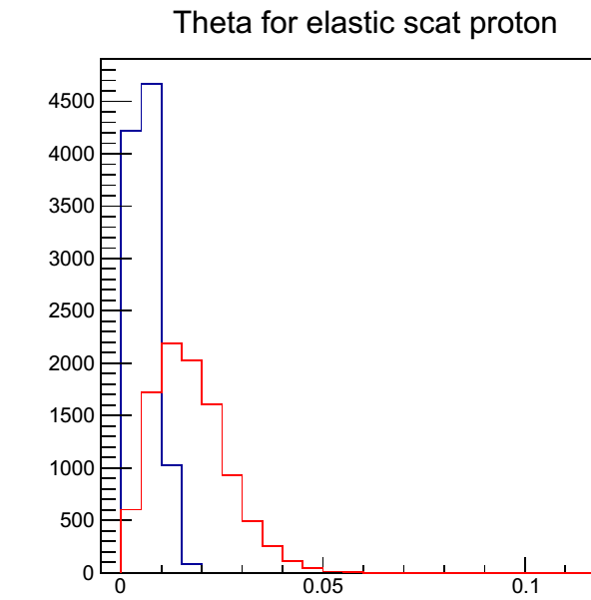
The angles or the recoil protons for 16 and 45 GeV/c.
Angles of the scattering protons
Angles of the recoil protons
Red line - for 16 GeV / c, blue - for 45 GeV / c.
Since the prototype detector was designed for 45 GeV/c, in present studies the sizes were changed based on the comparison of the angles of the recoil protons for 16 and 45 GeV/c.

Slide 29

Hodoscopes | Distance from PT ( mm) | Total dimensions (mm) | Dimension of scintillator width x thickness x length (mm) | Numbers of PM
 | Z | X × Y | X Y | X Y
 |  | Beam | Hodoscopes
H1 | -9000 | 40 × 40 | 6 × 3 × 40 6 × 3 × 40 | 9 9
H2 | -2800 | 40 × 40 | 6 × 3 × 40 6 × 3 × 40 | 9 9
 |  | Forward | Hodoscopes
H3 | 850 | 62 × 45 | 6 × 3 × 62 6 × 3 × 45 | 15 11
H4 | 2850 | 182 × 86 | 6 × 3 × 182 6 × 3 × 86 | 45 21
 |  | Recoil | Hodoscopes
 | X | Z × Y | Z Y | Z Y
H5 - H7 | 300 | 322 × 228 | 9 × 5 × 322 9 × 5 × 228 | 51 37
H6 - H8 | 600 | 432 × 430 | 9 × 5 × 432 9 × 5 × 420 | 71 69
84 × 84
Design of the hodoscopes

Slide 30
Since the angles are the same for both momenta, therefore the size of the hodoscope (H5 and H7) will be the same. For recoil particles
The distribution for 16 GeV / c turned out to be wider, therefore the dimensions of the hodoscope (H3) changed to the following 84x84 mm. For scattering particles
It’s necessary to understand the accuracy of the angle measurements to restrain the interval of the product of tangents. After this, one could obtain the relation S/(S+B).

Slide 31
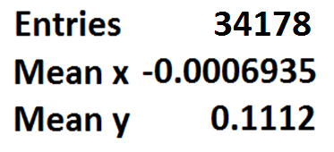
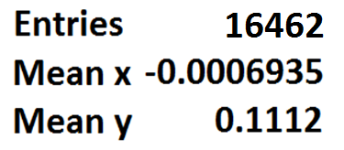
Two-dimensional histogram. The tangent products from the difference in azimuthal angles, taking into account the dimensions of the detectors H3 and H5.
Only for diffraction processes
Background
Only for elastic processes
Signal

Slide 32
Now we know the range in which we can expect elastic events in a two-dimensional histogram, taking into account the accuracy of recording the coordinates and sizes of the hodoscopes. And we can choose the regions of Δφ and tg1 * tg2 as follows : -0.2 < Δφ < 0.2 and 0.09 < tg1 * tg2 < 0.14
This figures show that the use of intervals of Δφ and tg1 * tg2, with a slight suppression of the signal, can significantly suppress background diffraction events. Thus, the ratio S / (S + B) = 0.995

Slide 33
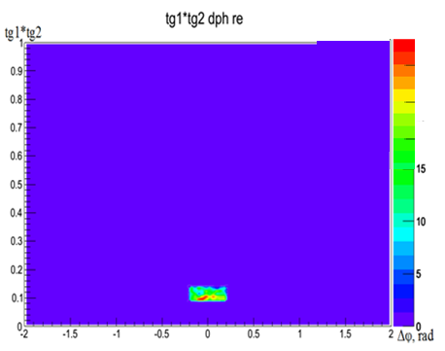
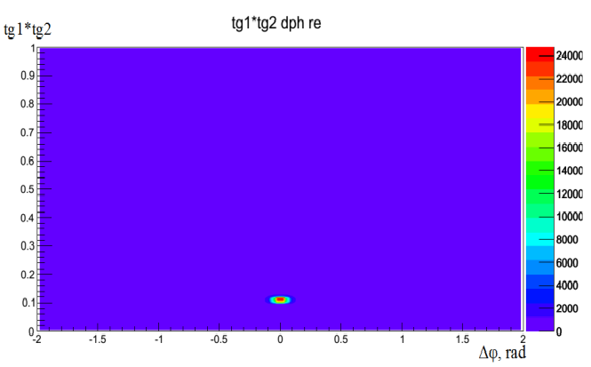
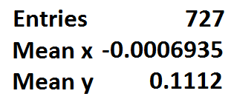
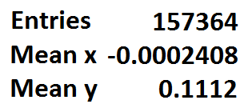
Two-dimensional histogram. The tangent products from the difference in azimuthal angles, taking into account the the regions of Δφ and tg1 * tg2
Only for diffraction processes
Background
Only for elastic processes
Signal
S/(S+B)=157364/(157364+721)=0.995

Slide 34
The momentum distributions of particles entering the recoil and scattering hodoscopes
The recoil particles
The scattered particles.
Blue line is elastic processes, red - diffraction processes
Signal Background
S / (S + B) = 0.995

Slide 35
Conclusion
We present the direct reconstruction of pp elastic scattering amplitudes at the SPASCHARM experiment.
The observables are expressed in terms of invariant amplitudes. These amplitudes are deduced analytically to solve bilinear relations.
The criteria to select elastic processes are discussed and presented. Monte-Carlo simulations of elastic scattering as well background reactions were carried out
Elastic and diffraction interactions of protons were simulated by using PYTHIA generator for 16 GeV incident protons, designed Setup geometry and the resolution of the detectors
Two-dimensional distributions of the product of the tangents of the polar angles of the recoil particle and the scattered particle versus difference of the azimuth angles of these particles, were obtained. The estimated ratio of the signal to background S/(S+B) is about 0.99.

Slide 36
Acknowledgments
The work has been supported in part by the NRNU MEPhI Academic Excellence Project (contract № 02.a03.21.0005, 27.08.2013).
.

Slide 37
Thank you for attention

