Slide 1
The status of SPASCHARM experiment with polarized target at U-70 accelerator
V. V. Abramov¹, N. A. Bazhanov², N. I. Belikov¹, A. A. Borisov¹, N. S. Borisov², S. I. Bukreeva¹,
A. M. Davidenko¹, A. A. Derevschikov¹, R. M. Fahrutdinov¹, A. N. Fedorov², Y. M. Goncharenko¹,
I. S. Gorodnov², V. A. Kormilitsyn¹, A. S. Kozhin¹, A. B. Lazarev², V. A. Maisheev¹,Y. M. Melnik¹, A. P. Meschanin¹, N. G. Minaev¹, V. V. Mochalov^{1, 3}, V. V. Moiseev¹, D. A. Morozov¹,
A. B. Neganov², L. V. Nogach¹, S. B. Nurushev^{1, 3}, V. A. Okorokov³, V. S. Petrov¹, Y. A. Plis²,
A. F. Prudkoglyad¹, A. V. Ryazantsev¹, V. L. Rykov³, S. V. Ryzhikov¹, P. A. Semenov^{1, 3},
V. A. Senko¹, N. A. Shalanda¹, M. M. Soldatov¹, L. F. Soloviev¹, M. N. Strikhanov³, Y. A. Usov¹,
A. N. Vasiliev^{1,3}, V. I. Yakimchuk¹, A. E. Yakutin¹
¹ NRC “Kurchatov Institute” – Institute for High Energy Physics, Protvino, Russia
² Joint Institute for Nuclear Researches, Dubna, Russia
³ National Research Nuclear University (Moscow Engineering Physics Institute), Moscow, Russia
DSPIN-2017, Dubna
September 15, 2017

Slide 2
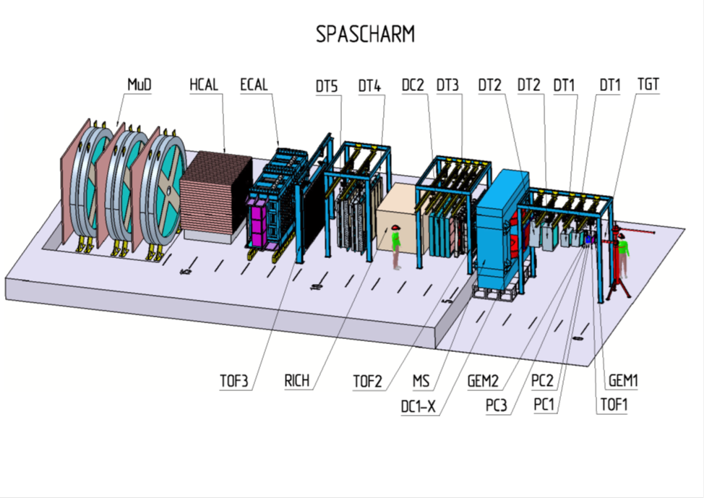
Brief overview of the SPASCHARM project
The main goals: Systematic study of spin phenomena for a wide range of inclusive and exclusive reactions in collisions of high-energy polarized hadrons in the QCD non-perturbative region.
The detector: Large acceptance forward spectrometer for charged and neutral particles with good identification, covering 2π in azimuth and 0 < x_{F} < 1 and p_{T} up to 2.5 GeV/c for the beams in the momentum range of ~10-45 GeV/c.
Stage 1: Study of single–spin asymmetries at the existing beam line 14, using unpolarized meson and proton beams, interacting with transversely polarized protons or deuterons of the “frozen” target. The first physics data taking run - Spring-2018.
Stage 2 (Beginning in 2022): Polarized proton and antiproton beams will be available at the new 24A beam line.
More on the SPASCHARM experiment see, for example, V. V. Mochalov, et al., Phys. Part. Nucl. 44 (2013) 930

Slide 3
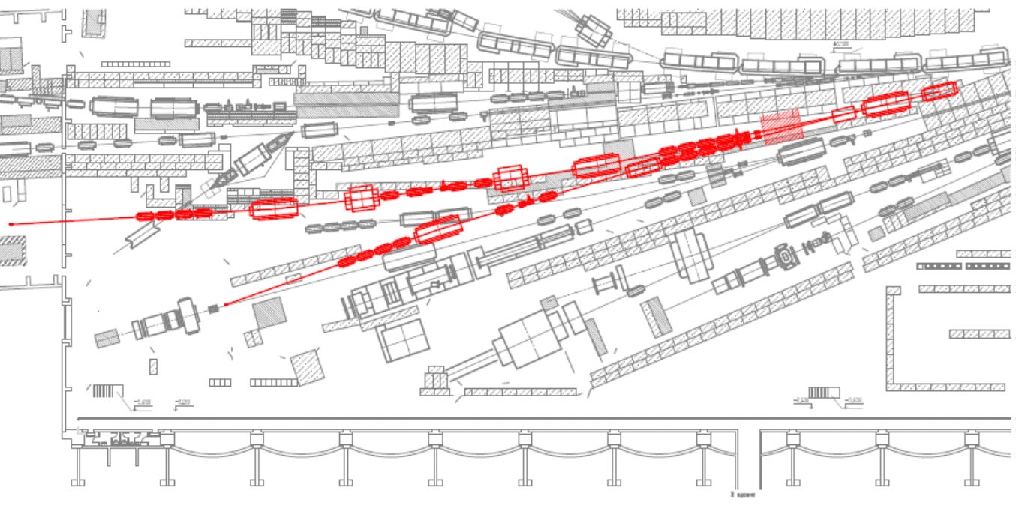
Beam line 14: The history and capabilities
One of the first beam lines at U-70 accelerator of IHEP operating for almost 50 years.
It provides for experiments the beams of negative or positive secondary particles from an internal target exposed to the primary proton beam, as well as a high intensity primary proton beam extracted from U-70, using the bent Silicon crystal. The special scheme with converter is used for generating a low intensity electron beam for the detector calibration.
Most polarization studies at U-70 of IHEP have been carried out just at the beam line 14 under the leadership of Prof. S. B. Nurushev, using polarized proton and deuteron targets.
The partial list of accomplished studies from their beginning in 1968:
Experiment HERA: Polarization in elastic scattering of particles and antiparticles. Spin-rotation parameters in elastic scattering of protons and negative pions.
Experiment PROZA: Polarization in exclusive quasi-elastic charge-exchange reactions.
Experiment PROZA-M: Single-spin asymmetries in inclusive production of neutral mesons in the unpolarized beam fragmentation (X_{F}>0) and central (X_{F}~0) regions. The spin asymmetry in cumulative reactions at polarized deuteron target.
Experiment PROZA-2: Single-spin asymmetries in inclusive production of neutral mesons in the polarized target fragmentation region (X_{F}<0).
Primary target
Beam 24A
Beam 14
Polarized target
Beam 24B
SPASCHARM, Stage 1 Area

Slide 4
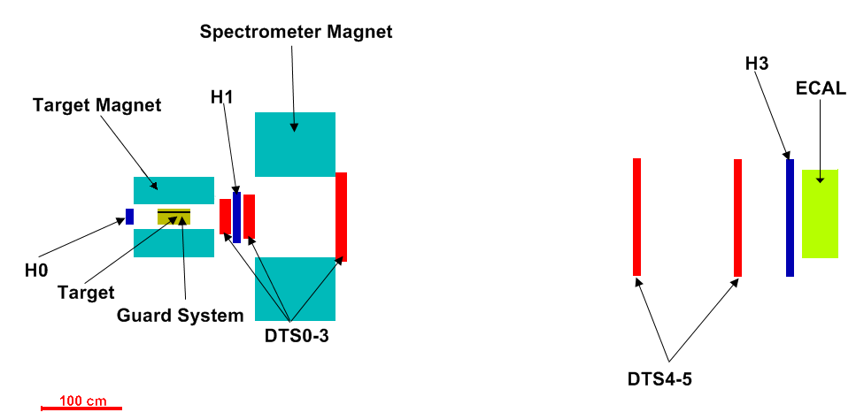
The SPASCHARM pilot configuration for the Spring 2018
Negative secondary beam from internal target:
Energy: 28-34 GeV
Composition:
Intensity: up to (1-2)×10⁶ per (1.5-2)-second long spill each 9-second cycle
Beam size at the target: σ_{x,y} ≈ 3-5 mm
Beam detectors:
Full flux trigger counters
Three Cherenkov counters
Beam hodoscopes: σ_{x,y} ≈ 0.2-0.6 mm, σ_{θ} ≈ 0.1-0.15 mrad
Acceptance:
2π in azimuth
Charged: Δθ_{x} ≈ ±120 mrad, Δθ_{y} ≈ ±100 mrad, 0 < x_{F} < 1, p_{T} < ~2.5 GeV/c
γ and π⁰: Δθ_{x} ≈ ±50 mrad, Δθ_{y} ≈ ±40 mrad, 0 < x_{F} < 1, p_{T} < ~1 GeV/c
Momentum resolution: σ_{p}/p ~ 1% (~2% in the Spring 2018, predominantly, due to lower field in the spectrometer magnet)
Particle ID:
2 multi-channel Cherenkov counters (not installed for the Spring 2018): π± ID 3-23 GeV; K± ID 11-23 GeV; proton ID > 11 GeV
Multiplicity & Time-Of-Flight hodoscopes (at design stage, not installed for the Spring 2018): π/K-separation up to 2 GeV

Slide 5
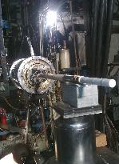
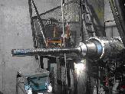
“Frozen” transversely polarized target
Target material: pentanol C₅H₁₂O with TEMPO radical
Polarization value: up to 75%
Dilution factor (ratio of the number of all nucleons to the number of polarized protons): 7.3
Target volume: length 200 mm, diameter 18 mm
Target thickness: 13.2 g/cm² which is ~10% of interaction length for 28 GeV pions and ~15% - for 50 GeV protons
Polarized target operates at extremely low
temperature achieved by dilution of He₃ in He₄:
The RF-pumping of polarization takes place in 2.4 T magnetic field at RF-frequency of ~70 GHz at the temperature of ~ 100 mK
Polarization decay time is ~1000-2000 hours in 0.4 T magnetic field at the temperature of 30-40 mK
Polarization reversal: every 1-2 days

Slide 6
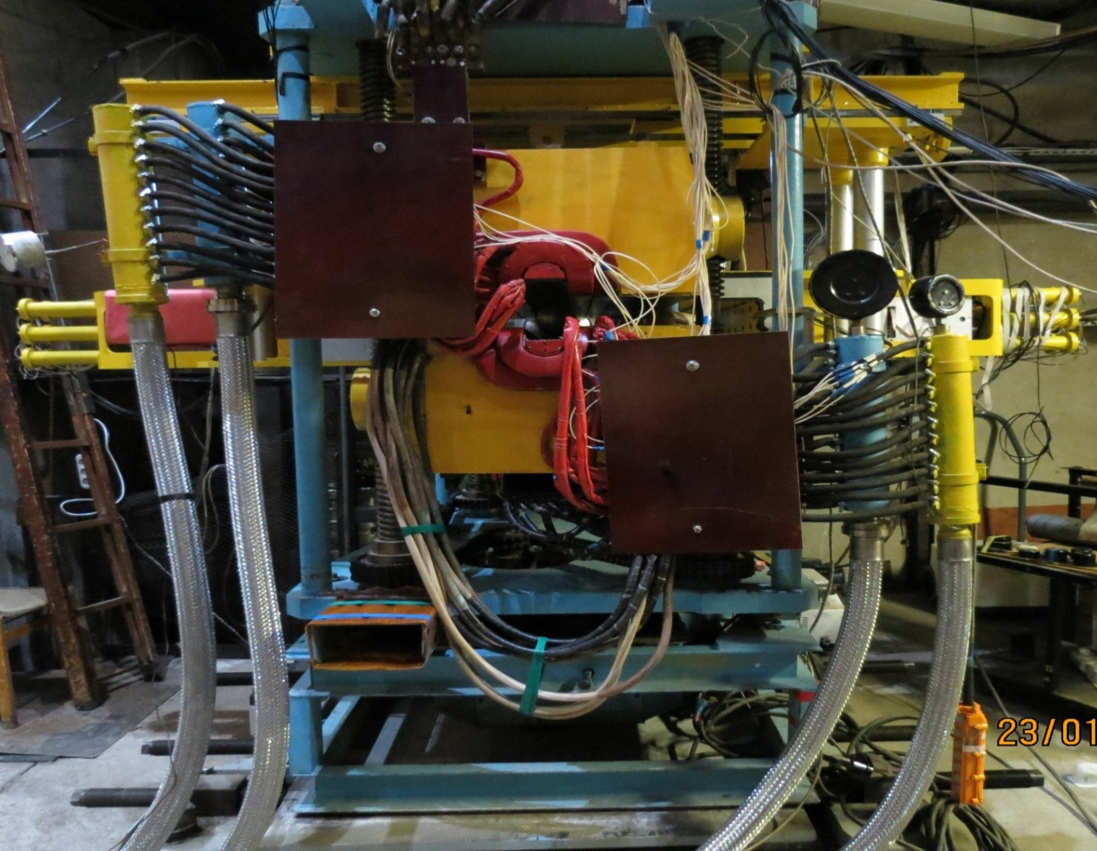
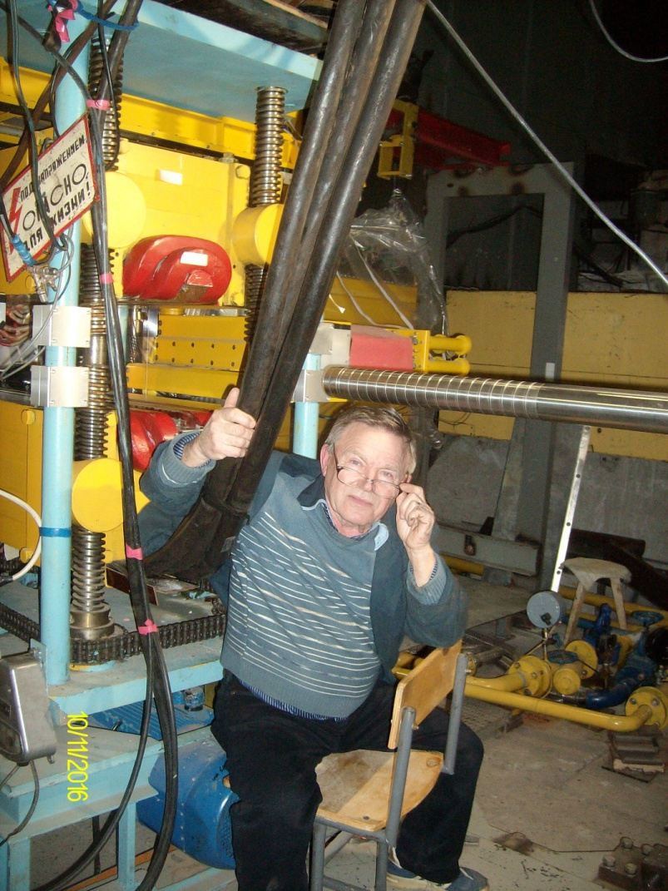
“Dinosaur” magnet for polarized target
Dipole magnet with conventional ‘warm ‘ copper coils and ferromagnetic (permendur) poles
Length (poles): 1 m
Aperture width: 80 mm
Variable vertical gap: 75 mm (closed yoke), 315 mm (open yoke)
Nominal coil current: 1.4 kA, power consumption: 300 kW
Closed yoke: Magnetic field in the aperture B = 2.4 T (!!!)
Open yoke: Magnetic field in the aperture B ≈ 0.4 T
Critical requirement
The uniformity of magnetic field of 2.4 T in the target volume of D = 18 mm & L=200 mm must be better than ~1.5×10⁻⁴
Aggravating factor: all ferromagnetics are close to saturation

Slide 7
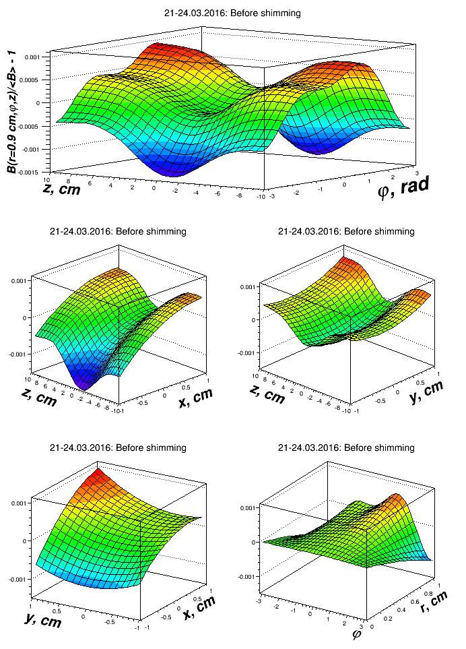
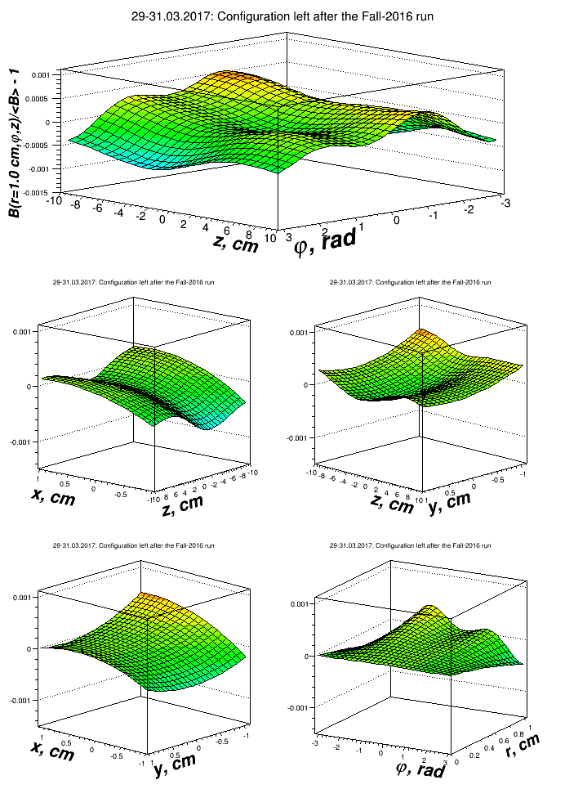
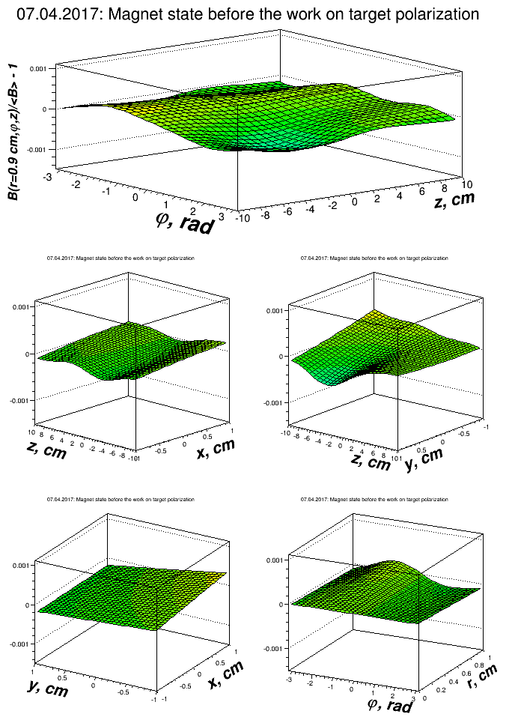
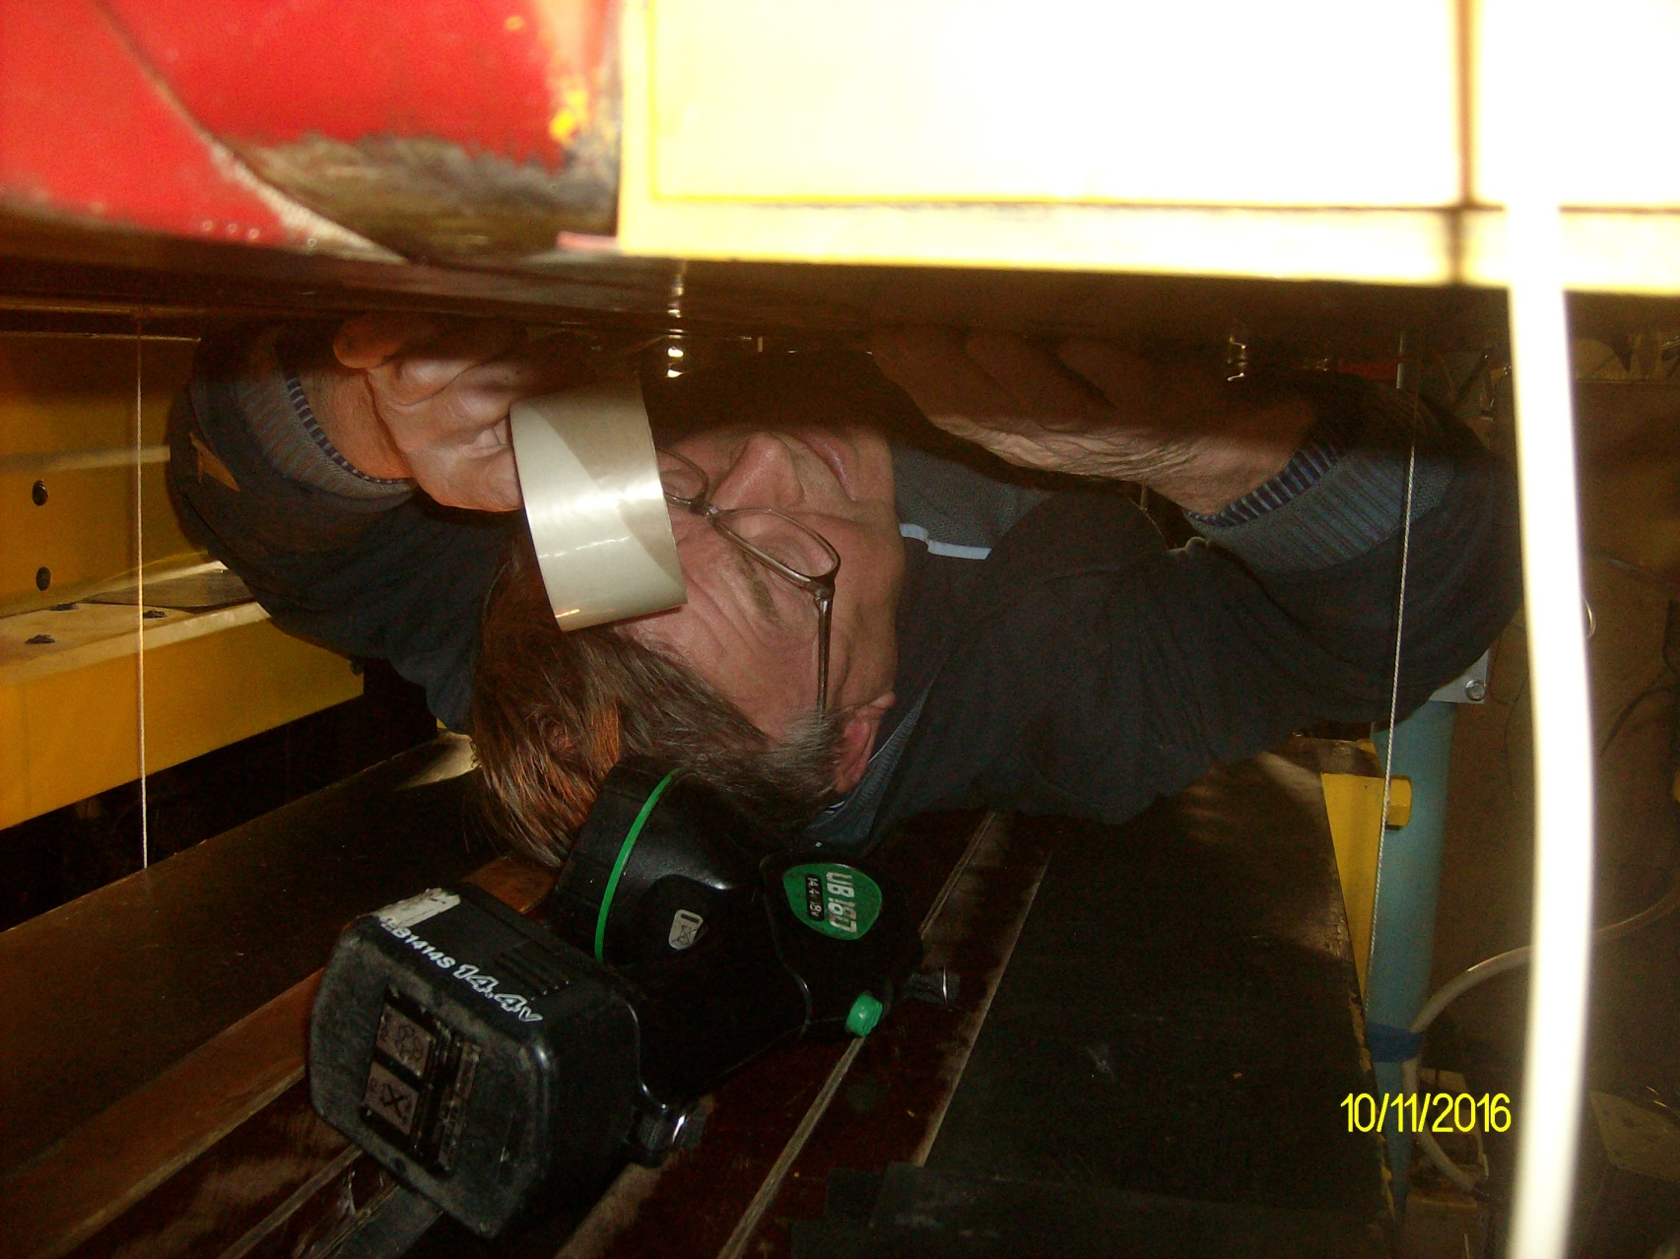
“Dinosaur” shimming: Spring 2016 – Spring 2017
ANSYS computer simulations greatly helped to save time and efforts on iterations for shimm adjustment at the real magnet
April 2016: Before shimming
(ΔB/B)_{MAX} = 2.5×10⁻³
RMS = (4.28±0.08)×10⁻⁴
November 2016
(ΔB/B)_{MAX} = 8.4×10⁻⁴
RMS = (1.86±0.07)×10⁻⁴
Target polarization achieved:
P(+) = 70%
P(-) = 64%
April 2017
(ΔB/B)_{MAX} = 7.8×10⁻⁴
RMS = (1.28±0.07)×10⁻⁴
Work with the target in the Fall 2017

Slide 8
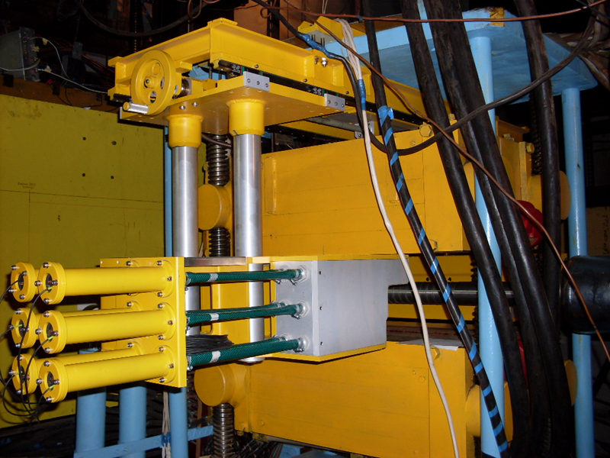
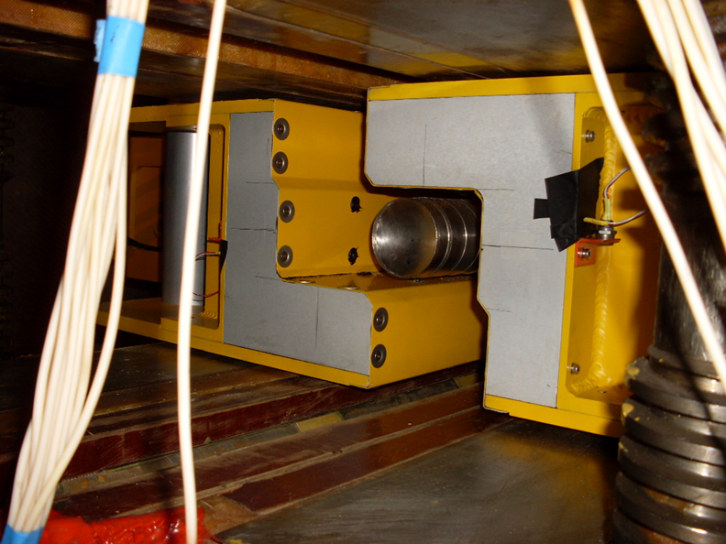
Veto (Guard) system around the polarized target
Veto detector for charged particles and γ-quanta
Scintillator-Lead sandwich of the thickness ~ 5X₀
Light-collection, using 1 mm wave-shifting fibers BFC-91AMC
Photodetectors: photomultipliers ФЭУ-84.
Total number of channels: 12
Usage:
Trigger and/or offline veto for elastic, quasi-elastic and some other exclusive processes
The veto system has shown its usefulness for the better selection of events within the target rather than in surrounding materials

Slide 9
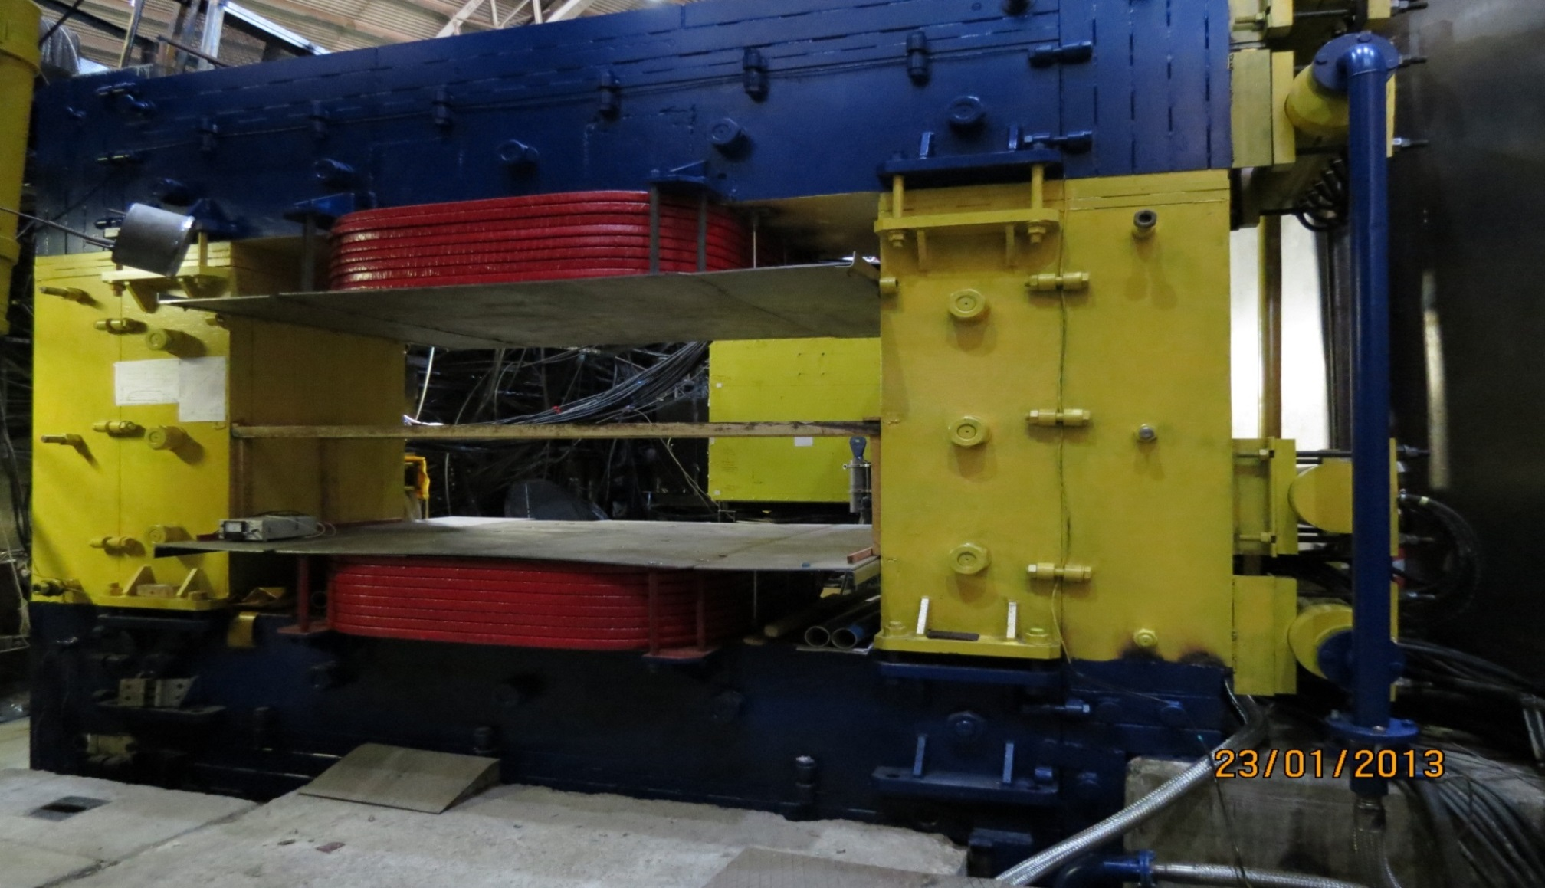
Spectrometer magnet
Aperture: H×V ≈ 2.3×1 m²
Nominal coil current: 2.5 kA
Power consumption: 1250 kW
Nominal magnetic field at center: ~1 T
Bending power: ~(1-1.5) T×m
In the Spring-2018:
The coil current 1 kA (40% of the nominal current)
Power consumption: ~200 kW
Magnetic field at center: ~(0.55-0.6) T
Bending power: ~(0.6-0.9) T×m.
Precise measurements of the magnetic field map: Fall 2017

Slide 10
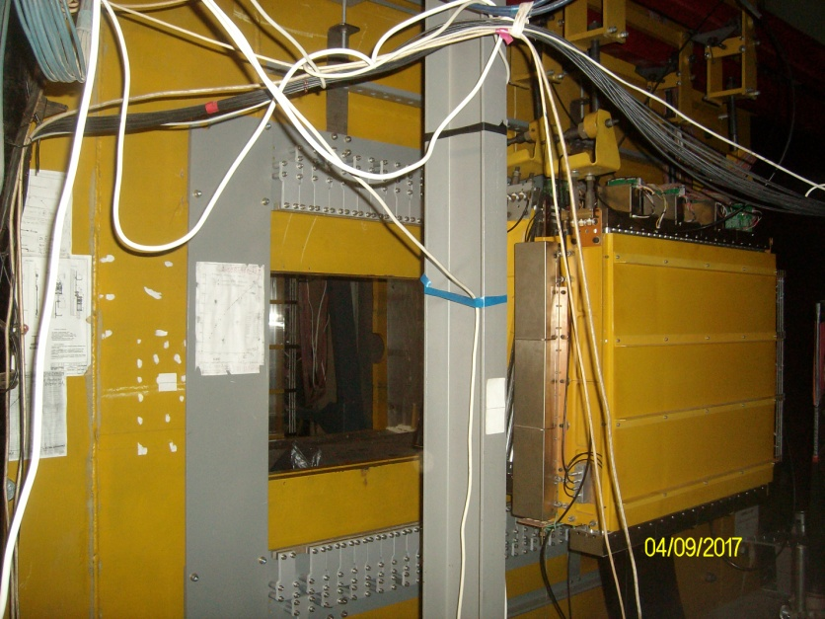
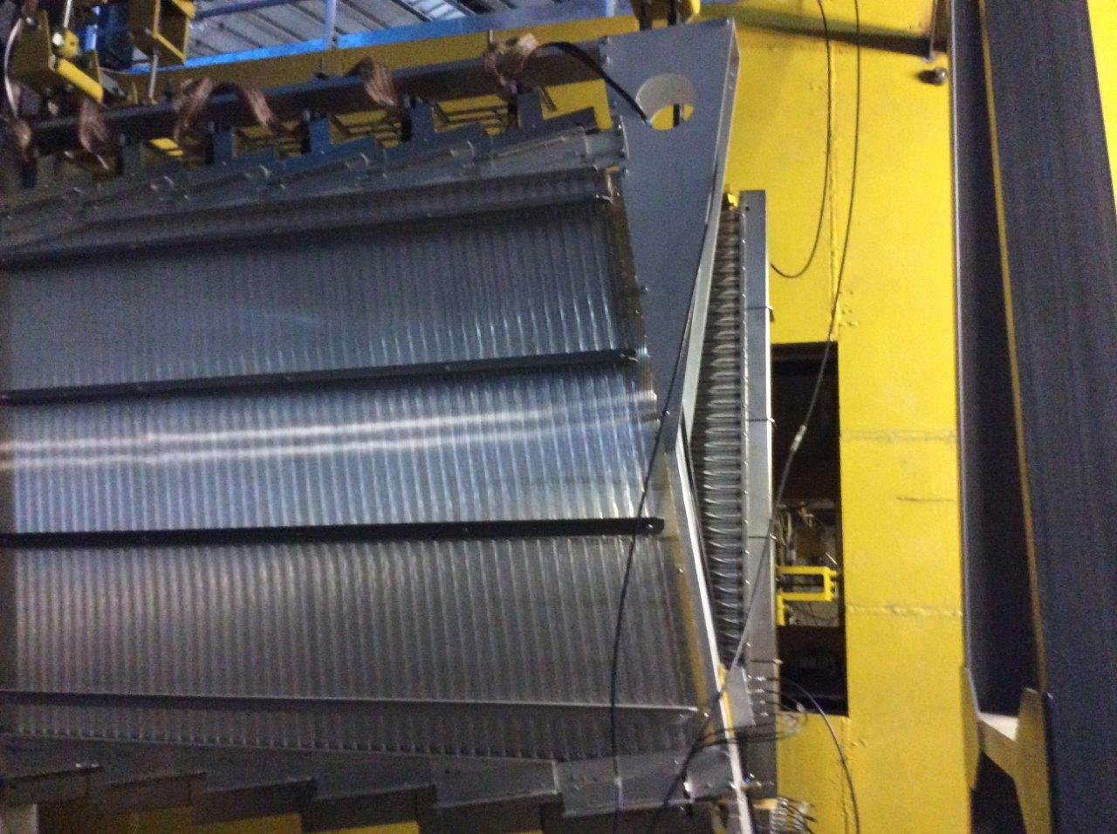
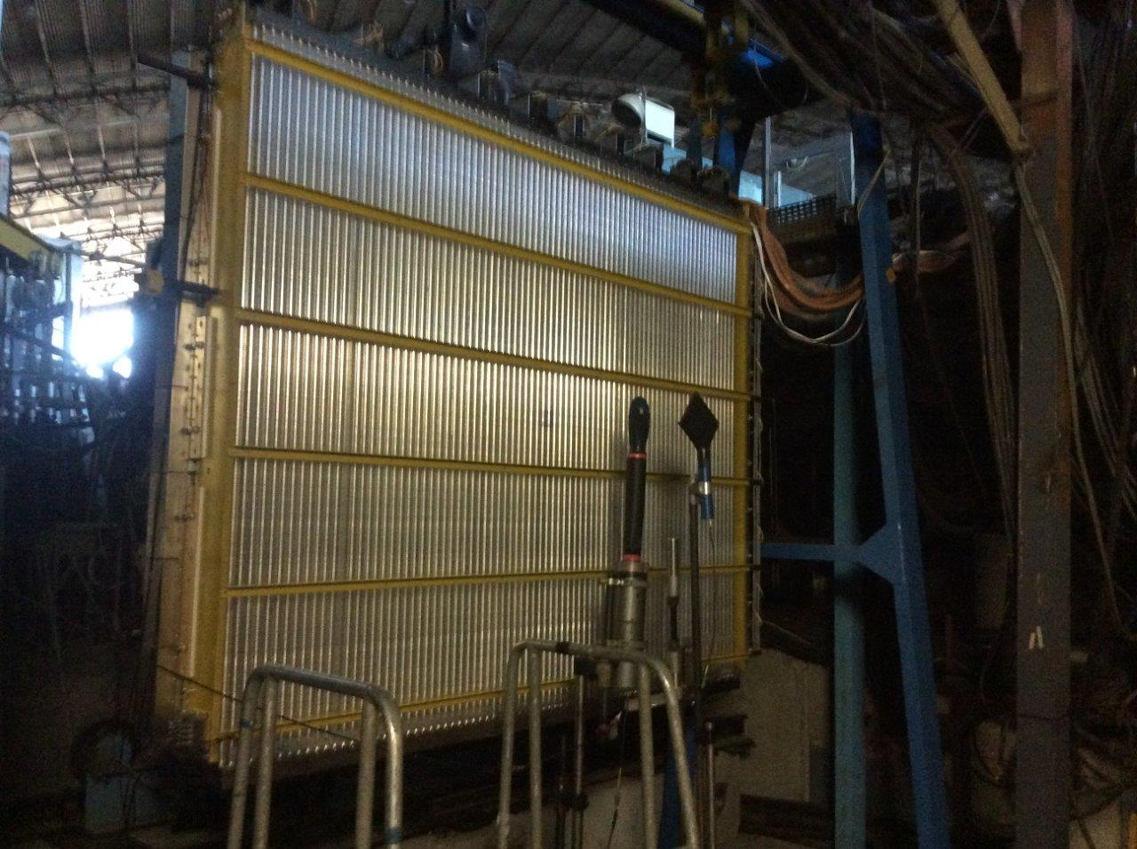
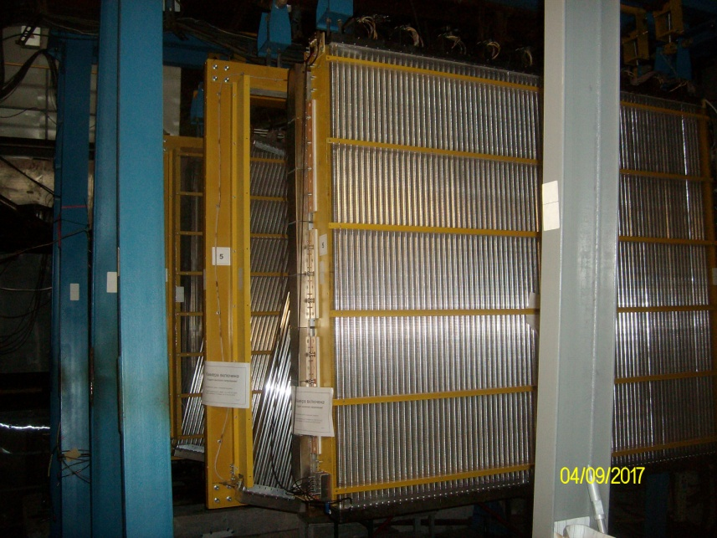
Tracking stations
5 tracking stations, comprised of 17 planes
Each plane consists of 3 drift-tube layers
Tube spatial resolution is ~(150-200) mkm (test with cosmic rays)
Total number of TDC channels: 2496
Negotiations are in progress on joining in the SPASCHARM project of the group from NRC “Kurchatov Institute” – ITEP, Moscow, with a number of proportional chambers
NAME | Distance from the target [m] | Planes | Tube diameter [mm] | Dimension X[cm]×Y[cm] | Number of channels
DTS0 | 1.0 | U,V,X,Y | 15 | 48 × 48 | 384
DTS1 | 2.00 | X,Y,U,V | 30 | 96 × 72 | 336
DTS3 | 5.50 | X,Y,U | 30 | 168 × 120 | 432
DTS4 | 8.00 | X,Y,U | 30 | 240 × 192 | 672
DTS5 | 10.00 | X,Y,U | 30 | 240 × 192 | 672
DTS0
DTS3
DTS4
DTS4 & 5

Slide 11
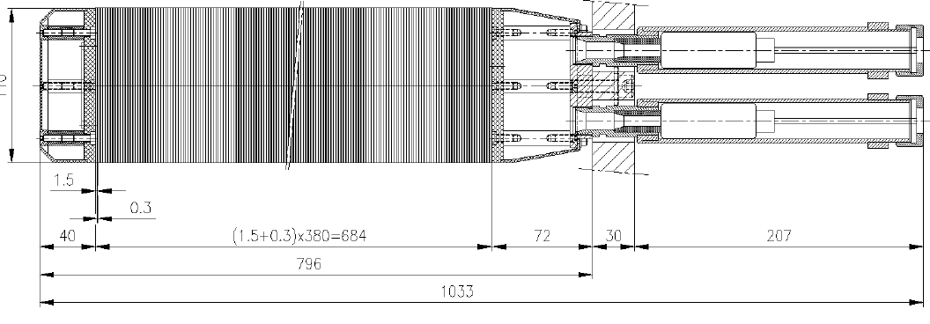
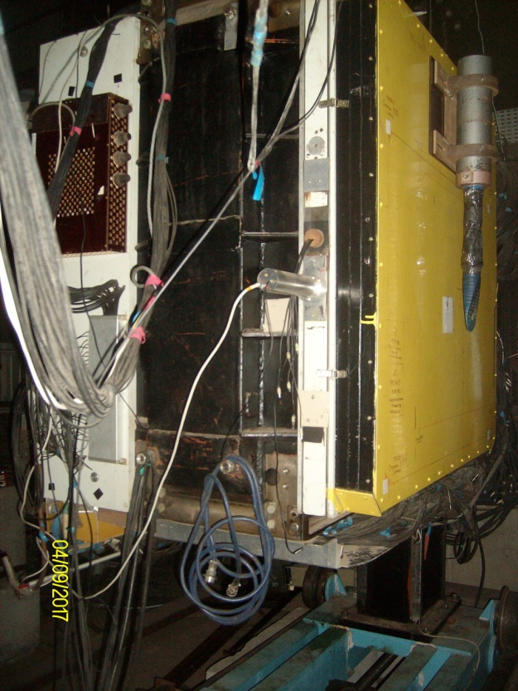
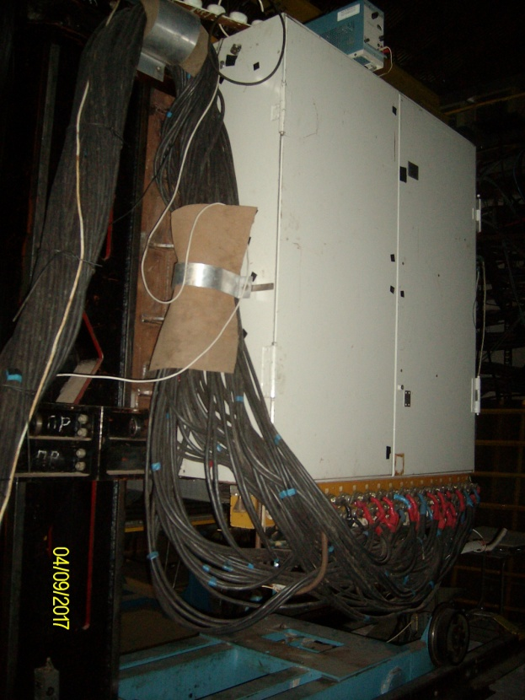
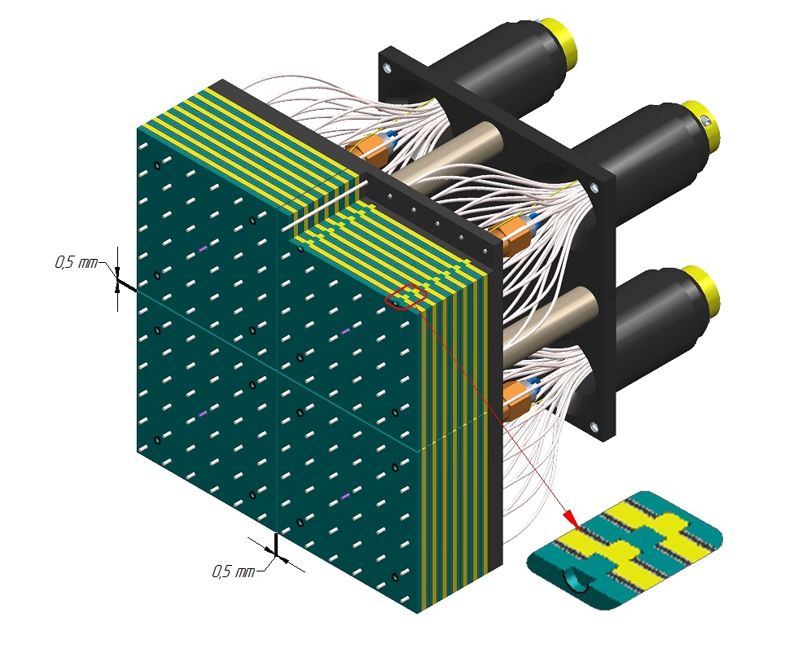
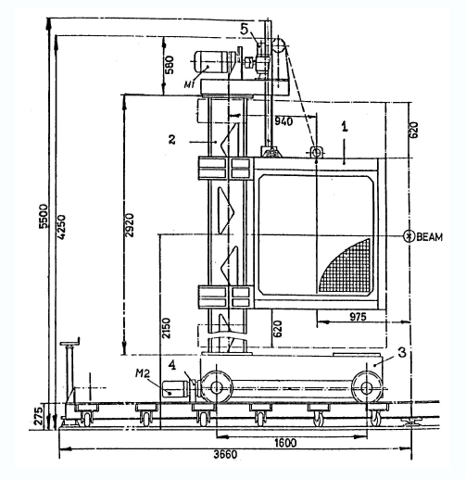
Electromagnetic calorimeter
720 of lead-glass cells of the size 38×38×450 mm³, depth ~18X₀
Covered area: H×V ≈ 1.15×0.92 m²
Photodetectors: ФЭУ-84
Energy resolution: σ_{E}/E ≈(12-14)%/√E, E in GeV
Distance from the target: 11 m
Is to be replaced with …
Fine-segmented ‘shashlyk’-type calorimeter
2400 cells of the size 55×55×700 mm³, depth ~20X₀
Cell structure: Scintillator: 1.5 mm, Lead: 0.3 mm
Covered area: H×V ≈ 3.3×2.2 m²
Photodetectors: Hamamatsu R7899
Energy resolution: σ_{E}/E ≈3%/√E, E in GeV
Front
Back

Slide 12
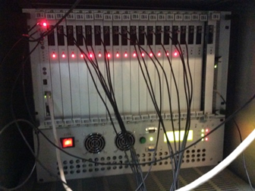
Data acquisition
Distributed architecture based on Ethernet 1G-10G
EuroMISS Front-End electronics
Separate EuroMISS crate(s) for each subsystem:
Registers for Hodoscopes, Veto-system, counters
One ADC crate (picture at left): 6-20 μs/event
Two TDC crates: 30-50 μs/event
Subsystem data are accumulated in the Crate-Controller’s buffer memories, time-stamped and sent to EventBuilder via Ethernet 1G-10G links – TCP/IP protocol
Avarage event size: ~2 kBytes
Data acquisition rate: ~10⁴ events/spill

Slide 13
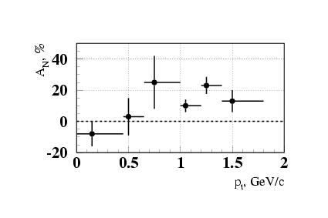
Physics studies with the pilot SPASCHARM setup
Physics program to start with at the beam line 14, using transversely polarized target:
Negative secondary beam of 28 GeV
Focus on measuring single-spin asymmetries A_{N} in inclusive processes
Final states with pions, γ and e± in the fragmentation region of unpolarized beam
But, should we expect any substantial A_{N} in the fragmentation region of unpolarized beam?
V. D. Apokin, et al., Proc. 8th Int. Symp. Spin. Phys., AIP Conf. Proc. 187 (2008) 105; V. D. Apokin, et al., Sov. J. Nucl. Phys. 49 (1989) 103
Reaction π⁻d↑→π⁰X at 40 GeV/c A_{N} = (16±5)% at p_{T} =(0.7-1.8) GeV/c and at x_{F} > 0.7
At small transverse momenta p_{T}, the transverse single-spin asymmetry A_{N} is consistent with zero
Remarkably, however, a quite sizeable asymmetry showed up at p_{T} ~ 1 GeV/с and above even in the unpolarized beam fragmentation region.
We plan to begin with measuring A_{N} for a number of reactions in π⁻p↑ and π⁻d↑ collisions with the goal to reveal the commonalities and differences in inclusive production of different final states.

Slide 14
Some reactions to study in π⁻p↑ and π⁻d↑ collisions at 28(34) GeV
Final state | N_{EVENTS}
π⁺ | 4.2·10⁹
π⁻ | 8.7·10⁹
π⁰→γγ | 4.3·10⁹
π⁰→γγ | 4.3·10⁹
η →γγ | 4.2·10⁸
η'→ π⁺ π⁻ η | 8.3·10⁵
K⁰_{S}→ π⁺ π⁻ | 1.3·10⁷
ρ⁰(770)→ π⁺ π⁻ | 4.2·10⁸
η→ π⁺ π⁻ π⁰ | 5.3·10⁶
ω(782) → π⁺ π⁻ π⁰ | 3.5·10⁷
ω(782)→ γ π⁰ | 3.8·10⁷
ρ⁺(770)→ π⁺ π⁰ | 2.9·10⁸
ρ–(770)→ π⁻ π⁰ | 7.5·10⁸
K⁰_{S}→ π⁰ π⁰ | 1.7·10⁷
a₀(980)→ η π⁰ | 1.8·10⁷
ω(782)→ e⁺ e⁻ | 1.7·10⁵
With PID for charged particles
Final state | N_{EVENTS}
K⁺ | 6.7·10⁸
K– | 9.0·10⁸
p | 9.2·10⁷
p̃ | 2.6·10⁸
K^{0*}(892)→ K⁺ π⁻ | 1.1·10⁸
K̃^{0*}(892)→ K– π⁺ | 4.3·10⁷
K^{+*}(892)→ K⁺ π⁰ | 1.9·10⁷
K̃–*(892)→ K– π⁰ | 3.8·10⁷
φ(1020)→ K⁺ K⁻ | 4.3·10⁶
Λ→ p π⁻ | 1.4·10⁶
Λ̃→ p̃ π⁺ | 1.1·10⁶
Δ⁺⁺→ p π⁺ | 9.3·10⁶
Δ⁻⁻→ p̃ π⁻ | 2.5·10⁷
Ξ⁻→ Λ π⁻ | 1.9·10⁶
Ξ̃⁺→ Λ̃ π⁺ | 1.6·10⁶
Σ⁰→ Λ γ | 1.2·10⁶
Σ⁰(1385)→ Λ π⁰ | 3.9·10⁶
N_{EVENTS} are estimated for π⁻p↑-collisions for ~50 days of data taking at an efficiency of ~70%
Additionaly …
Dependences of spin asymmetries on event multiplicity could be studied
Elements of polarization density matrices could be measured for some hyperons and vector mesons

Slide 15
Conclusion
The SPASCHARM pilot setup and the team
are (almost) ready for the first physics data
taking run in the Spring 2018
Please, stay tuned for the first results

