Slide 1
SPASCHARM project at Protvino
V. Mochalov
(on behalf of the SPASCHARM collaboration)

Slide 2
Outline
SPASCHARM Project
  Physics – single- double spin
  Polarized proton and antiproton beams
  Experimental Setup
SPASCHARM current (at beamline 14)
  Physics
  Current experimental Setup
  Experimental data and nearest plans

Slide 3
SPASCHARM physics motivation
The project is aimed at studying the spin structure of the nucleon and the spin dependence of the strong interaction at energies up to 50 GeV. The fixed target SPASCHARM experiment will systematically study polarization phenomena in exclusive and inclusive hadronic reactions.
The universal setup will detect dozens of reactions with polarized proton and nuclear targets. In parallel with single-spin asymmetries, the polarization of hyperons and the elements of the density spin matrix of vector mesons will be measured.
The ultimate goal of the experiment is to study spin structure of the proton, primarily the determination of the contribution of gluons to the spin of the proton through the investigation of spin effects in the formation of various charmonium states

Slide 4
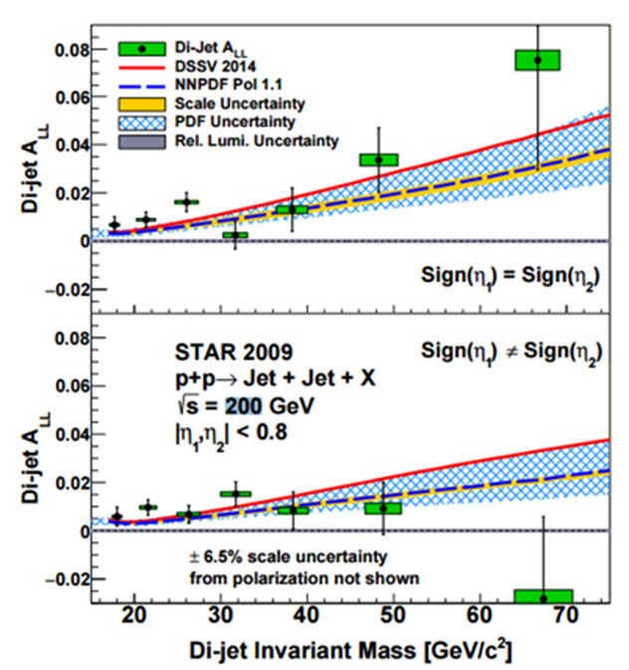
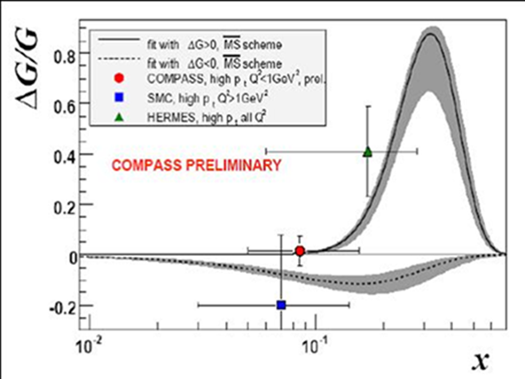
Double-spin asymmetry measurements motivation

Slide 5
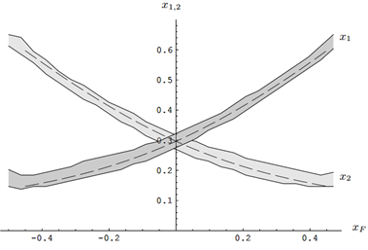
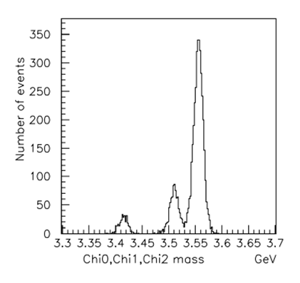
Double-spin asymmetry measurements expectation
Double-spin asymmetry A_{LL} in charmonium production to study gluon polarization ΔG/G(x) at large x_{F}

Slide 6
Physics motivation antiprotons
The presence of polarized both protons and antiprotons in the CP neutral-system potentially opens up opportunities for studying and comparing CP conjugate reactions with one another. This allows us to look at CP invariance in a new perspective, inaccessible to collisions of unpolarized particles.
Finally, the presence of eight types of unpolarized beams (π±, K±, p, p͂, d, C), in combination with a polarized and nuclear targets, extends the range of studies of polarization phenomena by an order of magnitude and enhances the uniqueness of the project. The study of energy dependence of spin effects reveals the dynamics of interaction. The measurements might be conducted at several energies in order to estimate the model parameters.

Slide 7
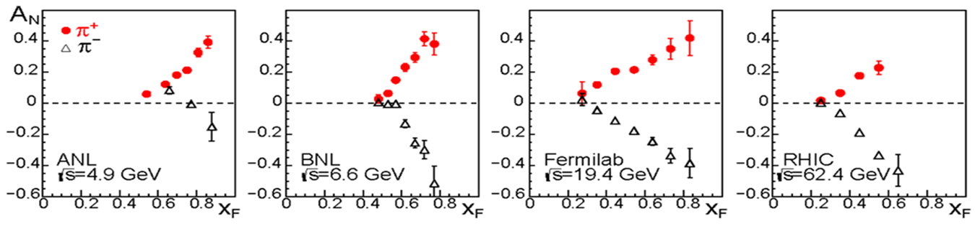
Single-spin asymmetry measurements motivation
Single–spin asymmetries and hyperon polarization almost do not depend on beam energy – accuracy is more important:
inclusive and exclusive reactions, including elastic, of the light (u, d, s – quarks) hadrons in the beam fragmentation region with polarized beam or target. The hyperon and vector mesons polarization (elements of the density spin matrix)

Slide 8
Elastic scattering
The SPASCHARM experiment requires to develop different methods to measure the beam polarization, including elastic scattering. It gives us possibility (and obligations) to study elastic scattering in pp and p(bar)p scattering.
The scattering matrix concept is convenient for describing the interaction in all its aspects, but, unfortunately, is not available for direct measurement. Therefore, it is necessary to determine a set of observables that allows the direct reconstruction of the scattering amplitudes (DRSA).
DRSA is a fully model-independent analysis using only fundamental conservation lows.

Slide 9
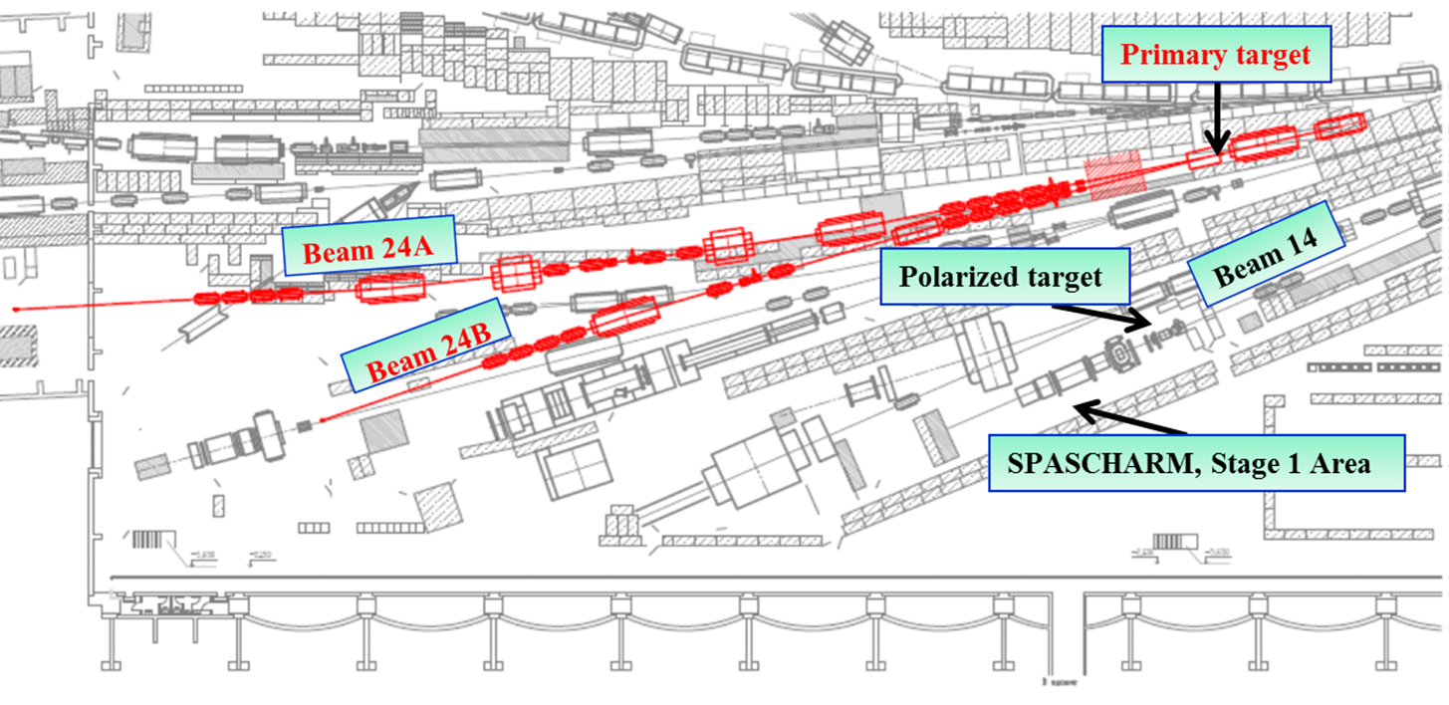
Beam-line
It is proposed to form polarized beams of protons and antiprotons in the beam channel 24A of the accelerator U-70.

Slide 10
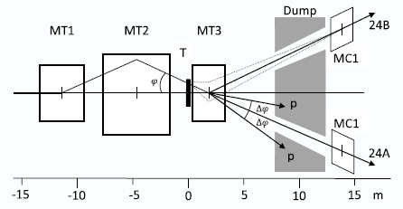
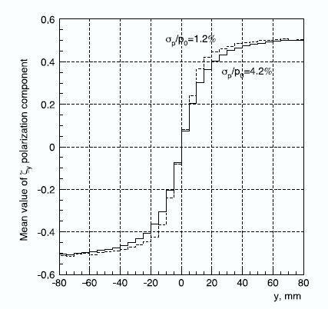
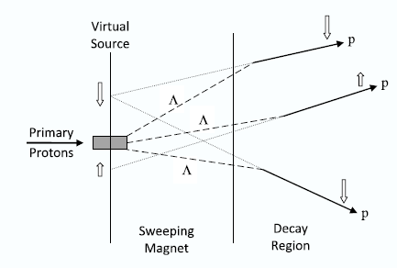
Beam target
(beam extracted from U70)
MT3 parameters have been chosen as a compromise between contradictory requirements to its length : 𝐿 = 2.6 m, aperture 𝐻 × 𝑉 = 140 × 56 mm², 𝐵𝑚𝑎𝑥 = 1.9 T. Target: Aluminum plate, 400 mm long, 3 mm high, and 100 mm wide

Slide 11
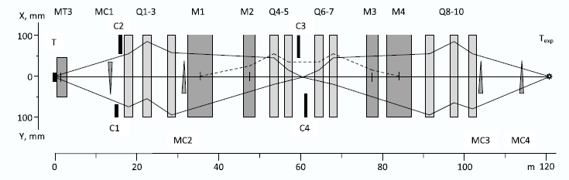
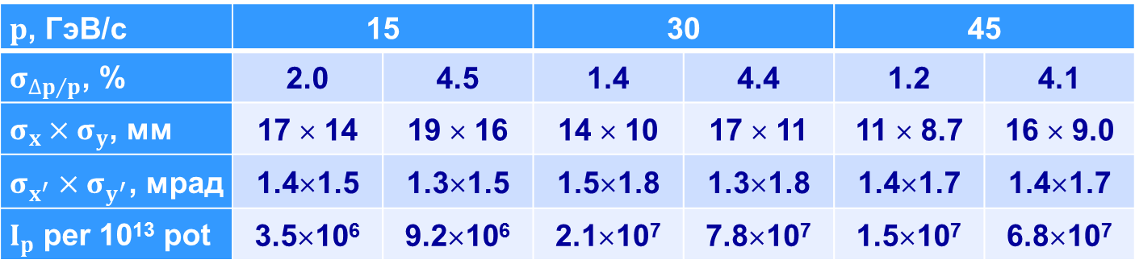
Optical scheme and properties
$p$, ГэВ/с | 15 |  | 30 |  | 45
$σ_{{∆p}/p}$, % | 2.0 | 4.5 | 1.4 | 4.4 | 1.2 | 4.1
$σ_{x}×σ_{y}$, мм | 17 × 14 | 19 × 16 | 14 × 10 | 17 × 11 | 11 × 8.7 | 16 × 9.0
$σ_{x^{′}}×σ_{y^{′}}$, мрад | 1.4×1.5 | 1.3×1.5 | 1.5×1.8 | 1.3×1.8 | 1.4×1.7 | 1.4×1.7
$I_{p}$ per 10¹³ pot | 3.5×10⁶ | 9.2×10⁶ | 2.1×10⁷ | 7.8×10⁷ | 1.5×10⁷ | 6.8×10⁷

Slide 12
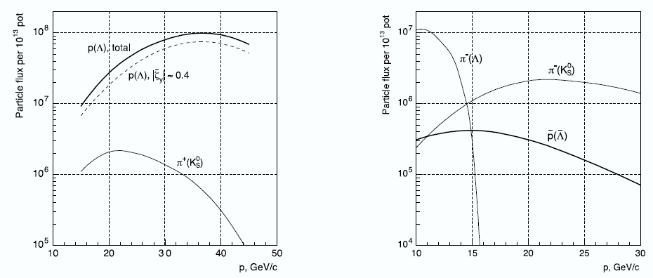
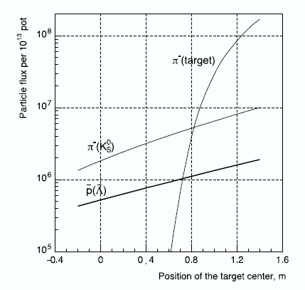
Beam intensity

Slide 13
Polarized beam summary
Calculations of the polarized beam parameters have been carried out.
The intensity of the antiproton beam with energy of 15 GeV can reach 10⁶ antiprotons per accelerator cycle (10¹⁰ antiprotons per day) for the 10¹³ primary protons from the U-70 to the primary target.
V.Abramov et al, The polarized proton and antiproton beam project at U-70 accelerator Nuclear Inst. and Methods in Physics Research, A 901 (2018) 62–68

Slide 14
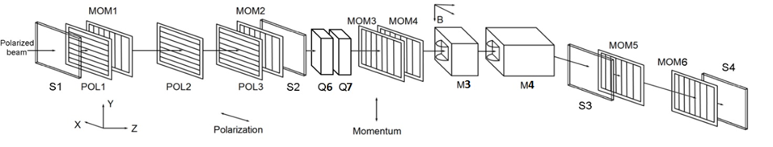
Polarimetry
Absolute polarimeter (elastic scattering)
  J.Phys.Conf.Ser. 798 (2017) no.1, 012179
  Journal of Physics: Conference Series 678 (2016) 012034
Inclusive pion production
  Journal of Physics: Conference Series 678 (2016) 012028
Primakoff effect polarimeter
Tagging system in intermediate focus and beam momentum measurement
  Intern. J. of Modern Physics: Conf. Ser. Vol. 40 (2016) 1660086

Slide 15
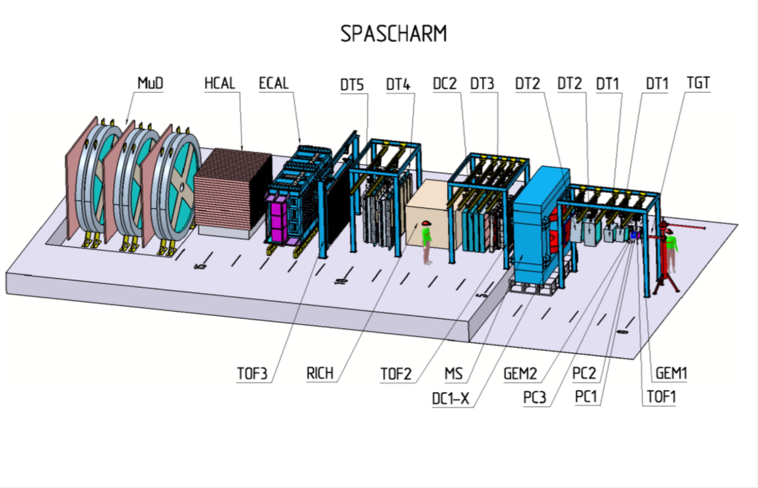
Experimental Setup

Slide 16
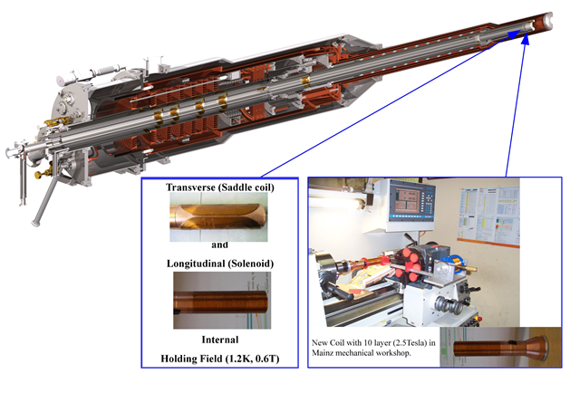
New challenging polarized target
New polarized (both transverse and longitudinal) without external holding field
Polarized target cryostat with superconducting coils
JINR-Mainz-Bonn-Bochum team

Slide 17
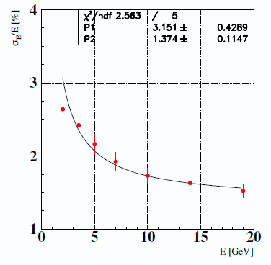
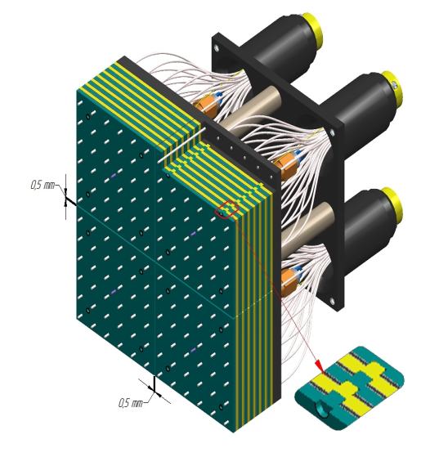
Electromagnetic Calorimeter
Fine-segmented “shashlyk”-type calorimeter,
Cell structure: Scintillator: 1.5 mm, Lead: 0.3 mm (380 layers)
2400 cells of the size 55×55×700 mm³, depth ~20X₀ About 11-12 m from target
Photodetectors: Hamamatsu R7899

Slide 18
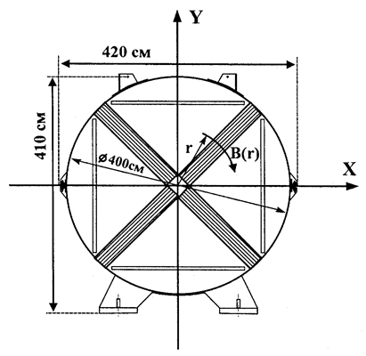
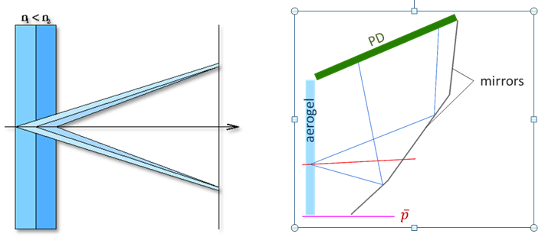
Particle Identification
PANDA type detector, Phys.Usp. 58 (2015) no.5, 503-511,
Usp.Fiz.Nauk 185 (2015) no.5, 540-548
Muon detector (drift tubes)

Slide 19
SPASCHARM at beamline 24
Cost Estimates
Cost of detectors - about 13 MEuro, including
  Shashlyk calorimeter – 2 Meuro (IHEP)
  RICH detector – 3.4 MEuro (BINP)
  Spin flippers and cryogenics – 2.6 MEuro (BINP, IHEP, industry)
  Polarimetry - 2 MEuro (MEPhI, IHEP, ITEP)
Cost of the beamline – 20-25 MEuro.
Total cost < 40 MEuro (about 1/5 of the JINR budget)
(new target not included)

Slide 20
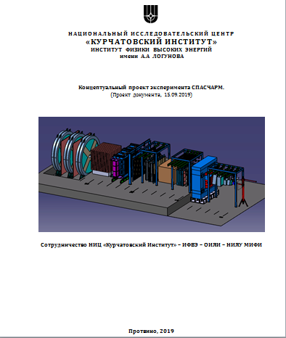
CDR
IHEP Preprint 2019-12 in russian

Slide 21
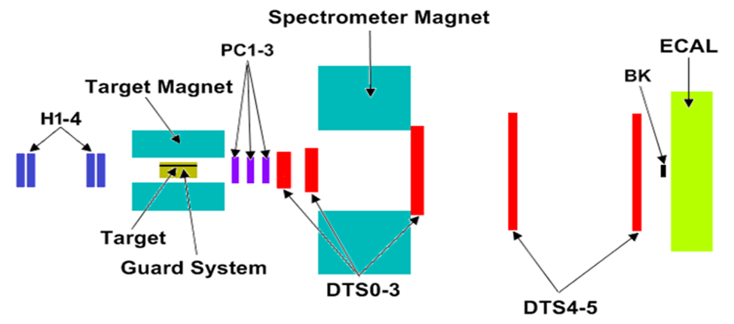
SPASCHARM at beamline 14
Beam Energy 28 GeV, Composition: pi/K/pbar=98%, 1.8%,0.25%,
Intensity: up to (0.7-1.2)×10⁶ per (3)-second long spill each 9-second cycle
2π in azimuth
Charged: Δθ_{x} > ±140 mrad, Δθ_{y} ≈ ±150 mrad, 0 < x_{F} < 1, p_{T} < ~2.5 GeV/c
γ and π⁰: Δθ_{x} ≈ ±50 mrad, Δθ_{y} ≈ ±40 mrad, 0 < x_{F} < 1, p_{T} < ~1 GeV/c
Small (0.6 T) Field in spectrometer magnet

Slide 22


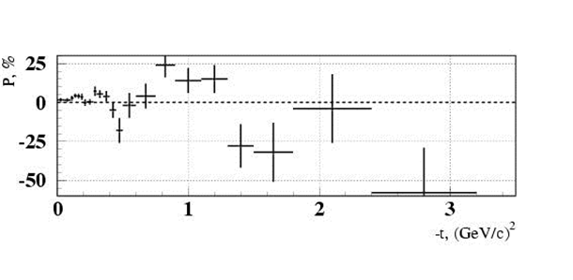
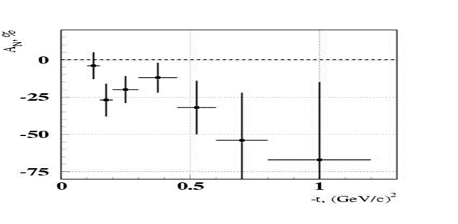
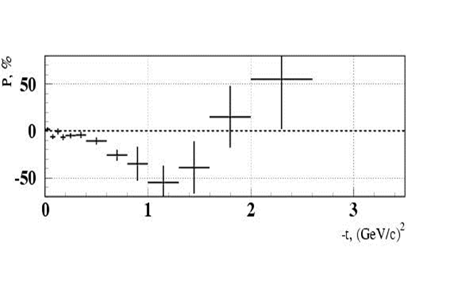
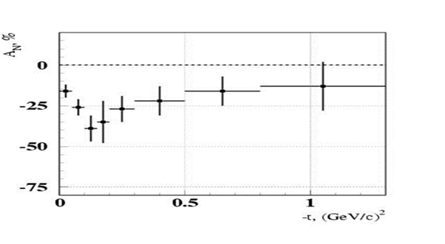


Beamline 14 motivation (exclusive)

Slide 23
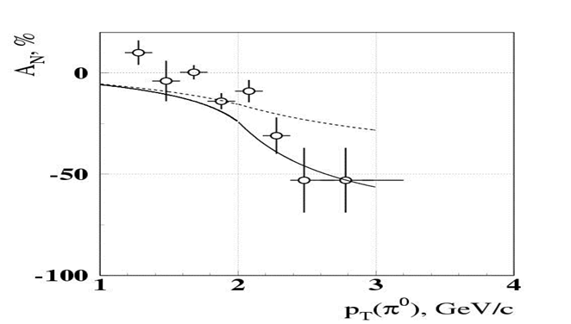
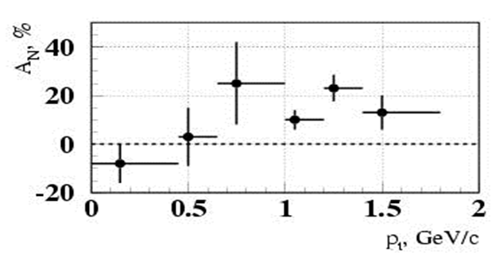
SPASCHARM at Beam-line 14
(motivation inclusive)
pp↑→π⁰X at x_{F}=0
pd↑→π⁰X at x_{F}>0.7
Phys.Lett. B243 (1990) 461-464, Sov.J.Nucl.Phys. 50 (1989) 432-437, Yad.Fiz. 50 (1989) 695-704
Phys.Atom.Nucl. 73 (2010) 2017-2021, Yad.Fiz. 73 (2010) 2072-2076
A_{N} = (16±5)% at p_{T} =(0.7-1.8) GeV/c and at x_{F} > 0.7.
A quite sizeable asymmetry showed up at p_{T} ~ 1 GeV/с and above even in the unpolarized beam fragmentation region.

Slide 24
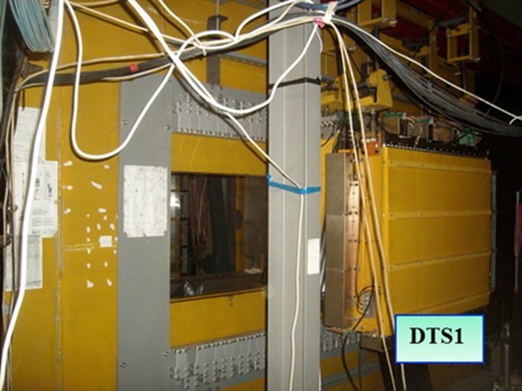
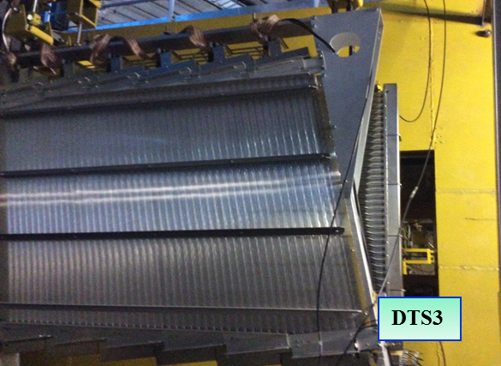
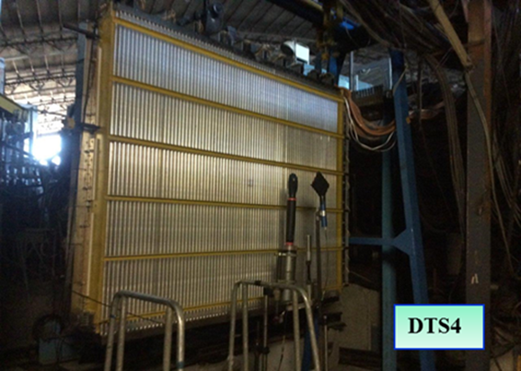
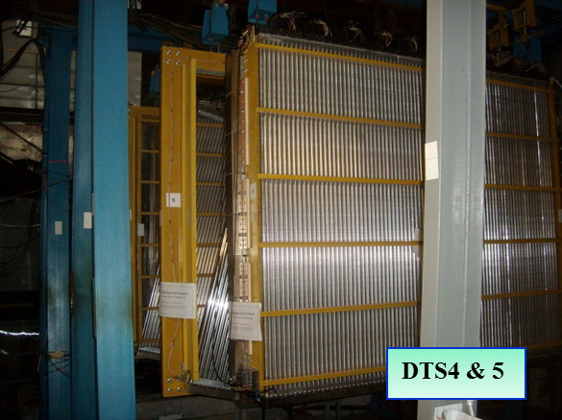
SPASCHARM 14: tracking system

Slide 25
Commisioning
The pilot version of the SPASCHARM setup was commissioned in 2018:
  Work with beam: 124 shifts (6 hout each) March 12 – April 12
  March 12-23: 46 shifts Commissioning itself
  March 23 –April 6 56 shifts with polarized target (partially commissioning)
  April 06-12 22 Shifts Carbon and empty target
Finally on “tapes” events with min.bias trigger:
  ~800 Mevents with polarized target (400 Mevents of them during commissioning phase)
  ~300 Mevents on Carbon and empty target
Totally: about 10^9 events for analysis

Slide 26
Problems found at analysis of Comissioning run and found solutions
Low efficiency and instability of drift tube chambers – new gas station developed and produced
Small amount of tracking planes before magnet – New station (15 mm tubes) produced
Broken PCY1 – replaced and repaed
EM5 (crate controller) and EM3 (TDC) – instabilities – new version of FPGA programming

Slide 27
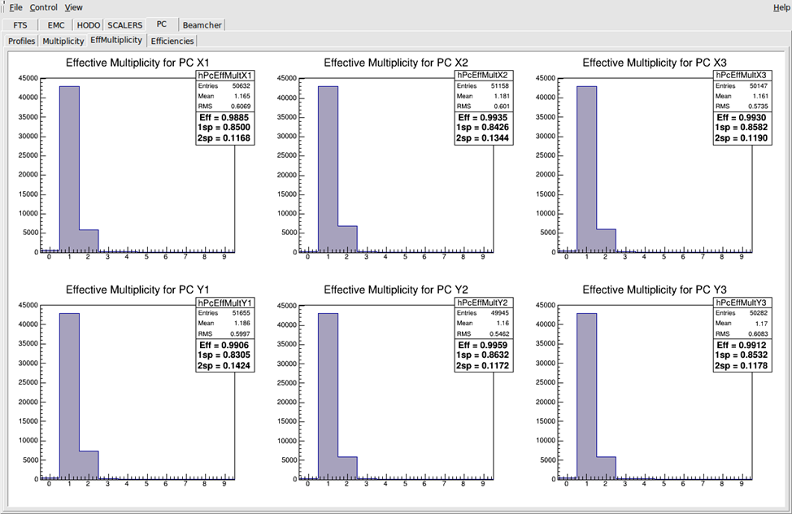
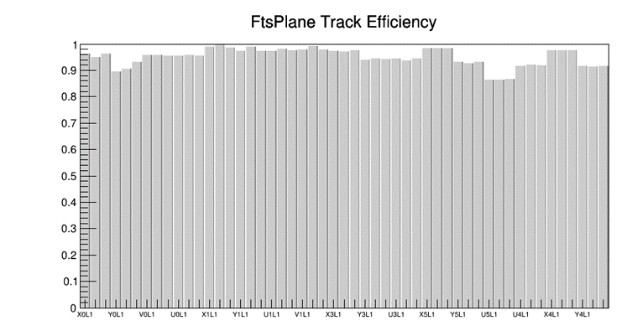
Tracking system efficiency
Efficiency in 2022 is even higher for all planes (96-98% foe “small” tubes and 94-97% for “large” ones (received from reconstructed tracks)

Slide 28
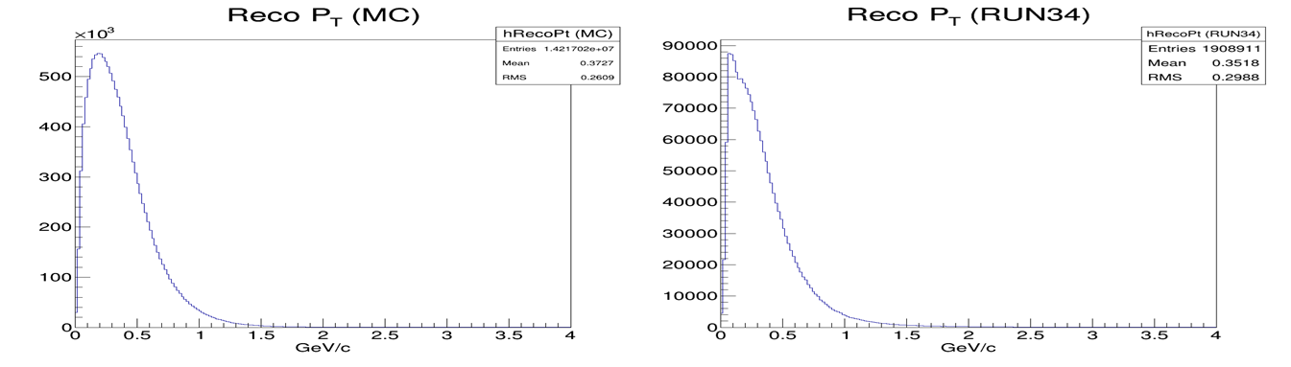
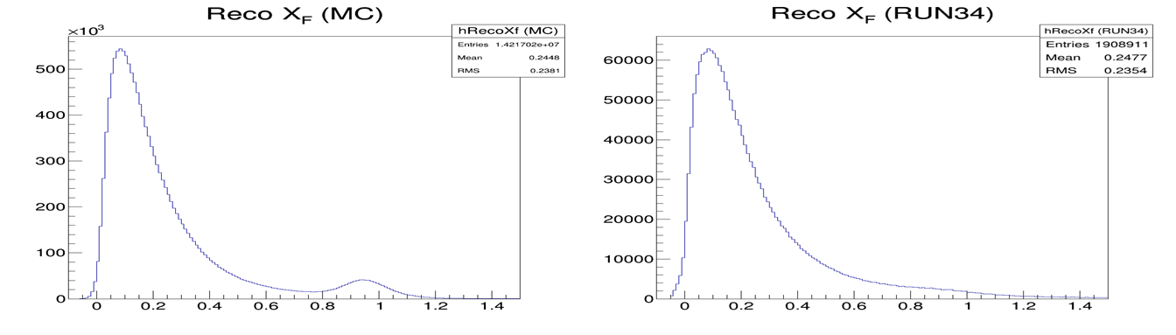
SPASCHARM 14: current activities
Analyzing first experimental data in reactions:
π⁻ + p↑ → π⁻ X, π⁻ + p↑ → π⁺ X

Slide 29
Expected statistical accuracy δA_{N} for π±
δA_{N} (π⁺) | 0.0<X_{F}<0.1 | 0.1<X_{F}<0.2 | 0.2<X_{F}<0.3 | 0.3<X_{F}<0.4 | 0.4<X_{F}<0.5 | 0.5<X_{F}<0.6 | 0.6<X_{F}<0.7 | 0.7<X_{F}<1.0
0.0<P_{T}<0.5 | 0.004 | 0.004 | 0.007 | 0.011 | 0.017 | 0.025 | 0.035 | 0.035
0.5<P_{T}<4.0 | 0.106 | 0.019 | 0.012 | 0.013 | 0.016 | 0.021 | 0.026 | 0.021
δA_{N} (π⁻) | 0.0<X_{F}<0.1 | 0.1<X_{F}<0.2 | 0.2<X_{F}<0.3 | 0.3<X_{F}<0.4 | 0.4<X_{F}<0.5 | 0.5<X_{F}<0.6 | 0.6<X_{F}<0.7 | 0.7<X_{F}<1.0
0.0<P_{T}<0.5 | 0.004 | 0.004 | 0.006 | 0.008 | 0.010 | 0.013 | 0.016 | 0.013
0.5<P_{T}<4.0 | 0.078 | 0.013 | 0.009 | 0.009 | 0.011 | 0.013 | 0.015 | 0.010
On average expected statistical accuracy is about 1%.
Study of systematics is required (including simulations)
and under way

Slide 30
Interest in K⁰ and ω(782)
The spin asymmetries in the production of K-meson have special interest because final state contains an s-quark, which, unlike u- and d-quarks, comes from the ‘sea’.
K⁰ registration is simple, even without PID.
Significant spin effect (asymmetry) was observed in exclusive production of ω(782).
Branching ratio of ω(782)->π⁺π⁻π⁰ is (89.2±0.7)%

Slide 31
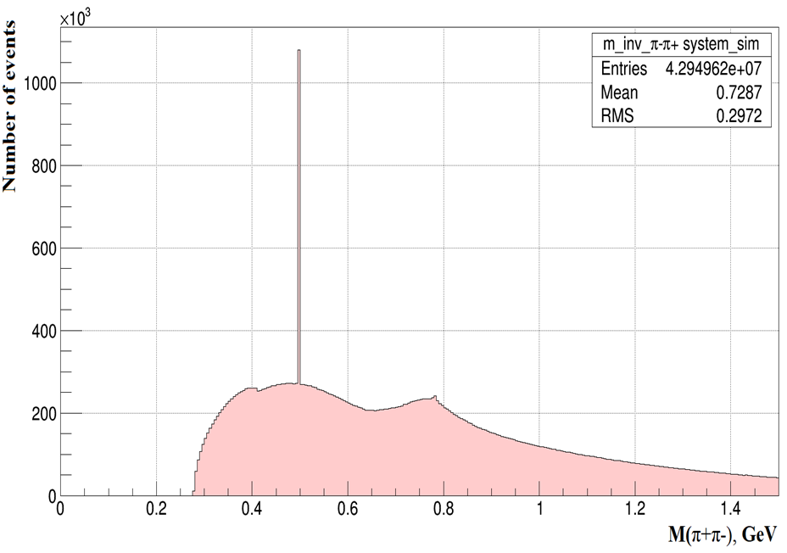
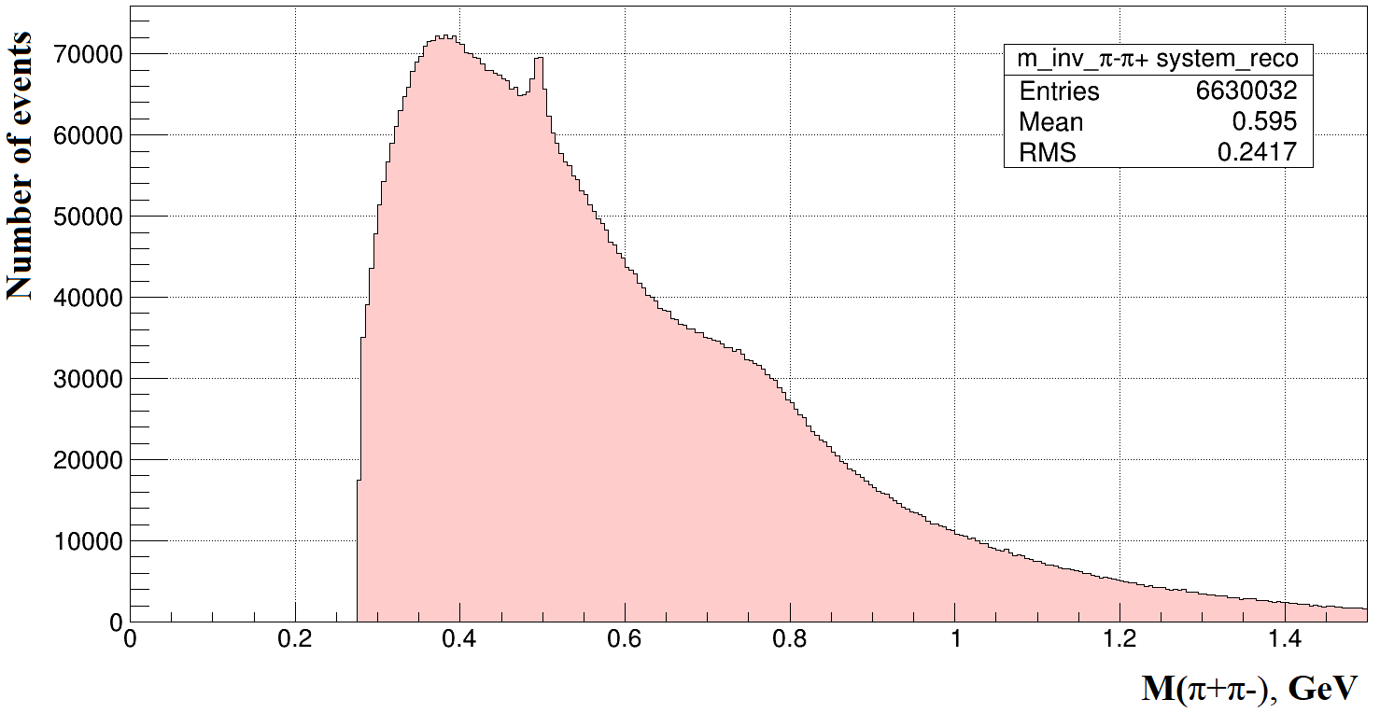
h⁺h⁻ mass spectrum
Reconstructed mass M for π⁺π⁻ pairs for True MC tracks (a) and for reconstructed MC h⁺h⁻ tracks (b)

Slide 32
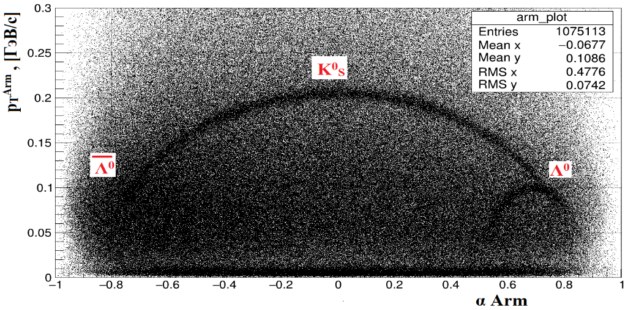
K⁰ reconstruction cut criteria
The Z-coordinate of the secondary vertex >8 cm from the primary vertex
Distance between h⁺ and h⁻ tracks <0.6 cm
The criterion of Armenteros-Podolyansky

Slide 33
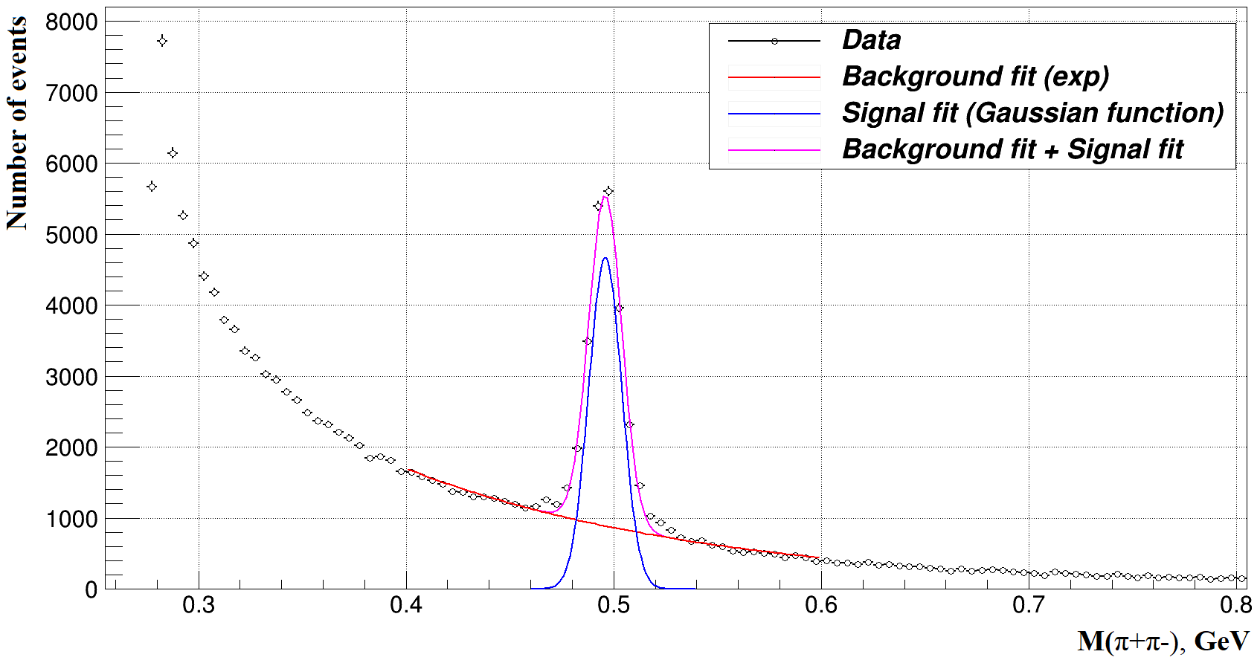
Invariant mass spectrum for min-bias events after all kinematics cuts
K⁰ width is about 8 MeV/c²

Slide 34
Expected statistics and accuracy
GeV/с | 0 < p_{Z} ≤ 4.0 | 4.0 < p_{Z} ≤ 8.0 | 8.0 < p_{Z} ≤ 12.0 | 12.0 < p_{Z} ≤ 16.0 | p_{Z} > 16.0
0 < p_{T} ≤ 0.25 | 6.6∙10⁵ | 1.6∙10⁶ | 5.0∙10⁵ | 9.3∙10⁴ | 3.2∙10⁴
0.25 < p_{T} ≤ 0.5 | 3.0∙10⁵ | 2.4∙10⁶ | 1.1∙10⁶ | 3.0∙10⁵ | 1.1∙10⁵
0.5 < p_{T} ≤ 1.0 | 3.0∙10³ | 1.0∙10⁶ | 1.3∙10⁶ | 4.6∙10⁵ | 1.6∙10⁵
p_{T} > 1.0 | - | 4.9∙10³ | 1.1∙10⁵ | 1.1∙10⁵ | 5.0∙10⁴
GeV/с | 0 < p_{Z} ≤ 4.0 | 4.0 < p_{Z} ≤ 8.0 | 8.0 < p_{Z} ≤ 12.0 | 12.0 < p_{Z} ≤ 16.0 | p_{Z} > 16.0
0 < p_{T} ≤ 0.25 | 0.016 | 0.01 | 0,018 | 0.043 | 0.073
0.25 < p_{T} ≤ 0.5 | 0.024 | 0.008 | 0.012 | 0.024 | 0.039
0.5 < p_{T} ≤ 1.0 | 0.237 | 0.013 | 0.011 | 0.019 | 0.033
p_{T} > 1.0 | - | 0.186 | 0.039 | 0.039 | 0.058

Slide 35
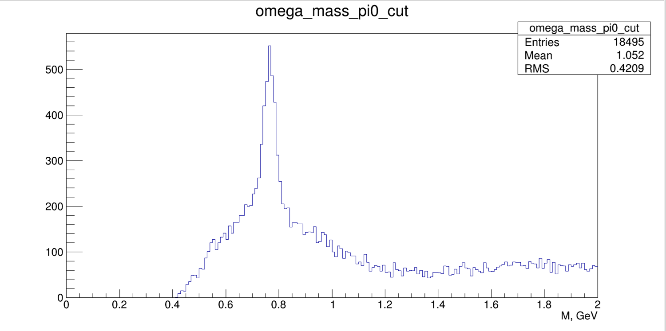
Reconstructed mass M for π⁺π⁻π⁰ clusters with cut on π⁰ mass

Slide 36
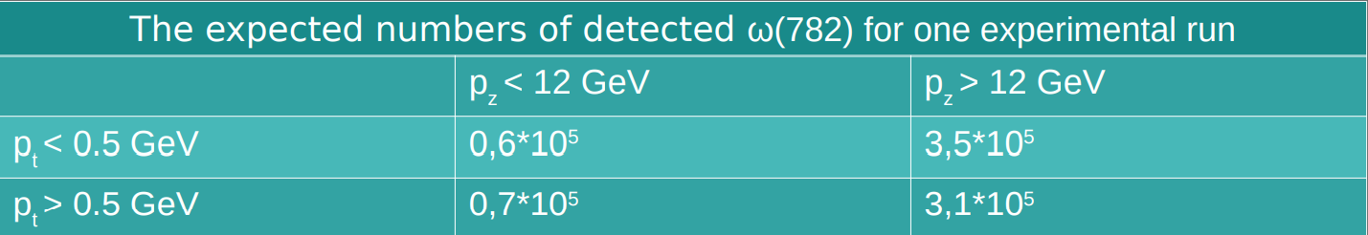
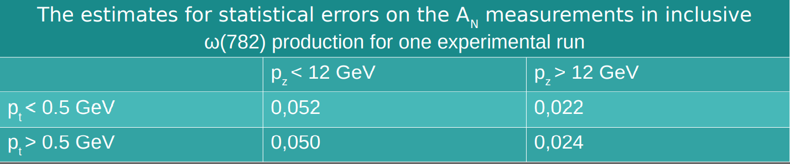
Expected statistic and accuracy for ω(782) measurements

Slide 37
Run 2021 preliminary plan
A_{N} measurements in charged pion, K⁰ and ω(782) production with polarized target
were destroyed due to COVID-19 limitations in Moscow region and JINR
New program:
  Precise study of Dilution factor
  A-dependence of vector-mesons and Λ-hyperon production
  Spin density matrix of vector mesons (?)
  Λ-hyperon polarization (?)

Slide 38
SPASCHARM plans
Data tacking run with polarized target (2022?)
Add big drift chambers (PINP-ITEP)
Add new beam detectors (together with MEPhI)
  New fiber hodoscope
  Beam profilometer and prototype of tagging station for beam-line 24
Realistic simulation

Slide 39
SPASCHARM 24 collaboration+
IHEP, JINR, PINP, ITEP, MEPhI
Future collaborators (when polarized beam project will start):
BINP (Novosibirsk) – Spin flipper, RICH
Mainz – PWA analysis
Mainz, Bonn, Bochum – target, tracking system
Charles University (Prague), Trieste University
JINR (BLTP, VBLHEP)

Slide 40

Conclusion
The fixed target SPASCHARM experiment will systematically study polarization phenomena in hadronic reactions at U70.
The universal setup will detect dozens of reactions, produced on a (non)polarized proton and nucluar targets. Measurements are planned for different types of beams (π±, K±, p, $\overline{p}$), including unique polarized antiproton beam. Different polarization observable will be studied In parallel A_{N}, P_{N}, A_{NN}, A_{LL}, D_{NN}, ρik, …
Pilot version of the SPASCHARM experiment was commissioned and first data were accumulated.
We are on the way to analyze first data and accumulate new ones.

Slide 41
Backup slides

Slide 42
The momentum distributions of particles entering the recoil and scattering hodoscopes
The recoil particles
The scattered particles.
Blue line is elastic processes, red - diffraction processes
Signal Background
S / (S + B) = 0.995

Slide 43
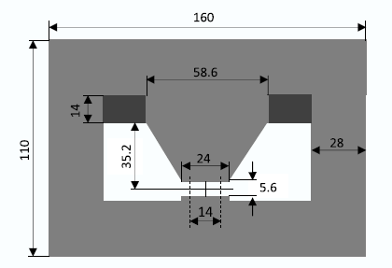

Slide 44
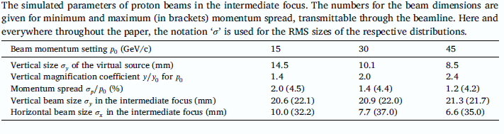

Slide 45
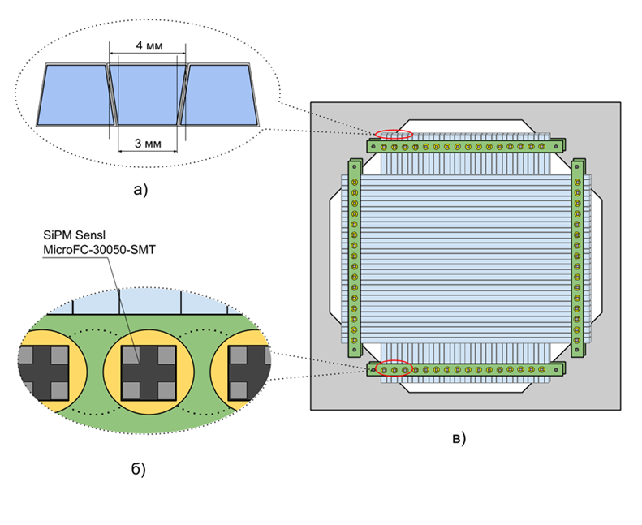
Hodoscope of tagging system

Slide 46
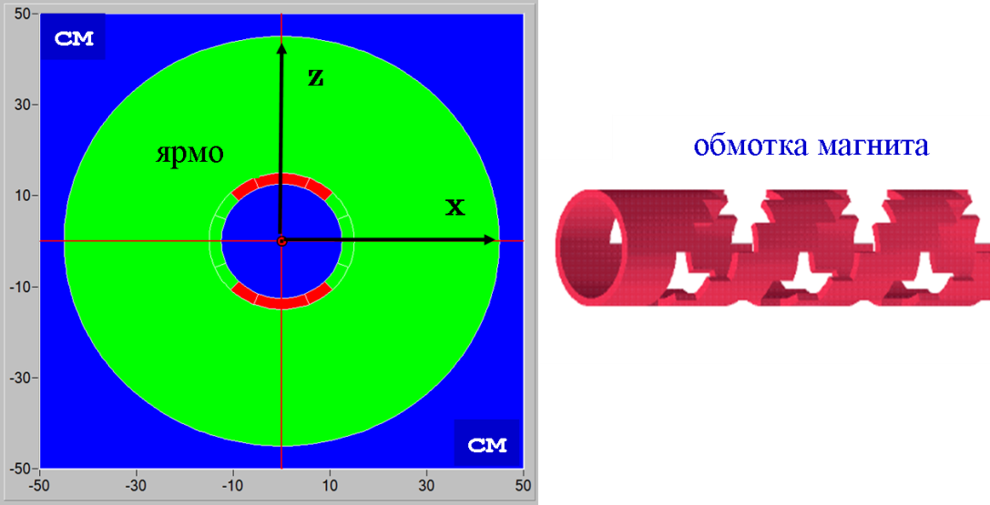
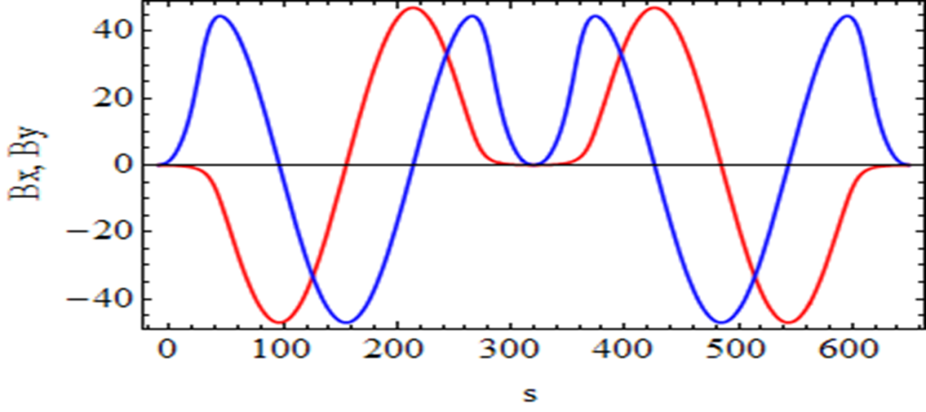
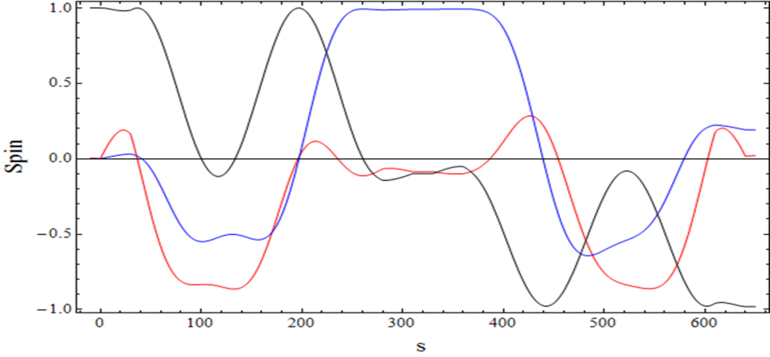
SPIN flipper (Shatunov Talk)
2 Helical magnets:
B_{max} = 47 kGs; λ= 2.5 m
Correctors:L=30 cm; B= 23 kGs; tilt = ± 0.1 rad;
Total length 6.5 m
Flipper optics: practically is equal to empty straight 6.5 m;
Spin transparency ≈ 97%

Slide 47
Project schedule (if money in 2022)
Final design (beamline and setup zone) – 2022-2023
Shashlyk calorimeter - 2023-2026
Spin flippers and cryogenics – 2023-2026 ;
RICH detector – 2024-2027 ;
Beamline end all civil construction – 2025-2026;
Polarimeters and beam control and tagging system - 2023-2025
Beam commissioning 2026-2027
First data taking run with polarized proton beam - 2027

Slide 48


SPASCHARM 14:
Polarized target magnet
Dipole magnet with conventional ‘warm ‘ copper coils and ferromagnetic (permendur) poles
Length (poles): 1 m
Aperture width: 80 mm
Variable vertical gap: 75 mm (closed yoke), 315 mm (open yoke)
Nominal coil current: 1.4 kA, power consumption: 300 kW
Closed yoke: Magnetic field in the aperture B = 2.4 T (!!!)
Open yoke: Magnetic field in the aperture B ≈ 0.4 T
Critical requirement
The uniformity of magnetic field of 2.4 T in the target volume of D = 18 mm & L=200 mm must be better than ~1.5×10⁻⁴
Aggravating factor: all ferromagnetics are close to saturation

Slide 49


Current (transverse) polarized target
Target material: pentanol C₅H₁₂O with TEMPO radical
Polarization value: up to 75% Dilution factor 7.3
Target dimensions: length 200 mm, diameter 18 mm
Target thickness: 13.2 g/cm² which is ~10% of interaction length for 28 GeV pions and ~15% - for 50 GeV protons
Polarized target operates at extremely low
temperature achieved by dilution of He₃ in He₄:
The RF-pumping of polarization takes place in 2.4 T magnetic field at RF-frequency of ~70 GHz at the temperature of ~ 100 mK
Polarization decay time is ~1000-2000 hours in 0.4 T magnetic field at the temperature of 30-40 mK- Polarization reversal: every 1-2 days
Target is created and operated by JINR

Slide 50

Magnet correction
RMS=(4.28±0.08)×10⁻⁴ | RMS=(1.86±0.07)×10⁻⁴ | RMS=(1.28±0.07)×10⁻⁴
(ΔB/B)_{MAX} = 2.5×10⁻³ | (ΔB/B)_{MAX} = 8.4×10⁻⁴ | (ΔB/B)_{MAX} = 7.8×10⁻⁴
Pol – N/A | POL=69% | POL > 70%

Slide 51



Spectrometer magnet
$$\begin{matrix}⋱ & X \\ Y & ⋱\end{matrix}$$ | 0 | 175 | 350 | 525 | 700
0 | 1.47493 | 1.40385 | 1.19856 | 0.89180 | 0.57204
100 | 1.49826 | 1.42978 | 1.22662 | 0.91376 | 0.58583
200 | 1.56563 | 1.50726 | 1.31544 | 0.98377 | 0.62758
300 | 1.67228 | 1.63846 | 1.48690 | 1.11726 | 0.69716
400 | 1.80469 | 1.81748 | 1.80361 | 1.34885 | 0.79707
500 | 1.86657 | 1.93767 | 2.25813 | 1.72721 | 0.93284

Slide 52




Характеристики трековой системы

Slide 53



New detectors

Slide 54

EMC
720 of lead-glass cells of the size 38×38×450 mm³, depth ~18X₀
Covered area: H×V ≈ 1.15×0.92 m²
Photodetectors: FEU-84
Energy resolution: σ_{E}/E ≈(14-16)%/√E, E in GeV
Distance from the target: 11 m

Slide 55

Система сбора данных
Average event size: ~2 kBytes
Data acquisition rate: ~(3-4)*10⁴ events/spill

Slide 56




Система медленного контроля

Slide 57


Previous results of single-spin asymmetry of inclusive K⁰_{s} production.
First and single result of single-spin asymmetry measurement for K0s was obtained in 1990 . (See Fig. 4 and Fig. 5)
B.E Bonner, et. al., Phys. Rev. D., v. 41 (1990) 13
Fig.4 Measured asymmetry versus K0s Feynman x (x_{F}) in p↑+Be →K⁰_{s}+X reaction.
Fig.5 Measured asymmetry versus K0s x_{T} in p↑+Be →K0s+X reaction.
It is interesting to check that result in other experiments (like SPASCHARM) and study the asymmetry in extended kinematic ranges (for x_{F} and p_{T})
7
N. Kalugin, 5th International Conference on Particle Physics and Astrophysics

Slide 58
SPASCHARM 14 collaboration
В.В. Абрамов, И.Л. Ажгирей, В.И. Бармин, Н.И. Беликов, А.А. Борисов, С.И. Букреева, А.Н. Васильев, В.И. Гаркуша, Ю.М. Гончаренко, А.А. Деревщиков, В.Н. Запольский, В.Г. Заручейский, Н.К. Калугин, В.А. Качанов, А.С. Кожин, В.А. Кормилицын, А.К.Лиходед, Е. Маслова, В.А. Маишеев, Ю.М. Мельник, А.П. Мещанин, Н.Г. Минаев, В.В. Моисеев, Д.А.Морозов, В.В. Мочалов, К.Д. Новиков, Л.В. Ногач, А.Орешков, В.С. Петров, С.В. Пославский А.Ф.Прудкогляд, С.В. Рыжиков, А.В. Рязанцев, П.А. Семенов, В.А. Сенько, С.Р.Слабоспицкий, М.М.Солдатов, Л.Ф. Соловьев, А.В. Узунян, Р.М.Фахрутдинов, Н.А.Шаланда, В.И. Якимчук, А.Е. Якутин
NRC Kurchatov Institute – IHEP
Н.А. Бажанов, Н.С. Борисов, И.С. Городнов, А.Б. Лазарев, А.Б. Неганов, Ю.А. Плис, О.Н.Щевелев, Ю.А. Усов, Ю.Н.Узиков
JINR
А.А. Богданов, М.Ф. Рунцо, М.Б. Нурушева, В.А.Окороков, В.Л. Рыков, В.М. М.Н. Стриханов
NRNU MEPhI
И.Алекссев, Б.Морозов, В. М. Нестеров, Д.Новинский, В.В. Рыльцов, Д. Н. Свирида, В.В. Тясин
NRC Kurchatov Institute ITPE, NRC Kurchatov Institute - PINP

Slide 59

Первые измерения односпиновой асимметрии в Протвино
В 1978 г. (почти 40 лет!) первые исследования с использованием поляризованной протонной мишени ИФВЭ-ОИЯИ

Slide 60


IHEP/1968 -1977
HERA Collaboration (France-USSR)
Polarization in elastic scattering of particles and antiparticles on polarized protons at 40 and 45 GeV.
Pomeron may carry the spin flip interaction (the first experimental hint)
Polarization in the elastic scattering of particle and antiparticle is not equal each to other with opposite sign in general, as it was predicted in the asymptotic model [S.M. Bilenky et al. 1963]
The energy variation of polarization depends on the type of particles and the magnitude of t.
Spin rotation parameter is consistent with the Chou - Yang model of rotating hadronic matter.
Chirality conservation hypothesis does not work

Slide 61


Поляризация в реакции π⁻p↑→π⁰n
Поляризация P(t) в области 0<|t|<0.35 (GeV/c)² равна (5.0±0.7)%.
Существует локальный минимум в области при t=-0.25 (GeV/c)^{2.}
Поляризация имеет минимум в области минимума в дифференциальном сечении.
Поляризация осциллирует.
V.D. Apokin et al., Sov. J. Nucl. Phys. 45:840, 1987, [Yad.Fiz.45:1355-1357,1987]
V.D. Apokin et al. Z.Phys.C15:293,1982

Slide 62



Поляризация в реакциях π⁻p↑→ηn and π⁻p↑→η’(958)n
Поляризация в реакции π⁻p↑→ηn при 40 ГэВ велика в широком интервале 0.05<-t<1.6 (GeV/c)² и достигает величины A_{N}=(-44±11)% в области |t| 0.8-1.6 (GeV/c)²
Минимум поляризации достигается в точке изменения наклона сечения
Поляризация меняет знак при -t=1.8 (GeV2/c)² .
Среднее значение поляризации в реакции π⁻p↑→η’(958)n в области 0.05< -t <0.5 (GeV2/c)² составляет (-17± 8)%.
V.D. Apokin et al., Z.Phys.C35:173,1987.

Slide 63




Асимметрия в реакциях π⁻p↑→ω(783)n и π⁻p↑→f₂(1270)n
I.A. Avvakumov et al. Yad.Fiz.42:1146,1985
ω регистрируется в моде распада πγ (branching 8.9%).
Асимметрия велика в обеих реакциях
Асимметрия минимальна примерно в области изменения наклона сечения как для ω,
так и для f₂
V.D. Apokin et al. Yad.Fiz.47:727-730,1988]

Slide 64

Статистика с использованием пи- пучка
Большое число реакций (диссертаций?)

Slide 65

Статистика с использованием каонного и антипротонного пучка
№ | частица | N_{EV} | S/B | № | частица | N_{EV} | S/B
1 | π⁺ | 2.1·10⁸ |  | 7 | n | 1.6·10⁷
2 | π⁻ | 2.6·10⁸ |  | 8 | ñ | 1.4·10⁸
3 | K⁺ | 1.7·10⁷ |  | 9 | Λ̃→ p̃ π⁺ | 2.1·10⁶ | 10
4 | K– | 2.2·10⁷ |  | 10 | Λ̃→ ñ π⁰ | 1.1·10⁶ | 0.13
5 | p | 1.6·10⁷ |  | 11 | Δ̃⁻⁻→ p̃ π⁻ | 4.2·10⁷ | 0.14
6 | p̃ | 1.8·10⁸ |  | 12 | Ξ⁻→ Λ π⁻ | 1.0·10⁵ | 10

