Slide 1
Study of hadron properties at PANDA
V. Mochalov (IHEP, Protvino)
on behalf of the PANDA collaboration

Slide 2
content
Short introduction: FAIR, HESR & PANDA
  (FAIR – Facility for Antiproton and Ion Research)
  (HESR – High Energy Storage Ring)
  (PANDA– antiProton ANnihilation at DArmstadt)
  Hadron Physics
  PANDA experiment advantages
  Charm spectroscopy
  Light exotics
  Baryon studies
Conclusion

Slide 3
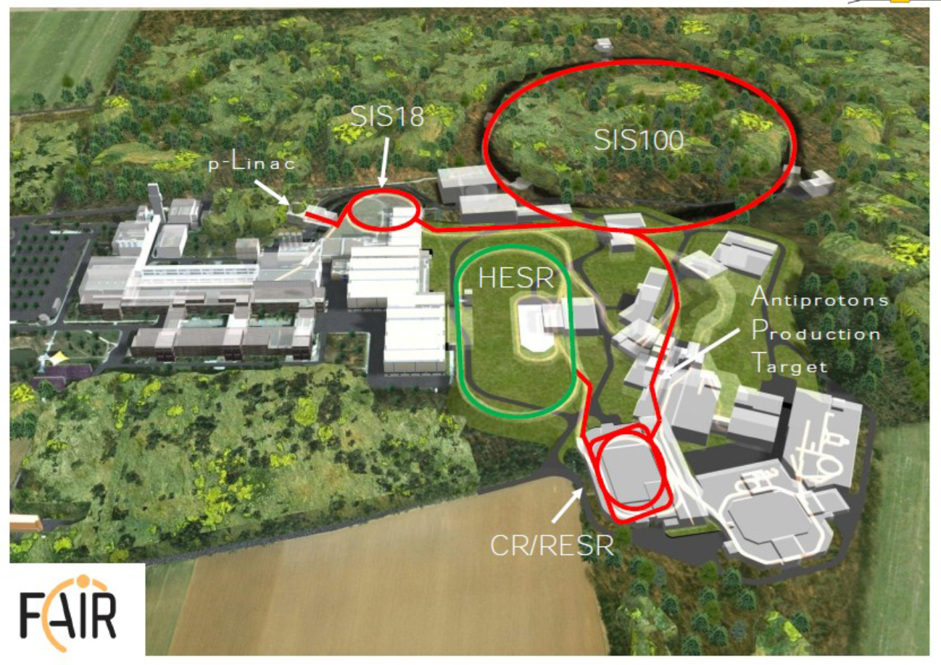
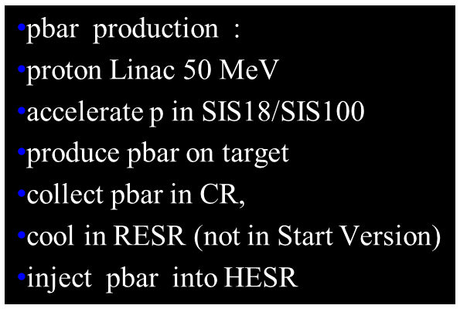
FAIR facility
Areal view July 27th, 2013

Slide 4
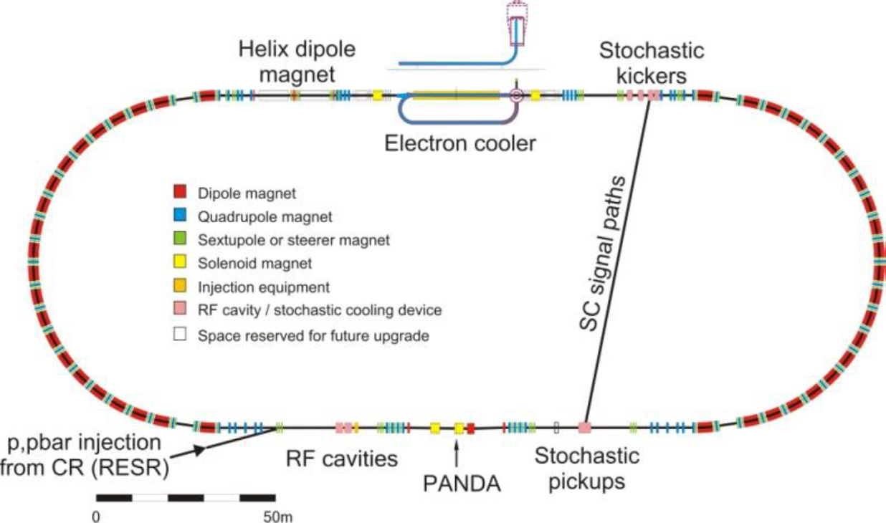

FAIR facility
$\overline{p}$ beam with momentum from 1.5 GeV/c up to15 GeV/c on a proton fixed target (or nuclear target), average interaction rate 20 MHz, √s from 2.25 up to 5.46 GeV, d<100 μ
High intensity mode
  Stochastic cooling, p≥ 3.8 GeV/c
  10¹¹ antiprotons stored
  Luminosity up to 2⋅10³² cm⁻² s⁻¹
  Δ p/p = 2 ⋅ 10⁻⁴
High resolution mode
  e- cooling, 1.5≤ p≤ 8.9 GeV/c
  10¹⁰ antiprotons stored
  Luminosity up to 2 ⋅10³¹ cm⁻² s⁻¹
  Δ p/p = 4⋅10⁻⁵

Slide 5
Main detector requirements
Capability to detect events with high rate (up to 2 · 10⁷ s⁻¹ interactions)
Nearly 4π solid angle for large acceptance and PWA
p±, K±, p±, e±, μ±, γ identification
Displaced vertex detection – vertex information for D, K_{S,} Σ, Λ (cτ = 317 μm for D±)
Photon detection from 10 MeV to 10 GeV
Efficient event selection & good momentum resolution
Self-triggered electronics
Free streaming data
20 MHz interaction rate
Complete real-time event reconstruction

Slide 6
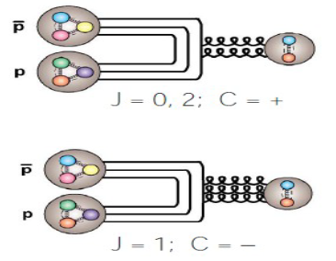
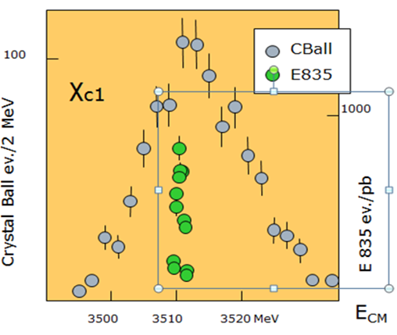
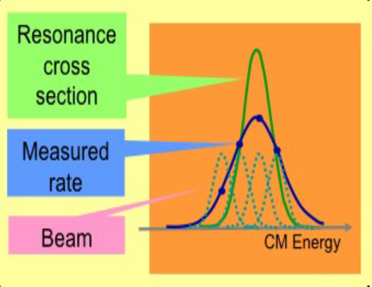

PANDA ADVANTAGES
Possibility to produce directly all quantum numbers (only J^{PC}=1⁻⁻ are allowed in direct production at e⁺e⁻ colliders).
In the formation mode, masses and widths will be measured very accurately. The accuracy of mass and width measurements depends only on the beam parameters, not on the detector resolution. Detector characteristics are important for selection of a given final state and background suppression
Typical resolution:
e+e- Crystal Ball: ~ 10 MeV
$\overline{p}$p Fermilab: 240 keV
$\overline{p}$p PANDA: ~30-100 keV

Slide 7
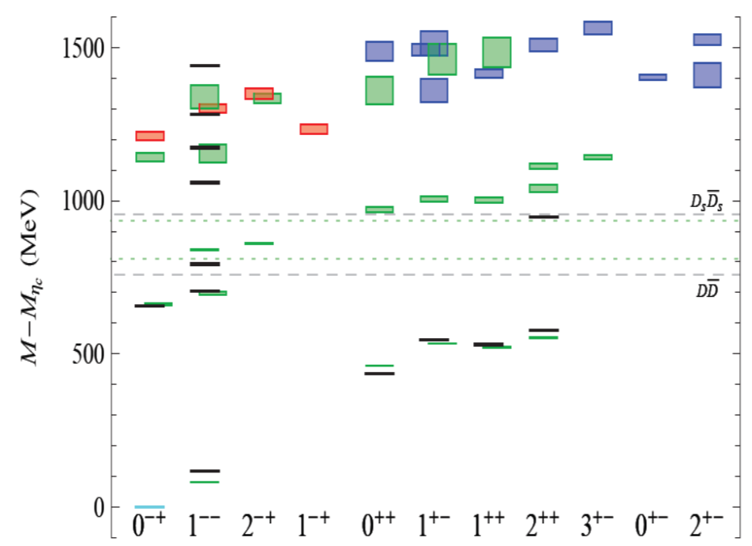
Lattice QCD charmonium spectra
lightest supermultiplet
first excited supermultiplet
other states (cc)
L. Liu et al, arXiv: 1204.5425v1 [hep-ph]

Slide 8
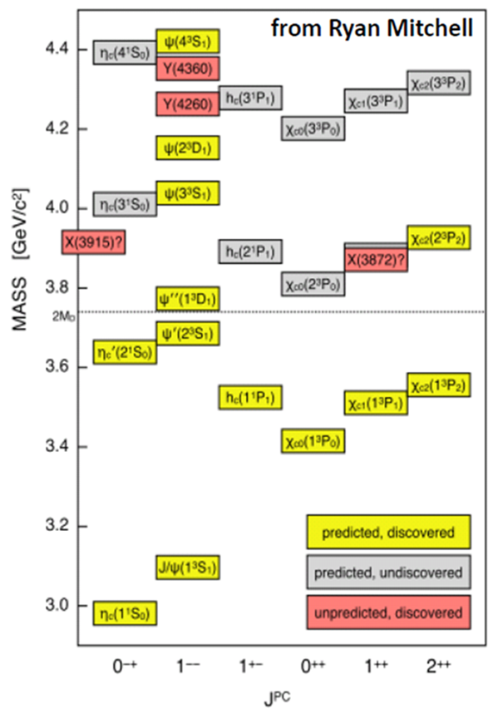
Charm spectroscopy
All charmonium states below open charm threshold are observed
All charmonium 1⁻⁻ states are observed
Above open charm threshold:
  many expected states are not observed
  many unexpected ones are observed
States with high angular momentum predicted in potential models (J>3) have to be verified for theory’s confirmation(?).
Suppressed at B factories, they may be observed at PANDA

Slide 9
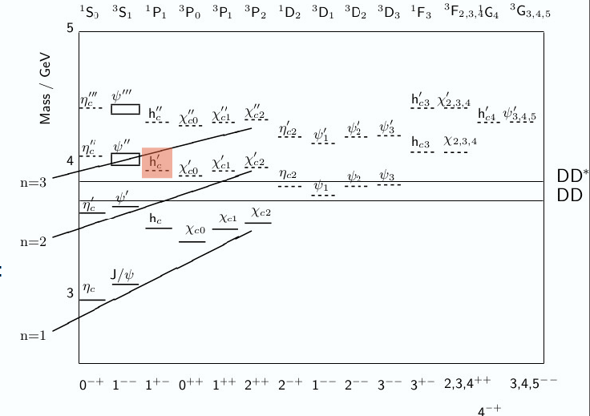
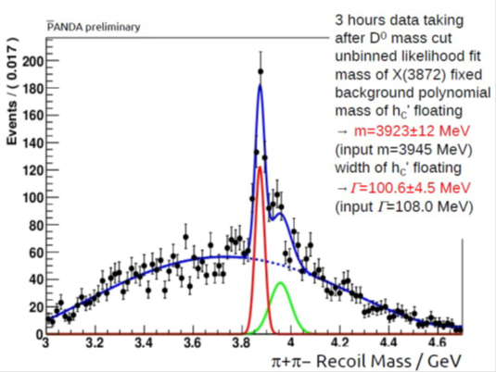
Study of high
The h’_{c} (n=2, ¹P₁, m=3934-3956 GeV) state with J^{PC}=0⁻⁺ is one of the yet unobserved states
h_{c} (n=1) was never observed in B decays, as 0 ⁻⁺→0 ⁻⁺1⁺⁻ is forbidden
h_{c} (n=1) was observed at CLEO and BESIII in the isospin violating decay
ψ⁰→h_{c}π⁰
MC simulations were performed for the decay p(bar)p→ (π+π−)recoil+h’_{c}
S. Lange
Cross-section simulation 4.5 nb for h’_{c} and 50 nb for X(3872)
arXiV:1311.7597 [hep-ex]

Slide 10
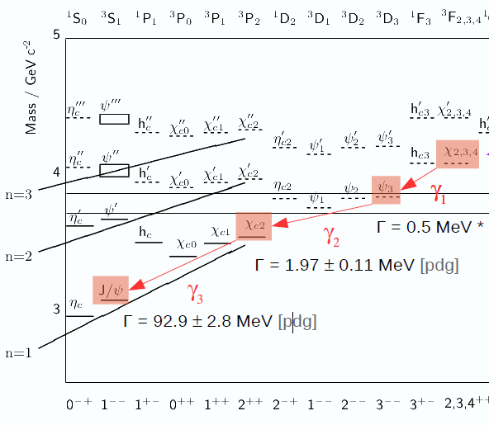

Radiative Cascade for 3F4 (= 2S+1LJ ) cc state
Disadvantage of using the h_{c}’ is that the width is as large as Γ=87 MeV.
On the other hand, the yet unobserved ³F₄ state is more appropriate due to its very narrow predicted width of 8.3 MeV
³F₄ state predicted, never seen (Suppressed search in BES III, Belle II)
PANDA can do this search
Xsection 10 nb used
Recoil mass technique is used
arXiV:1311.7597 [hep-ex]

Slide 11

X (3872) puzzle
The case of X(3872): isospin violating, very narrow, known quantum numbers (LHCb), it;s nature is not clear.
Breaks isospin in the decays J/ψρ(->π⁺ π⁻) – isospin violation, J/ψω(->π⁺ π⁻ π⁰) → it is not charmonium?
Within Δm < 1 MeV of the DD* threshold S-wave molecular state?
Large cross-section – it is charmonium χ_{c1}(2P)?- (S.S. Gershtein, A.K. Likhoded, A.V. Luchinsky Phys.Rev. D74 (2006) 016002) - For molecule should be lower by factor 10^2)
Probably two narrow states (CDF)
X(3872) may be a mixture of usual charmonia χ_{c1}(2P)-calculated and molecule DD*
($\overline{D}D∗+$ $\overline{D}∗D$) + χ_c1(2P) it is desireable to find mechanism to suppress χ_c1(2P) production.
Charge partner? – not in the mass window neither in width found yet
Need to measure the width and channels to understand its nature
M.Galuska, PoS Bormio 2013 (2013) 023
Goal: measure the width of X(3872) to understand better its nature
In PANDA: mass resolution 20 times better than B factories
[PDG upper limit: Γ<1.2 MeV @ 90% c.l.]

Slide 12
Scanning of D-states
Many new results and update recently from LHCb: width of D_{S} is still a challenge
PANDA will scan resonance mass to determine precisely the width of D_{S}
Mass resolution ~ 100 keV
D mesons
DS mesons
courtesy of A. Palano from CHARM 2013

Slide 13
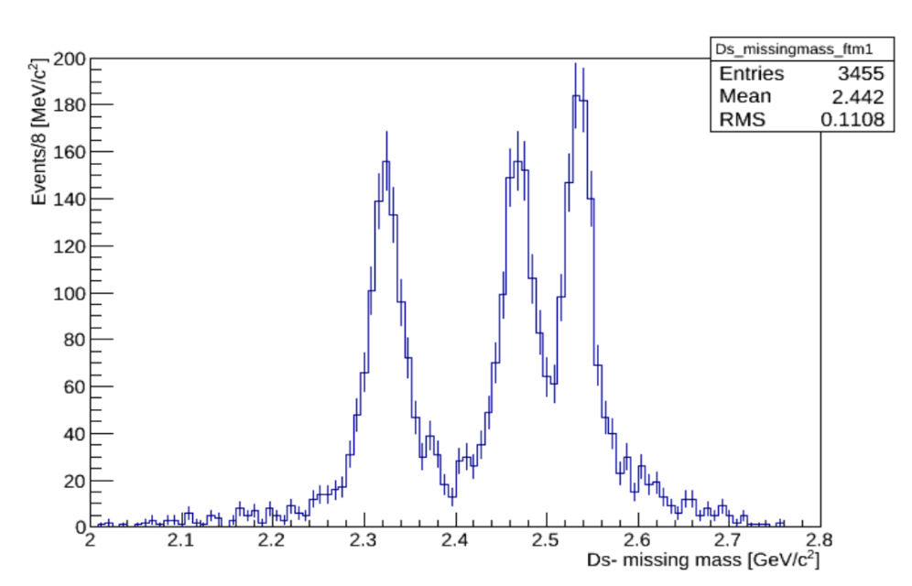
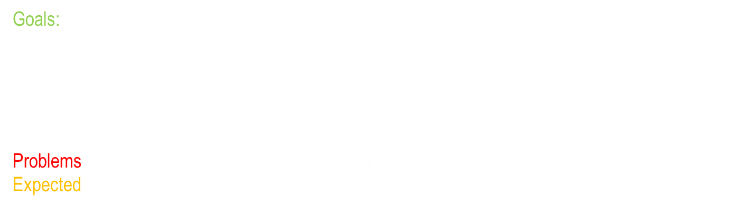
Challenges in DS meson spectroscopy
3 states included in this simulation:
D_{S}(2317), D_{S}(2460) and D_{S}(2535)
TRUTH MATCHED VALUES
p>50 MeV/c
ε = 35%
Sig+comb bkg
Fit to Sig. events
DS(2535)
DS(2460)
DS(2317)
E. Prencipe
Work in progress
E. Prencipe
Work in progress
Goals:
1. Cross section measurement in $\overline{p}$p (unknown, difficult predictions: 1-100 nb)
2. Measurement of the width with mass scan and the excitation function of cross section
3. Mixing between D states with same spin, e.g. D_{S}(2460) and D_{S}(2535)
4. Chiral symmetry breaking, involving very precise mass measurement: D_{S} (2317) and D_{S} (2460) can be interpreted as chiral partners of the same heavy-light system
Problems – background is 1000 times higher than signal
Expected – 10³-10⁵ events/day

Slide 14
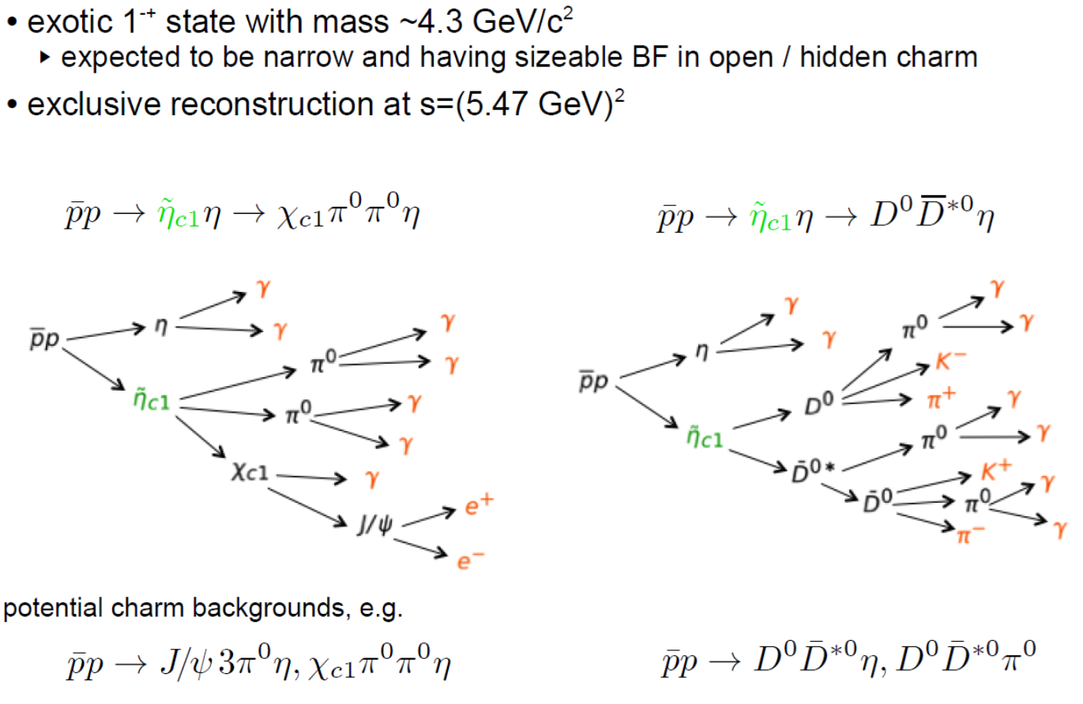
Exotic states study

Slide 15
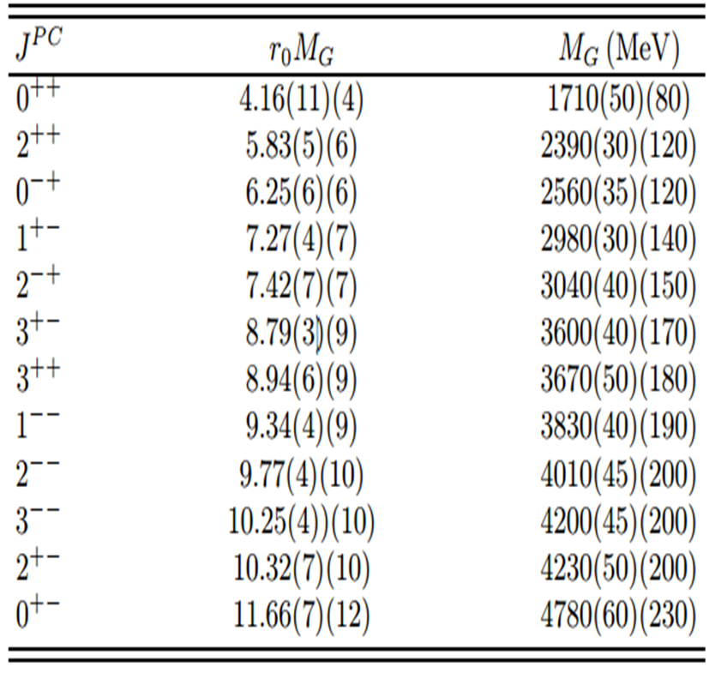
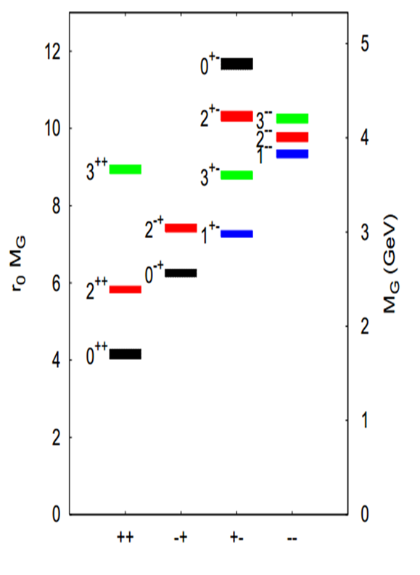
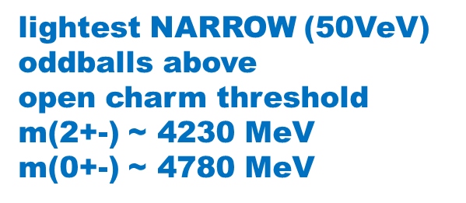
GluEballs

Slide 16
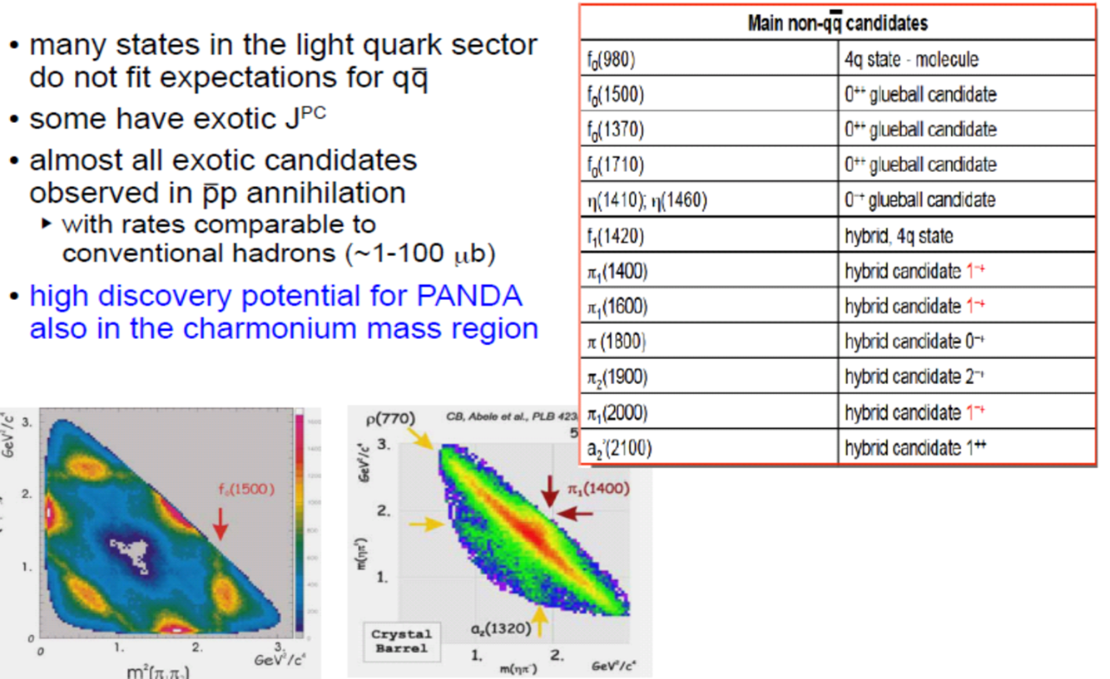
Light sector exotics
E.Prencipe Talk, ICNFP -2014, PRD 89, 112004 (2014)

Slide 17

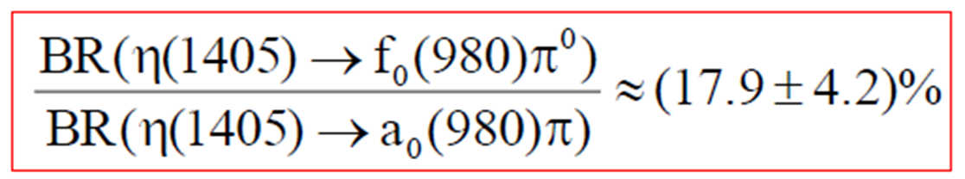
Light quark sector - Isospin breaking study
Study of channel: J/ψ → ϕϕγ → (K+K-) (K+K-) γ
Large isospin breaking: η(1440) and f0(980) showed incompability BESIII: PRL 108 (2012) 182001:
But !!!

Slide 18
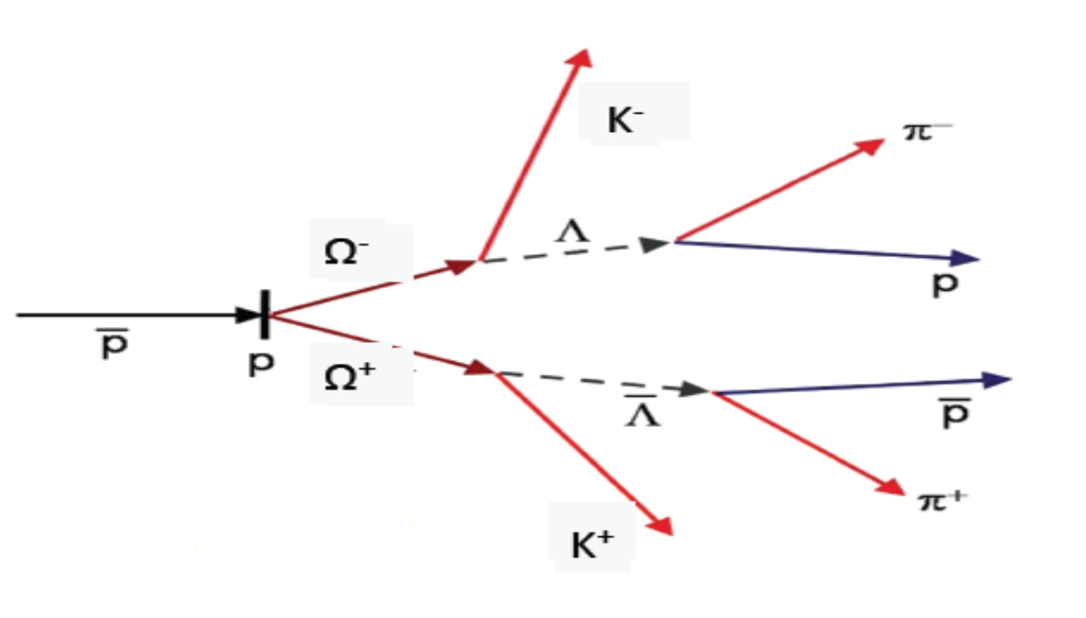
Hyperon-anti-hyperon production

Slide 19
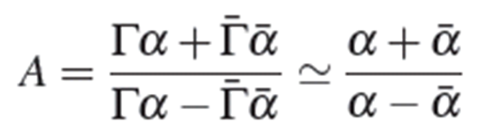
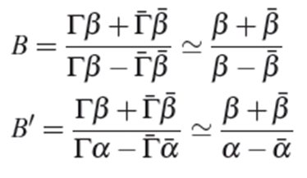
Exclusive double hyperon study
Measurement of spin observables – spin density matrix (polarization) and correlation parameters
CP violation
  In decay width Γ(Y→Bπ) and conjugate decay Γ(¯Y → ¯Bπ)
Much more with polarization:
  the asymmetry parameter α quantifies
  the tendency of the decay baryon to be
  preferably emitted in the hyperon spin direction
  With hyperon decay to another decay
  additional CP asymmetries can be achieved

Slide 20
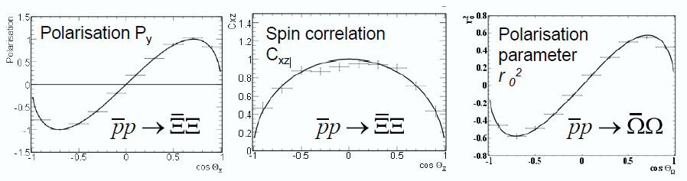
Simulations studies of polarization and spin correlations for Ξ and the recently derived polarization parameters of the Ω show excellent prospects for PANDA
Results and Plots by Erik Thomé, Ph. D. Thesis, Uppsala University (2012).

Slide 21
Physics beyond the theme of the Talk
Nucleon Structure
  Timelike Nucleon Formfactors
  Transverse momentum dependent PDF (Spin Studies in Drell-Yan Production)
Nuclear Physics
Hypernuclei:
  Production of double Λ-hypernuclei (A.Sanches Talk 25/08)
  ➔ γ-spectroscopy of hypernuclei, YY interaction
Hadrons in Nuclear Medium
  J/ψ absorption
  Mass shift of charmed hadrons in nuclear matter
Full physics program e-Print: arXiv:0903.3905 [hep-ex]
Sudol et al. EPJA 44 (2010) 373
M.C. Mora Esp´ı, PhD thesis (2012)

Slide 22
SUMMARY
The PANDA experiment will have a great potential for discovery (Glueballs, hybrids, XYZ …)
Thanks to LHCb and electron B-factories for exciting results, but still too much left to investigate:
  Annihilation process will give us the possibility to study directly gluon contribution and will give us unique possibility to investigate states with high spins and exotic quantum numbers.
  The unprecendent precision of PANDA detector and FAIR antiproton beam will allow to measure masses and width of the particle at the level of 30-100 keV to understand the nature of charmonium (-like) particles and to study interference in particle production.
  Many predicted states yet have to be observed and measured precisely at PANDA.

Slide 23
PANDA TEAM
PANDA Collaboration, 520 members, 69 Institutes, 18 Countries (2014)

Slide 24
BACKUP slides

Slide 25
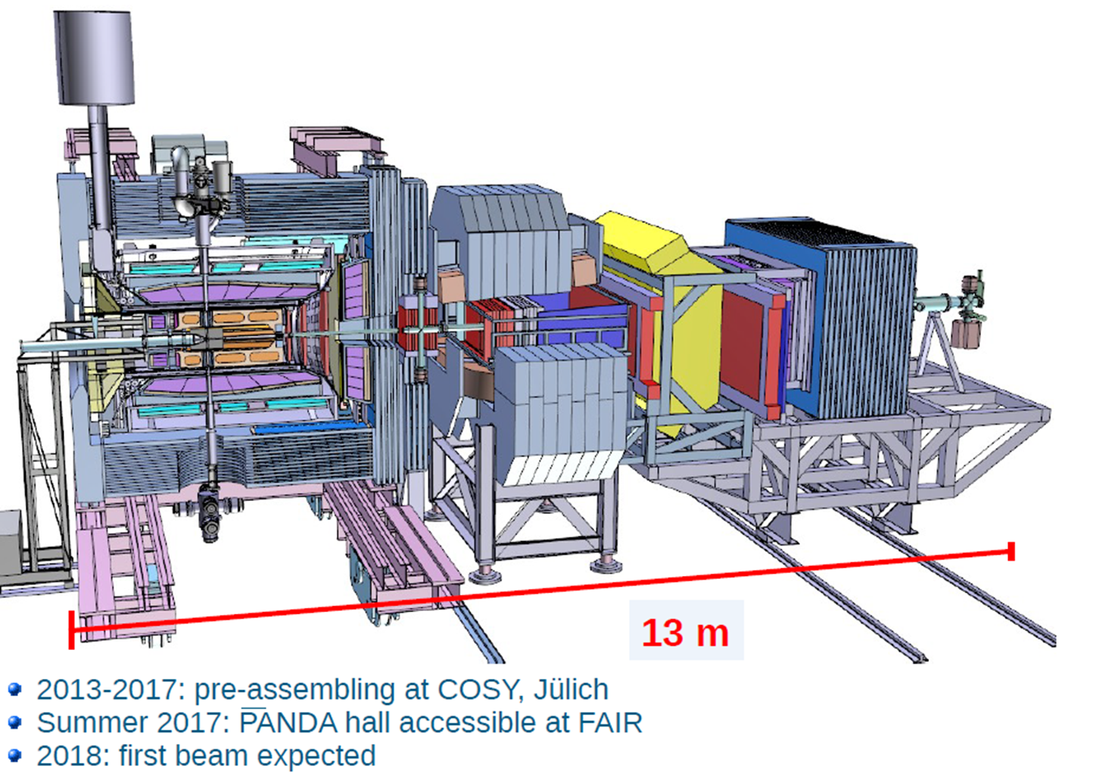
PANDA DETECTOR

Slide 26
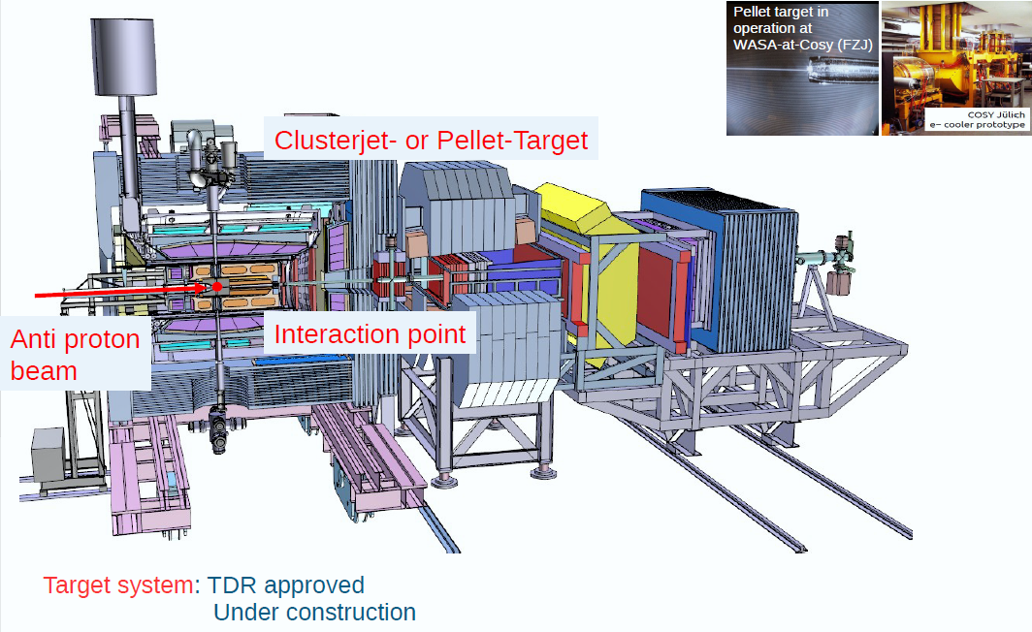

Slide 27
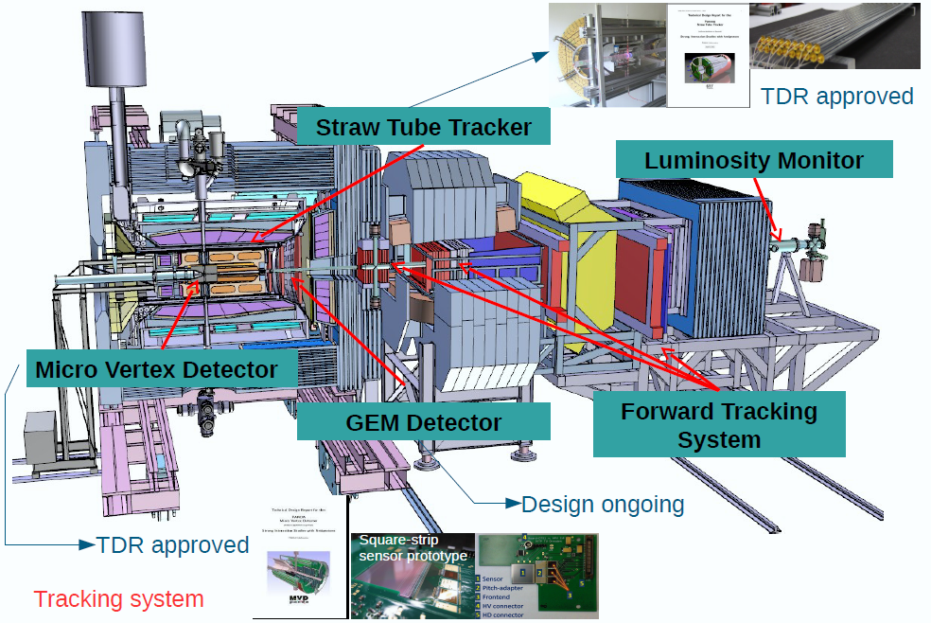
PANDA tracking

Slide 28
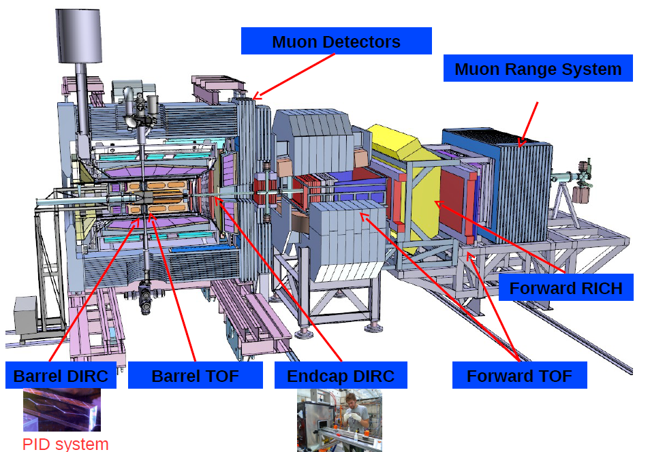
PANDA identification

Slide 29
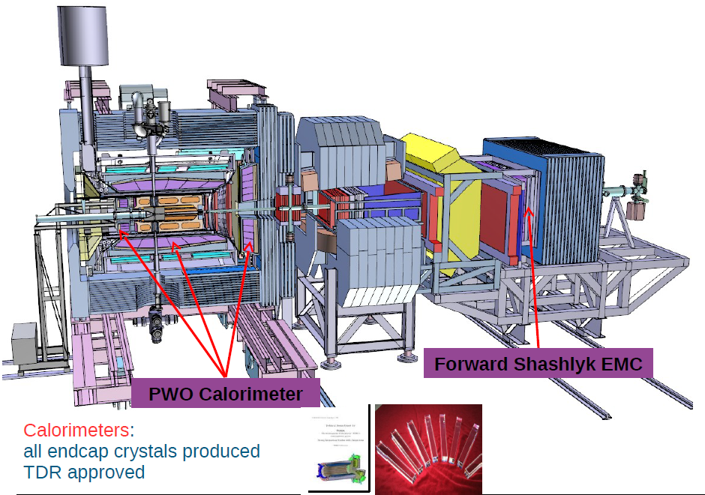
PANDA calorimeters

Slide 30
PDG 2012 states – conventional states

Slide 31
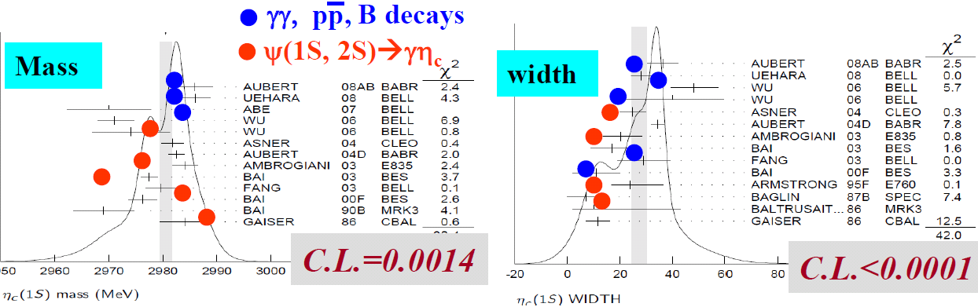
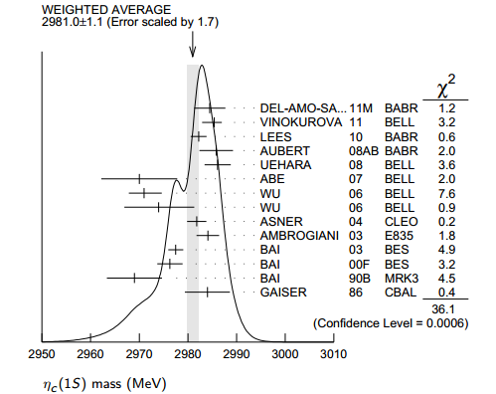
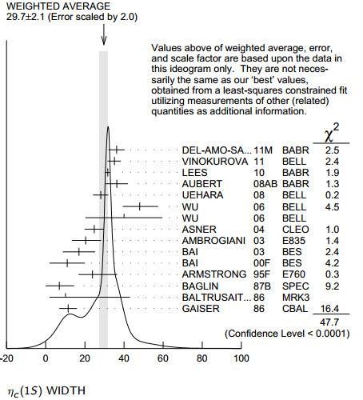
Conventional states: masses and width of η_{c}
Data from Xiaoyan SHEN Talk at PANDA-meeting

Slide 32
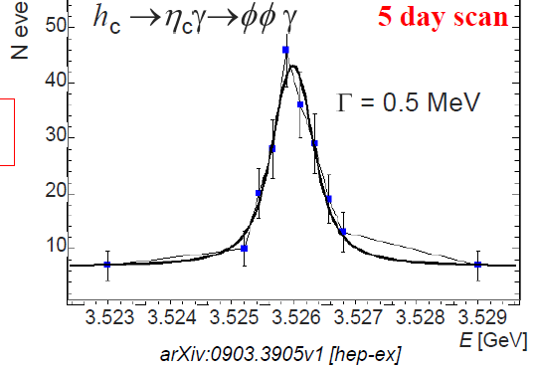
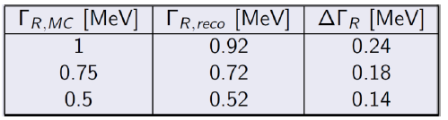
Conventional states: h_{c} width

Slide 33
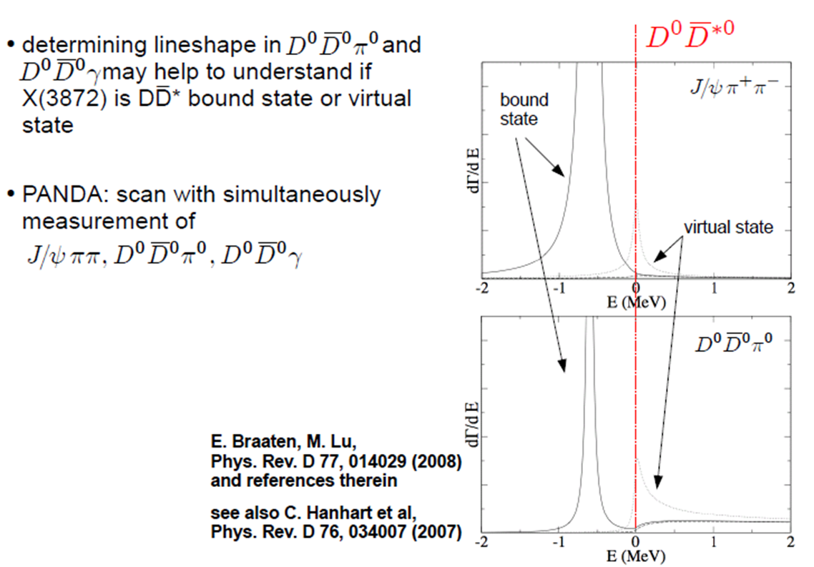
X(3872) scan

Slide 34
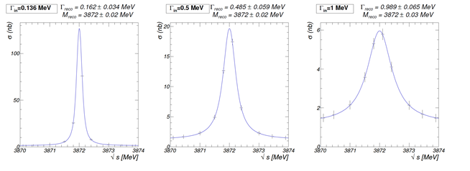
X(3872) puzzle
The mass value of M = 3871.68 ± 0.17 MeV is .05±0.27 MeV lower than the sum of masses of the D⁰ and D^{*0}
PANDA will measure width at the level of 0.1 MeV with 20 keV accuracy.

Slide 35
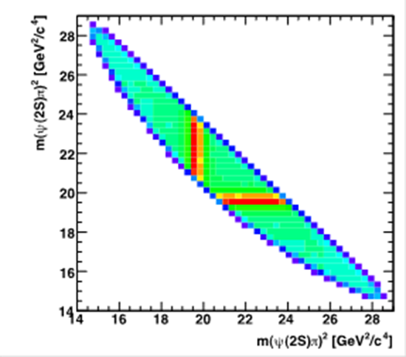
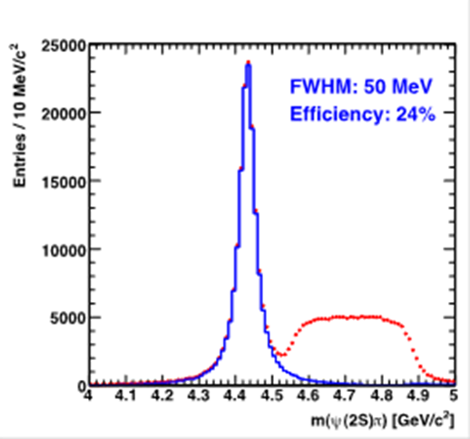
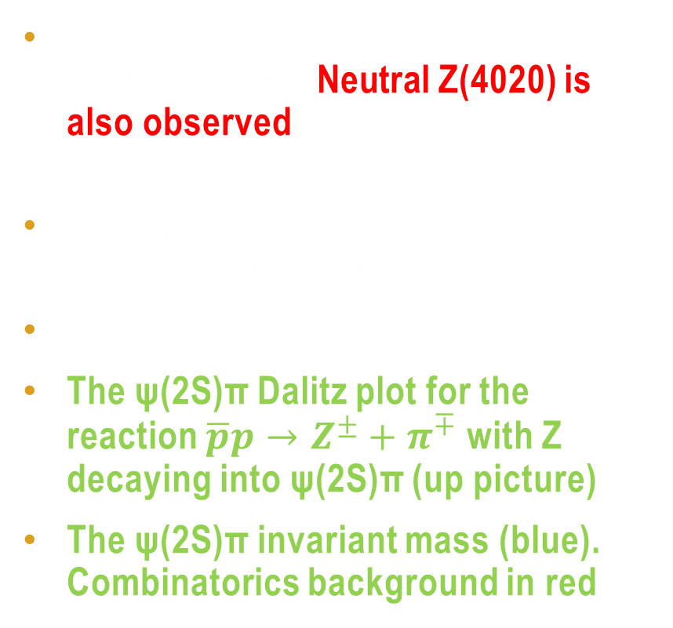
Charge study: Z(4430) and others
Charge states Z(4430), Z(4020,4025) - are observed (Neutral Z(4020) is also observed), they can not be charmonium (charged)
They must contain a cc-bar pair due to its decay into ψ’π⁺.
Decay into J/ψπ⁺ is not observed
The ψ(2S)π Dalitz plot for the reaction $\overline{p}p→Z^{±}+π^{∓}$ with Z decaying into ψ(2S)π (up picture)
The ψ(2S)π invariant mass (blue). Combinatorics background in red

Slide 36

Search for z(4430) partners
PANDA can investigate the Z⁺(4430) even further by switching to studies of the Z⁺(4430) in formation mode.
Due to the charge of the Z, this is only possible by annihilating the antiprotons on a neutron in a deuterium target. Experimentally it is no problem to replace the hydrogen gas, for example in a pellet target, with deuterium. The reaction to look for in would then be:
$$\overline{p}d→Z^{−}+p_{spectator}$$
With decay $Z^{−}→ψ(2S)π^{−}→J/ψπ^{+}π^{−}π^{−}$

Slide 37

OPEN CHARm in panda$\overline{ p}p→{D^{+}}_{s}^{}D_{}^{∗} _{s0}$(2317)

Slide 38
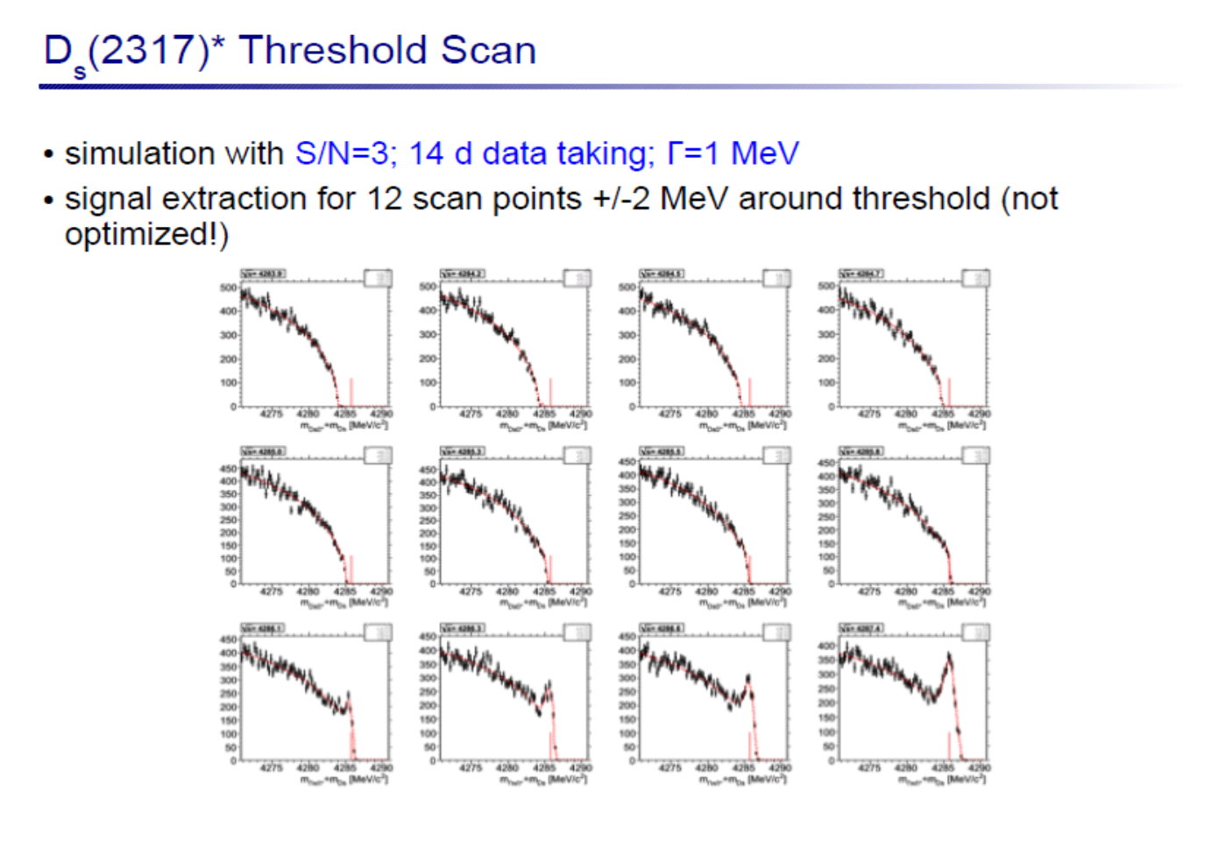

Slide 39
D_{s}*(2317) threshold scan

Slide 40
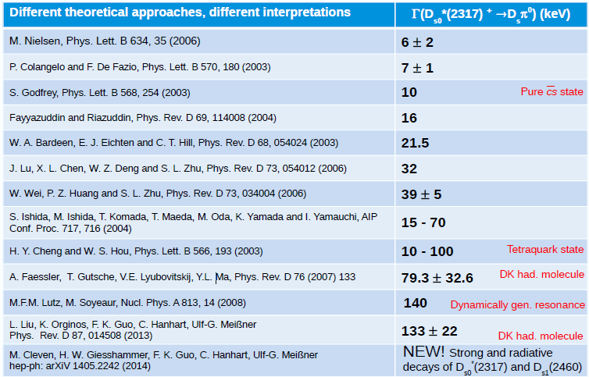
Theory predictions of Ds width

Slide 41
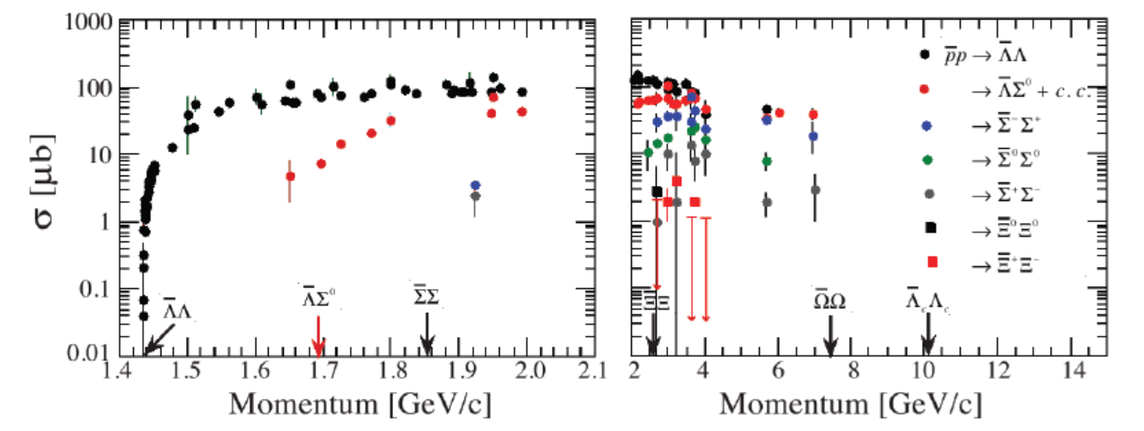
Pair Hyperon production
Almost full symmetry for the particles an anti-particles gives unique possibility to measure CP effects minimizing systematics

Slide 42
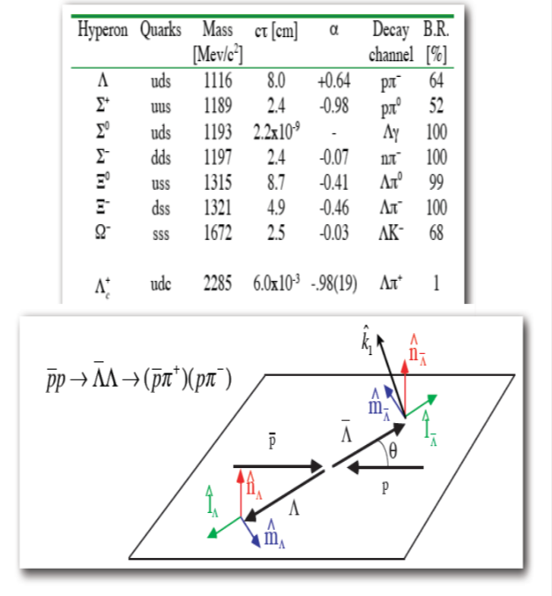
BARYON spectroscopy (Erik Thomé PHD)

Slide 43
Polarization study in

Slide 44
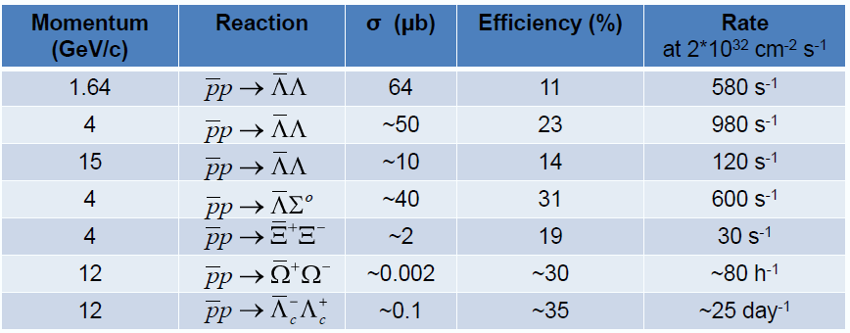
Perspectives for PANDA (2-hyperon)
Table prepared by Karin Schönning (BEACH 2014, Birmingham), based on
*Sophie Grape, Ph. D. Thesis, Uppsala University 2009
** Erik Thomé, Ph. D. Thesis, Uppsala University 2012

Slide 45
Other physics
Nucleon Structure from electromagnetic processes
  The extension of form factor measurements to the so called time-like region separating the magnetic and electric components can be performed with an order of magnitude improvement
  clean identification of dileptons can be used to measure a whole series of other electromagnetic processes like for example Drell-Yan in order to get access to the transverse spin structure functions.
Study hyper-nuclei (including - double) and charm-nuclei, when the strange (one or two) or charmed particle "implanted" into the nuclei instead of the usual nucleon
Hadrons in nuclear matter

Slide 47
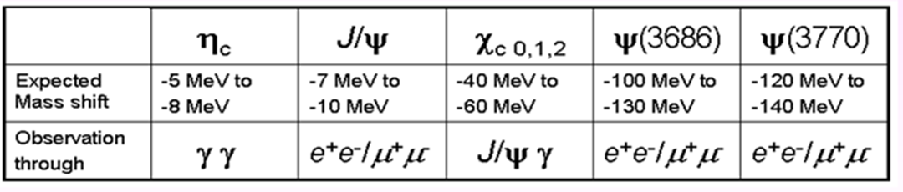
Expected mass shift in nuclear matter

