Slide 1
SPASCHARM experiment at U70
V. Mochalov
(on behalf of the SPASCHARM collaboration)

Slide 2
Outline
SPASCHARM Project
Physics – single- double spin
Polarized proton and antiproton beams
Experimental Setup
SPASCHARM current (at beamline 14)
Physics
Current experimental Setup
First run to collect experimental data

Slide 3
Motivation 1
The project is aimed at studying the spin structure of the nucleon and the spin dependence of the strong interaction at energies up to 50 GeV. The fixed target SPASCHARM experiment will systematically study polarization phenomena in exclusive and inclusive hadronic reactions.
The universal setup will detect dozens of particles, produced on a polarized proton and nuclear targets. In parallel with single-spin asymmetries, the polarization of hyperons and the elements of the density spin matrix of vector mesons will be measured.
The ultimate goal of the experiment is to study spin structure of the proton, primarily the determination of the contribution of gluons to the spin of the proton through the investigation of spin effects in the formation of various charmonium states

Slide 4
Motivation 2
The presence of polarized both protons and antiprotons in the CP neutral -system potentially opens up opportunities for studying and comparing CP conjugate reactions with one another. This allows us to look at CP invariance in a new perspective, inaccessible to collisions of unpolarized particles.
Finally, the presence of eight types of unpolarized beams (π±, K±, p, p͂, d, C), in combination with a polarized and nuclear targets, extends the range of studies of polarization phenomena by an order of magnitude and enhances the uniqueness of the project. The study of energy dependence of spin effects reveals the dynamics of interaction. The measurements might be conducted at several energies in order to estimate the model parameters.

Slide 5
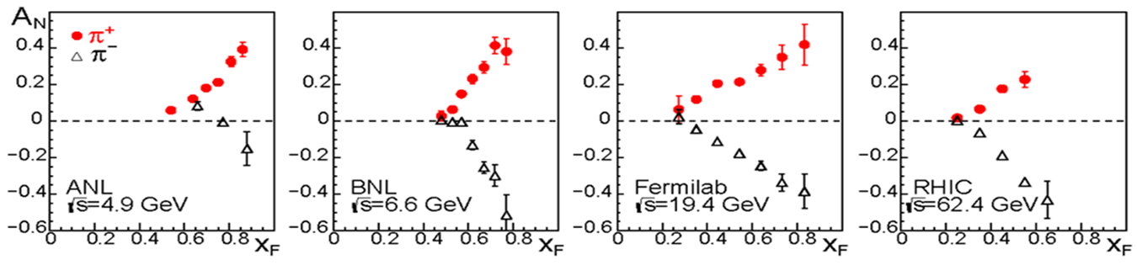
Single-spin asymmetry measurements (motivation 1)
Single–spin asymmetries and hyperon polarization almost do not depend on beam energy – accuracy is more important:
inclusive and exclusive reactions, including elastic, of the light (u, d, s – quarks) hadrons in the beam fragmentation region with polarized beam or target. The hyperon and vector mesons polarization (elements of the density spin matrix)

Slide 6
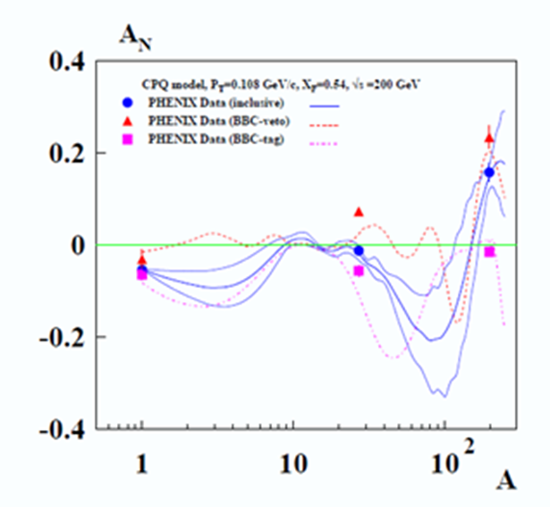
Single-spin asymmetry measurements (motivation 2)
Anomalous behavior (change of the sign) of the neutron asymmetry on nuclei (PHENIX)

Slide 7
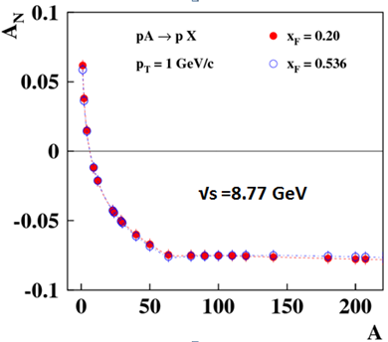
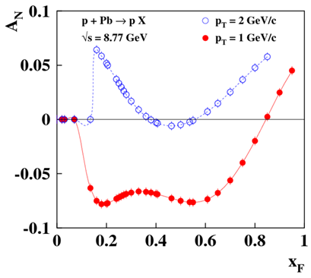
Single-spin prediction (nuclear targets)

Slide 8
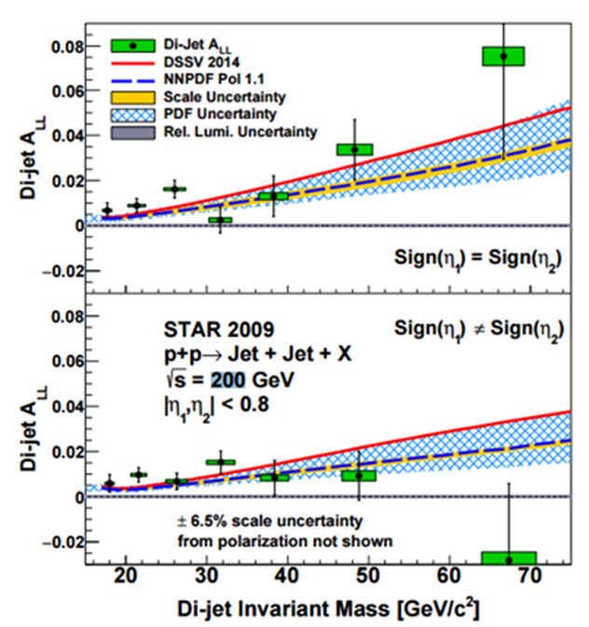
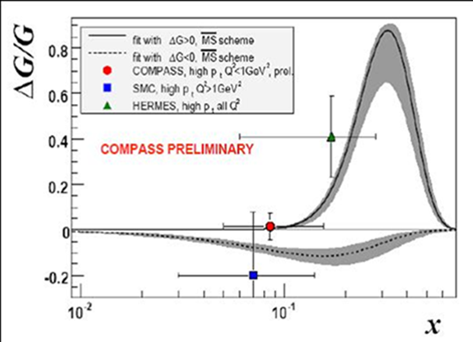
Double-spin asymmetry measurements (motivation)

Slide 9
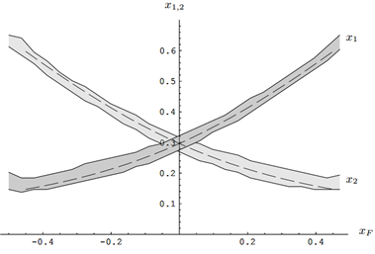
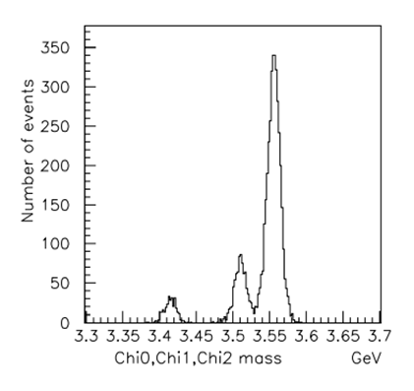
Double-spin asymmetry measurements (expectation)
Double-spin asymmetry A_{LL} in charmonium production to study gluon polarization ΔG/G(x) at large x_{F}

Slide 10
Elastic scattering
Elastic scattering is required for absolute polarimetry
Special elastic scattering measurements with own physical program (KnE Energ.Phys. 3 (2018) 326-332)
See also talk by Marina Nurusheva (later talk)

Slide 11
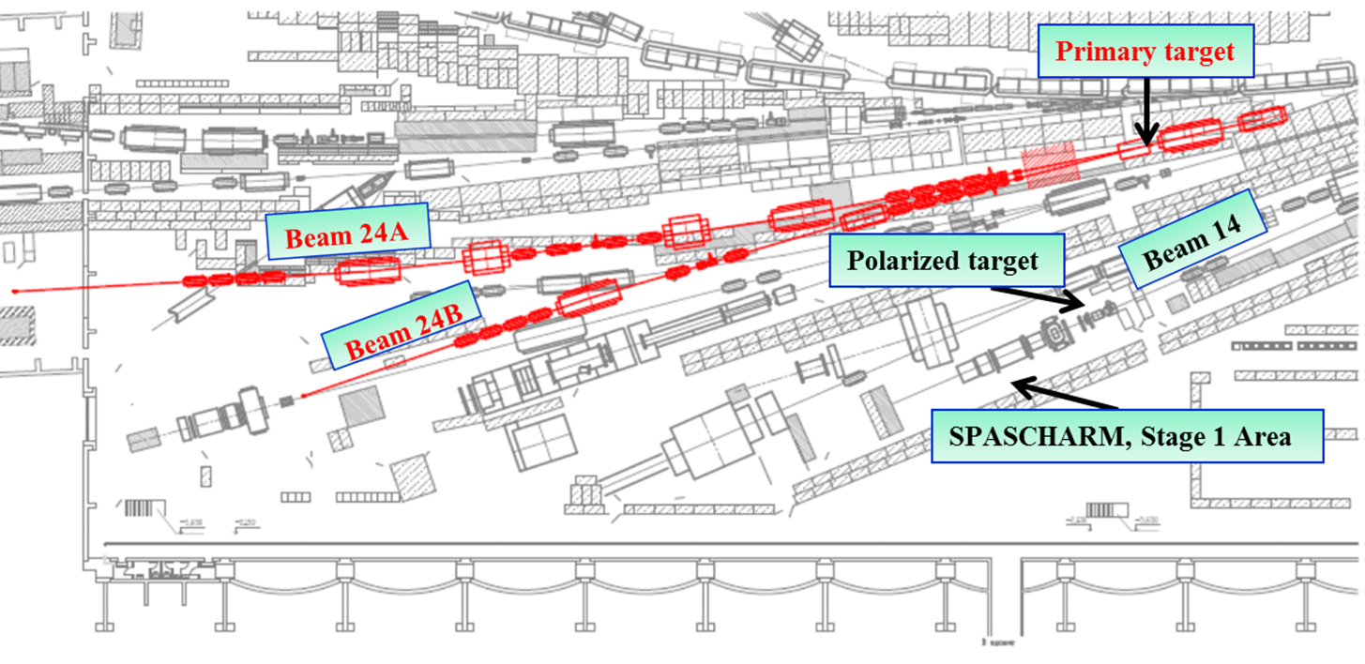
Beam-line
It is proposed to form polarized beams of protons and antiprotons in the beam channel 24A of the accelerator U-70.

Slide 12
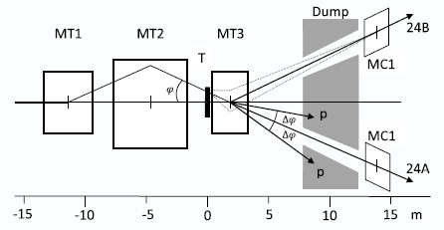
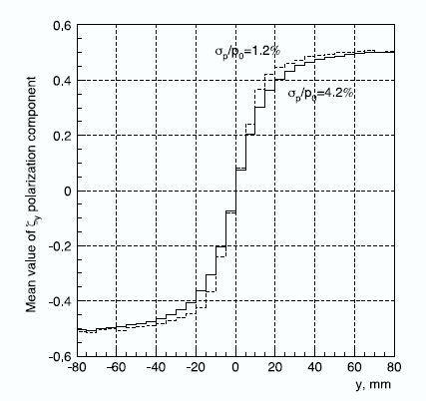
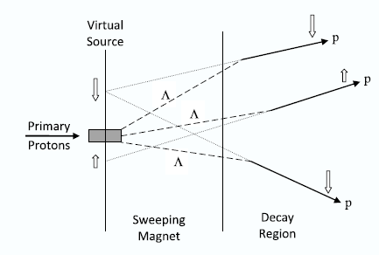
Beam target (beam extracted from U70)
MT3 parameters have been chosen as a compromise between contradictory requirements to its length : 𝐿 = 2.6 m, aperture 𝐻 × 𝑉 = 140 × 56 mm², 𝐵𝑚𝑎𝑥 = 1.9 T. Target: Aluminum plate, 400 mm long, 3 mm high, and 100 mm wide

Slide 13
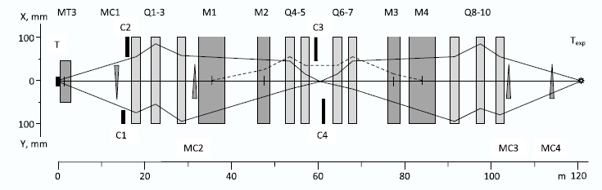
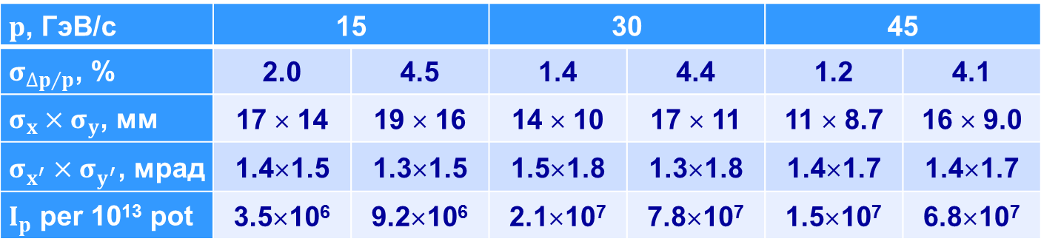
Optical scheme and properties
$p$, ГэВ/с | 15 |  | 30 |  | 45
$σ_{{∆p}/p}$, % | 2.0 | 4.5 | 1.4 | 4.4 | 1.2 | 4.1
$σ_{x}×σ_{y}$, мм | 17 × 14 | 19 × 16 | 14 × 10 | 17 × 11 | 11 × 8.7 | 16 × 9.0
$σ_{x^{′}}×σ_{y^{′}}$, мрад | 1.4×1.5 | 1.3×1.5 | 1.5×1.8 | 1.3×1.8 | 1.4×1.7 | 1.4×1.7
$I_{p}$ per 10¹³ pot | 3.5×10⁶ | 9.2×10⁶ | 2.1×10⁷ | 7.8×10⁷ | 1.5×10⁷ | 6.8×10⁷

Slide 14
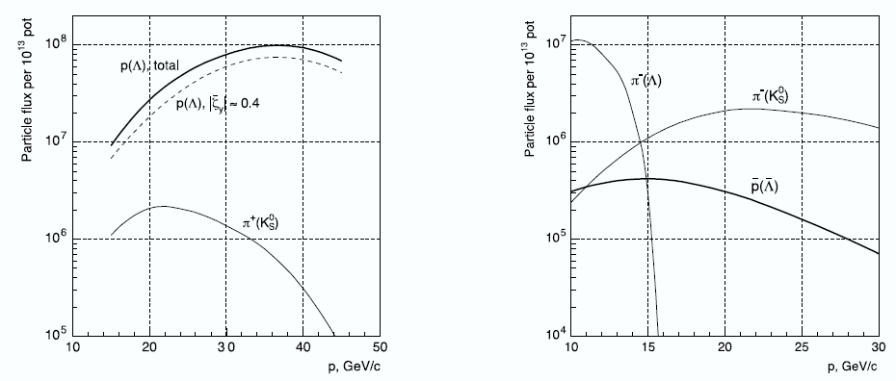
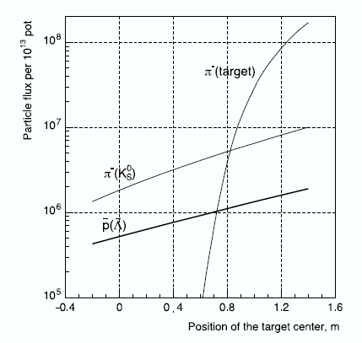
Beam intensity

Slide 15
Polarized beam summary
Calculations of the polarized beam parameters have been carried out.
The intensity of the antiproton beam with energy of 15 GeV can reach 10⁶ antiprotons per accelerator cycle (10¹⁰ antiprotons per day) for the 10¹³ primary protons from the U-70 to the primary target.
V.Abramov et al, The polarized proton and antiproton beam project at U-70 accelerator Nuclear Inst. and Methods in Physics Research, A 901 (2018) 62–68

Slide 16
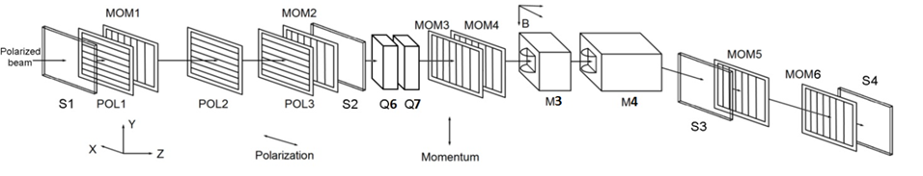
Polarimetry
Absolute polarimeter (elastic scattering)
J.Phys.Conf.Ser. 798 (2017) no.1, 012179
Journal of Physics: Conference Series 678 (2016) 012034
Inclusive pion production
Journal of Physics: Conference Series 678 (2016) 012028
Primakoff effect polarimeter
Tagging system in intermediate focus and beam momentum measurement
Intern. J. of Modern Physics: Conf. Ser. Vol. 40 (2016) 1660086

Slide 17
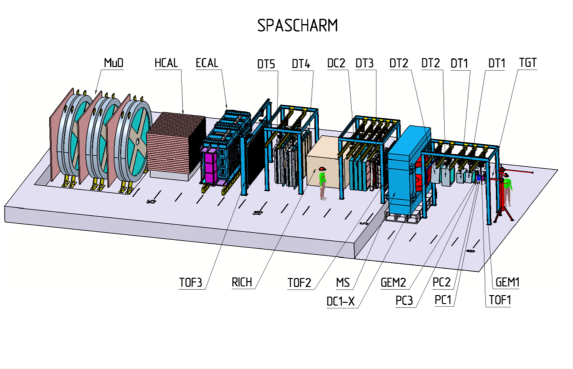
Experimental Setup

Slide 18
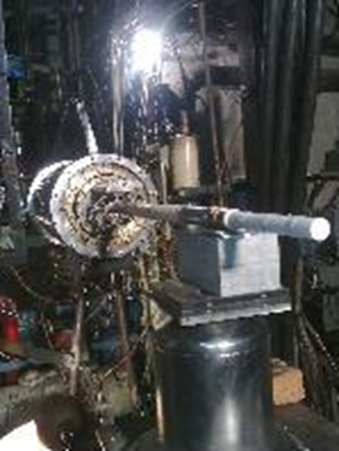
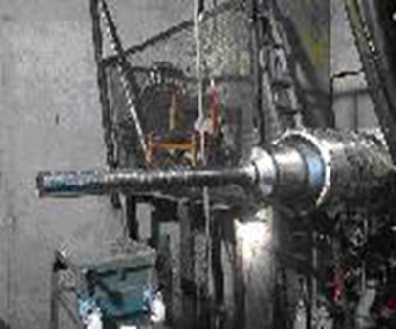
Current (transverse) polarized target
Target material: pentanol C₅H₁₂O with TEMPO radical
Polarization value: up to 75% Dilution factor 7.3
Target dimensions: length 200 mm, diameter 18 mm
Target thickness: 13.2 g/cm² which is ~10% of interaction length for 28 GeV pions and ~15% - for 50 GeV protons
Polarized target operates at extremely low
temperature achieved by dilution of He₃ in He₄:
The RF-pumping of polarization takes place in 2.4 T magnetic field at RF-frequency of ~70 GHz at the temperature of ~ 100 mK
Polarization decay time is ~1000-2000 hours in 0.4 T magnetic field at the temperature of 30-40 mK- Polarization reversal: every 1-2 days
Target is created and operated by JINR

Slide 19
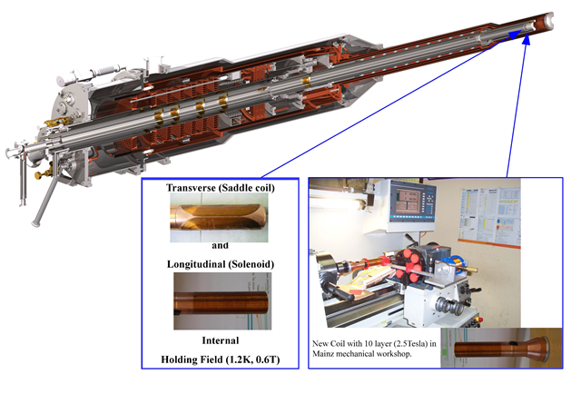
New challenging polarized target
New polarized (both transverse and longitudinal) without external holding field
Polarized target cryostat with superconducting coils
JINR-Mainz-Bonn-Bochum team

Slide 20
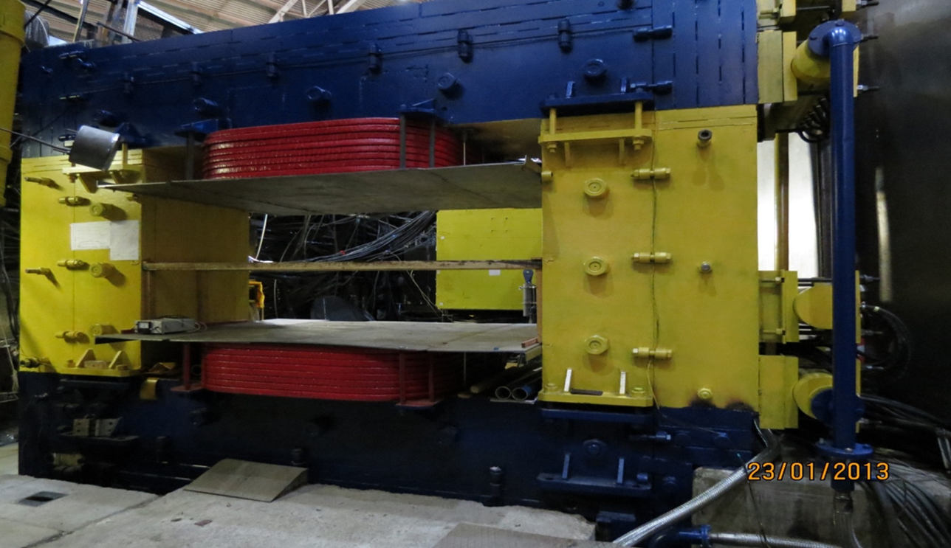
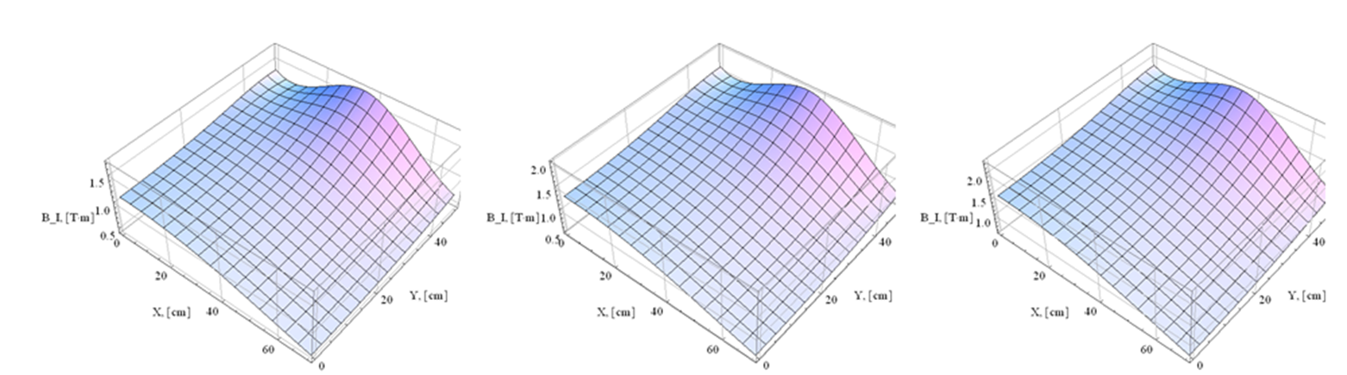
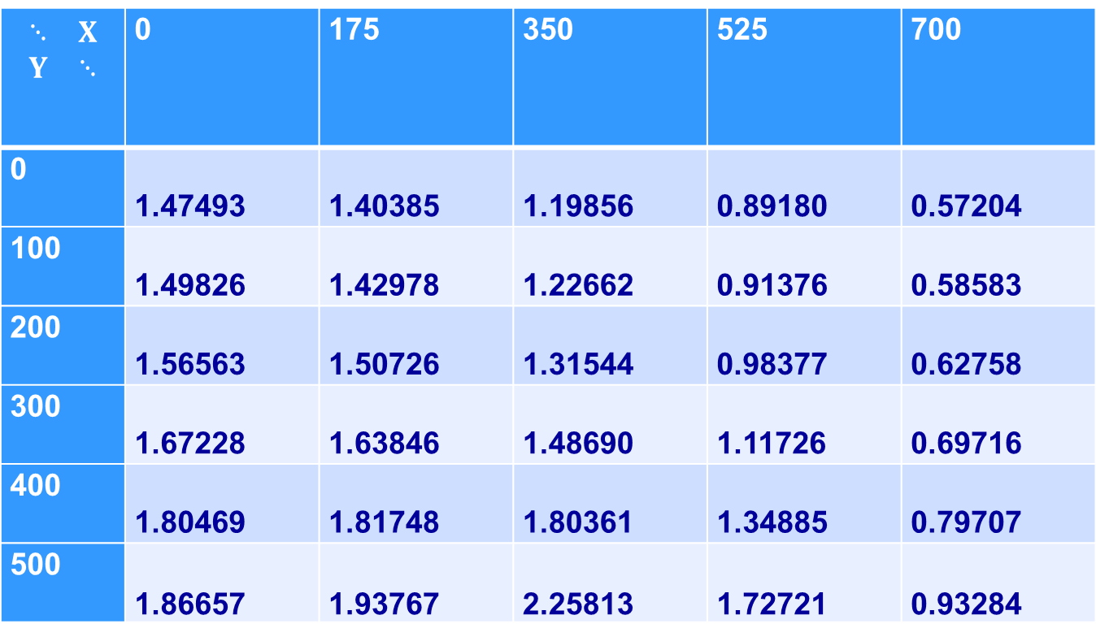
Spectrometer magnet
$$\begin{matrix}⋱ & X \\ Y & ⋱\end{matrix}$$ | 0 | 175 | 350 | 525 | 700
0 | 1.47493 | 1.40385 | 1.19856 | 0.89180 | 0.57204
100 | 1.49826 | 1.42978 | 1.22662 | 0.91376 | 0.58583
200 | 1.56563 | 1.50726 | 1.31544 | 0.98377 | 0.62758
300 | 1.67228 | 1.63846 | 1.48690 | 1.11726 | 0.69716
400 | 1.80469 | 1.81748 | 1.80361 | 1.34885 | 0.79707
500 | 1.86657 | 1.93767 | 2.25813 | 1.72721 | 0.93284

Slide 21
Tracking system
Detector name | Distance from target, [m] | Planes | Tube diameter, [mm] | Dimensions, Y[см]xX[см] | Channels
DTS2 | 1,67 | X,Y,U,V | 30 | 72 × 96 | 336
DTS3 | 5,29 | X,Y,U | 30 | 120 × 168 | 432
DTS4 | 8,07 | X,Y,U | 30 | 192 × 240 | 672
DTS5 | 9,77 | X,Y,U | 30 | 192 × 240 | 672
PC1 | 0,55 | X,Y | 1 | 20 × 20 | 400
PC2 | 0,62 | X,Y | 1 | 20 × 20 | 400
PC3 | 0,69 | X,Y | 1 | 20 × 20 | 400
DTS1 | 1,00 | U,V,X,Y | 15 | 48 × 48 | 384

Slide 22
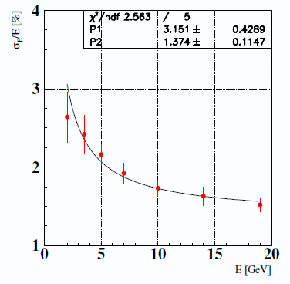
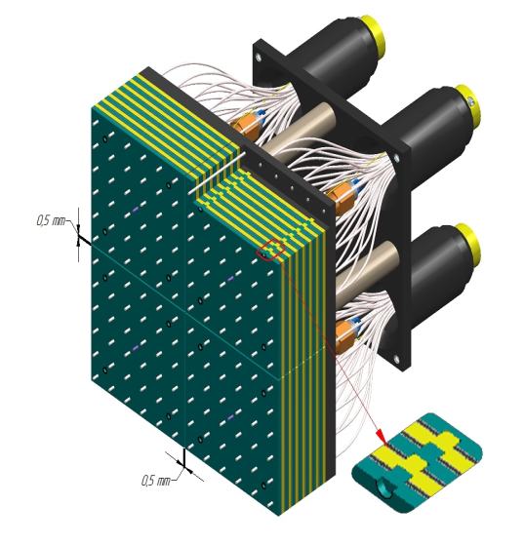
Electromagnetic Calorimeter
Fine-segmented “shashlyk”-type calorimeter,
Cell structure: Scintillator: 1.5 mm, Lead: 0.3 mm (380 layers)
2400 cells of the size 55×55×700 mm³, depth ~20X₀ About 11-12 m from target
Photodetectors: Hamamatsu R7899

Slide 23
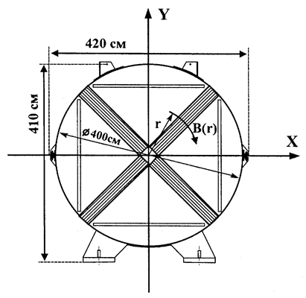
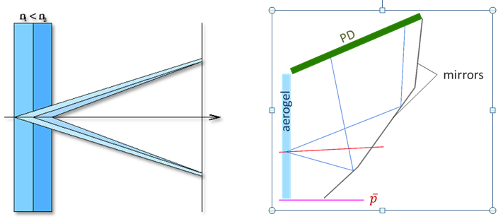
Particle Identification
PANDA type detector, Phys.Usp. 58 (2015) no.5, 503-511,
Usp.Fiz.Nauk 185 (2015) no.5, 540-548
Muon detector (drift tubes)

Slide 24
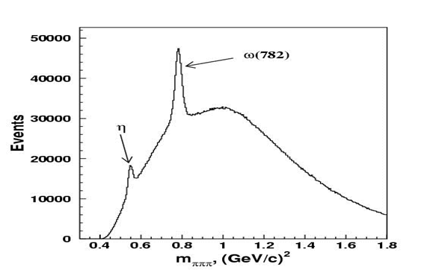
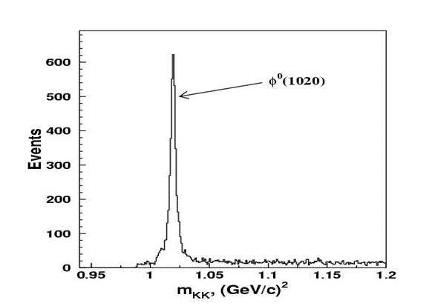
Expected accuracy
Asymmetry measurement statistic errors in reactions
π⁻р↑→ ω(782)X, η’(958)X are 0.3÷3% for different kinematic intervals
Accuracy in the reaction π⁻p↑→ f₂(1270) X is even better (0.1÷1%)

Slide 25
SPASCHARM at beamline 24 Cost Estimates
Cost of detectors - about 13 MEuro, including
Shashlyk calorimeter – 2 Meuro (IHEP)
RICH detector – 3.4 MEuro (BINP)
Spin flippers and cryogenics – 2.6 MEuro (BINP, IHEP, industry)
Polarimetry - 2 MEuro (MEPhI, IHEP, ITEP)
Cost of the beamline – 20-25 MEuro.
Total cost < 40 MEuro (about 1/5 of the JINR budget)
(new target not included)

Slide 26
Project schedule (if money in 2020)
Final design (beamline and setup zone) – 2020-2021
Shashlyk calorimeter - 2021-2024
Spin flippers and cryogenics – 2021-2024 ;
RICH detector – 2022-2025 ;
Beamline end all civil construction – 2023-2024;
Polarimeters and beam control and tagging system - 2022-2024
Beam commissioning 2024-2025
First data taking run with polarized proton beam - 2025

Slide 27
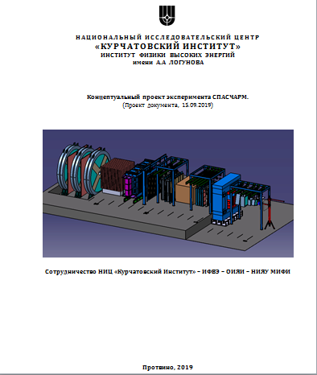
CDR
CDR will be published this fall
(IHEP Preprint in russian), available online version

Slide 28


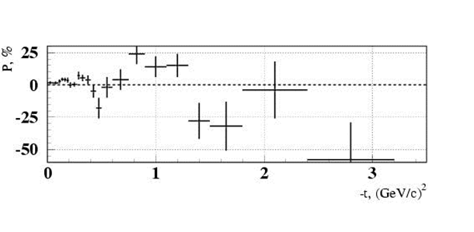
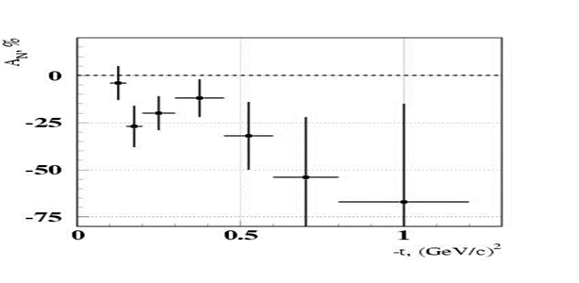
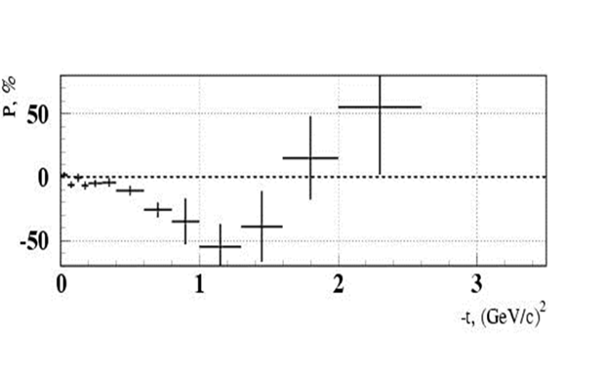
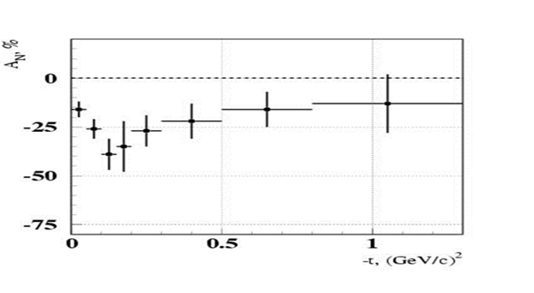


Beamline 14 motivation (exclusive)

Slide 29
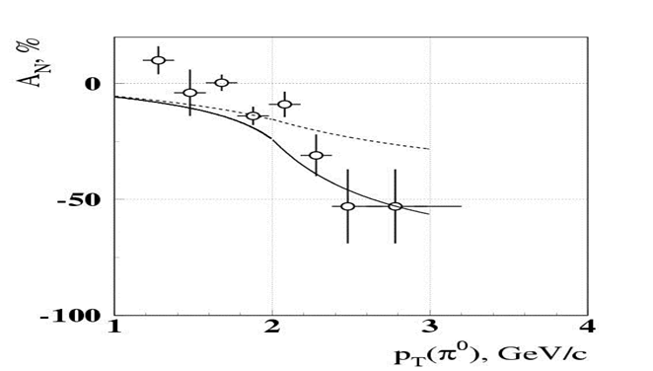
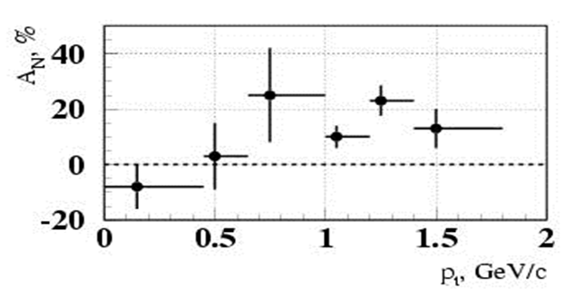
SPASCHARM at Beam-line 14 (motivation inclusive)
pp↑→π⁰X at x_{F}=0
pd↑→π⁰X at x_{F}>0.7
Phys.Lett. B243 (1990) 461-464, Sov.J.Nucl.Phys. 50 (1989) 432-437, Yad.Fiz. 50 (1989) 695-704
Phys.Atom.Nucl. 73 (2010) 2017-2021, Yad.Fiz. 73 (2010) 2072-2076
A_{N} = (16±5)% at p_{T} =(0.7-1.8) GeV/c and at x_{F} > 0.7.
A quite sizeable asymmetry showed up at p_{T} ~ 1 GeV/с and above even in the unpolarized beam fragmentation region.

Slide 30
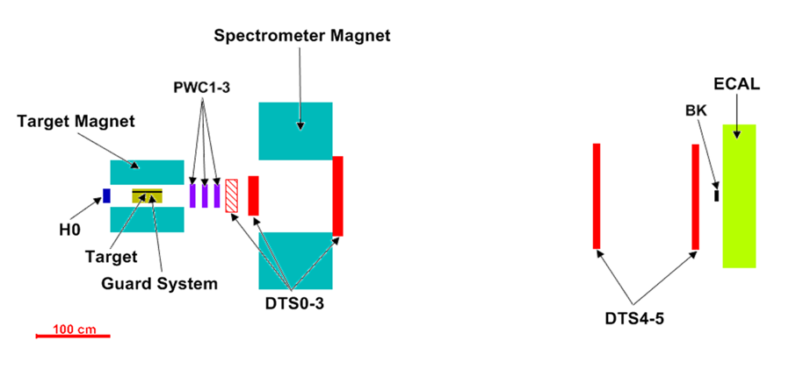
SPASCHARM at beamline 14
Beam Energy 28 GeV, Composition: pi/K/pbar=98%, 1.8%,0.25%,
Intensity: up to (1-2)×10⁶ per (1-2)-second long spill each 9-second cycle
2π in azimuth
Charged: Δθ_{x} > ±140 mrad, Δθ_{y} ≈ ±150 mrad, 0 < x_{F} < 1, p_{T} < ~2.5 GeV/c
γ and π⁰: Δθ_{x} ≈ ±50 mrad, Δθ_{y} ≈ ±40 mrad, 0 < x_{F} < 1, p_{T} < ~1 GeV/c
Small (0.6 T) Field in spectrometer magnet

Slide 31
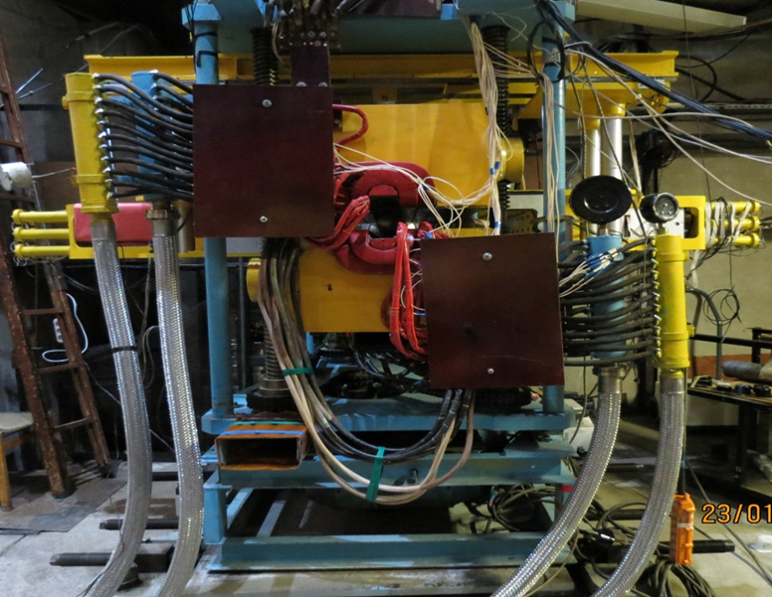
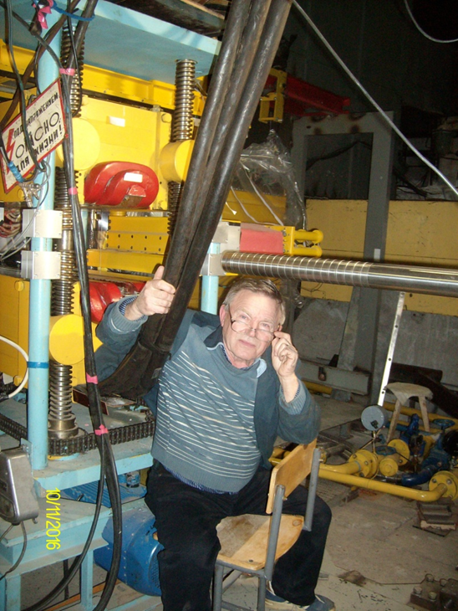
SPASCHARM 14: Polarized target magnet
Dipole magnet with conventional ‘warm ‘ copper coils and ferromagnetic (permendur) poles
Length (poles): 1 m
Aperture width: 80 mm
Variable vertical gap: 75 mm (closed yoke), 315 mm (open yoke)
Nominal coil current: 1.4 kA, power consumption: 300 kW
Closed yoke: Magnetic field in the aperture B = 2.4 T (!!!)
Open yoke: Magnetic field in the aperture B ≈ 0.4 T
Critical requirement
The uniformity of magnetic field of 2.4 T in the target volume of D = 18 mm & L=200 mm must be better than ~1.5×10⁻⁴
Aggravating factor: all ferromagnetics are close to saturation

Slide 32
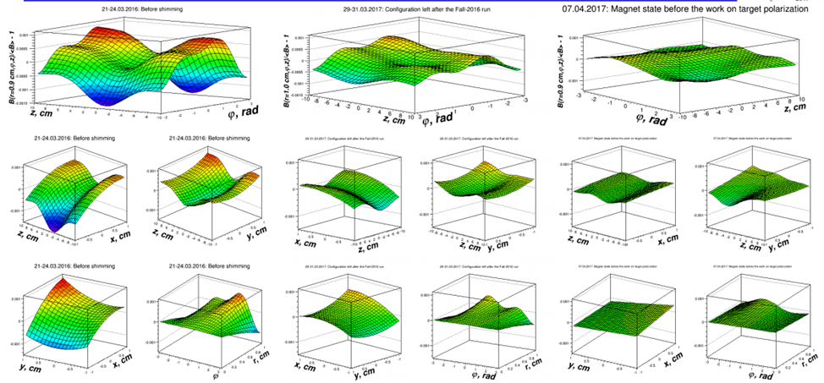
Magnet correction
RMS=(4.28±0.08)×10⁻⁴ | RMS=(1.86±0.07)×10⁻⁴ | RMS=(1.28±0.07)×10⁻⁴
(ΔB/B)_{MAX} = 2.5×10⁻³ | (ΔB/B)_{MAX} = 8.4×10⁻⁴ | (ΔB/B)_{MAX} = 7.8×10⁻⁴
Pol – N/A | POL=69% | POL > 70%

Slide 33
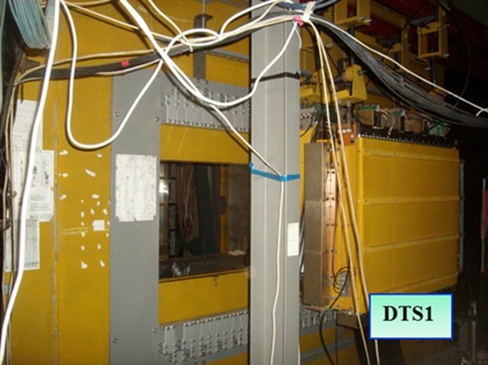
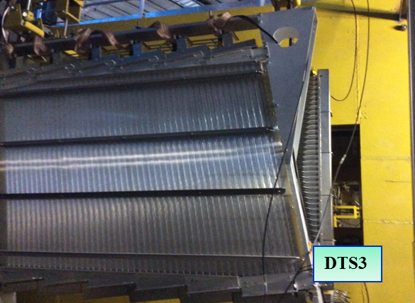
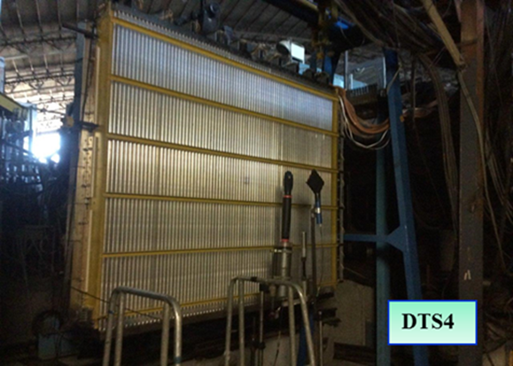
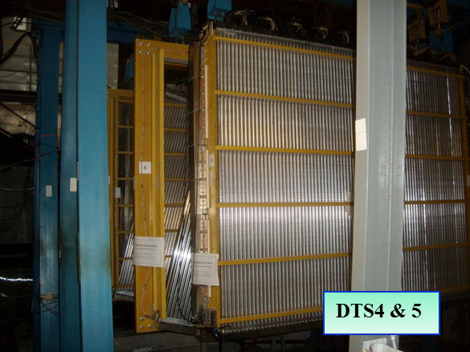
SPASCHARM 14: tracking system

Slide 34
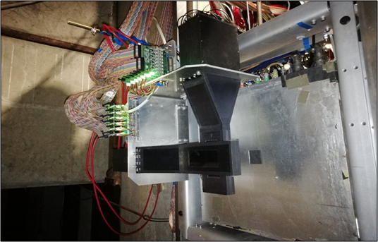
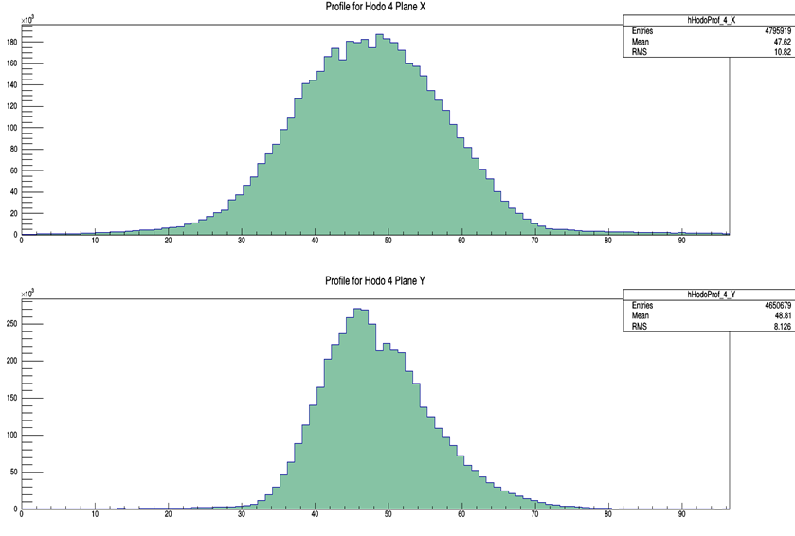
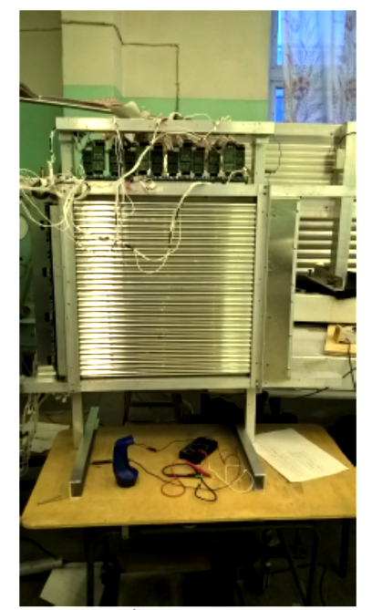
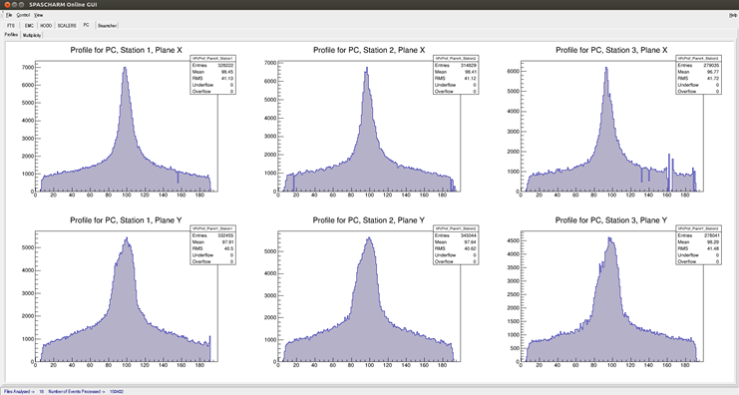
New detectors

Slide 35
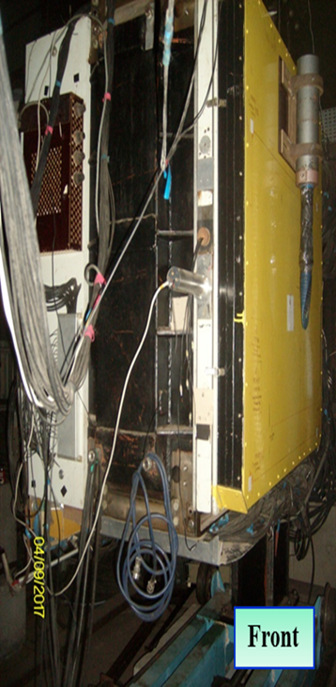
EMC
720 of lead-glass cells of the size 38×38×450 mm³, depth ~18X₀
Covered area: H×V ≈ 1.15×0.92 m²
Photodetectors: FEU-84
Energy resolution: σ_{E}/E ≈(12-14)%/√E, E in GeV
Distance from the target: 11 m

Slide 36
Final state | N_{EVENTS}
π⁺ | 4.2·10⁹
π⁻ | 8.7·10⁹
π⁰→γγ | 4.3·10⁹
π⁰→γγ | 4.3·10⁹
η →γγ | 4.2·10⁸
η'→ π⁺ π⁻ η | 8.3·10⁵
K⁰_{S}→ π⁺ π⁻ | 1.3·10⁷
ρ⁰(770)→ π⁺ π⁻ | 4.2·10⁸
η→ π⁺ π⁻ π⁰ | 5.3·10⁶
ω(782) → π⁺ π⁻ π⁰ | 3.5·10⁷
ω(782)→ γ π⁰ | 3.8·10⁷
ρ⁺(770)→ π⁺ π⁰ | 2.9·10⁸
ρ–(770)→ π⁻ π⁰ | 7.5·10⁸
K⁰_{S}→ π⁰ π⁰ | 1.7·10⁷
a₀(980)→ η π⁰ | 1.8·10⁷
ω(782)→ e⁺ e⁻ | 1.7·10⁵
Final state | N_{EVENTS}
K⁺ | 6.7·10⁸
K– | 9.0·10⁸
p | 9.2·10⁷
p̃ | 2.6·10⁸
K^{0*}(892)→ K⁺ π⁻ | 1.1·10⁸
K̃^{0*}(892)→ K– π⁺ | 4.3·10⁷
K^{+*}(892)→ K⁺ π⁰ | 1.9·10⁷
K̃–*(892)→ K– π⁰ | 3.8·10⁷
φ(1020)→ K⁺ K⁻ | 4.3·10⁶
Λ→ p π⁻ | 1.4·10⁶
Λ̃→ p̃ π⁺ | 1.1·10⁶
Δ⁺⁺→ p π⁺ | 9.3·10⁶
Δ⁻⁻→ p̃ π⁻ | 2.5·10⁷
Ξ⁻→ Λ π⁻ | 1.9·10⁶
Ξ̃⁺→ Λ̃ π⁺ | 1.6·10⁶
Σ⁰→ Λ γ | 1.2·10⁶
Σ⁰(1385)→ Λ π⁰ | 3.9·10⁶

Slide 37
Finally !!!
The pilot version of the SPASCHARM setup was commissioned in 2018:
Work with beam: 124 shifts (6 hout each) March 12 – April 12
March 12-23: 46 shifts Commissioning itself
March 23 –April 6 56 shifts with polarized target (partially commissioning)
April 06-12 22 Shifts Carbon and empty target
Finally on “tapes” events with min.bias trigger:
~800 Mevents with polarized target (300 Mevents of them during commissioning phase)
~300 Mevents on Carbon and empty target
Totally: about 10^9 events for analysis

Slide 38
SPASCHARM 14: current activities
Analyzing first experimental data
Analysis of the hardware performance
Development software and data reconstruction for reactions: π⁻ + p↑ → π⁻ X, π⁻ + p↑ → π⁺ X, π⁻ + p↑ → π⁰ X, π⁻ + p↑ → ω(π⁻ π⁺ π⁰) X
Systematic error estimation (also simulation)
Simulation
Reconstruction algorithm performance
Investigation possibility to study asymmetry in K^0 and ω inclusive production
Hardware
Tracking system optimization, including new station
DAQ (mainly TDC) optimization

Slide 39
SPASCHARM 14 collaboration
В.В. Абрамов, И.Л. Ажгирей, В.И. Бармин, Н.И. Беликов, А.А. Борисов, С.И. Букреева, А.Н. Васильев, В.И. Гаркуша, Ю.М. Гончаренко, А.А. Деревщиков, В.Н. Запольский, В.Г. Заручейский, Н.К. Калугин, В.А. Качанов, А.С. Кожин, В.А. Кормилицын, А.К.Лиходед, Е. Маслова, В.А. Маишеев, Ю.М. Мельник, А.П. Мещанин, Н.Г. Минаев, В.В. Моисеев, Д.А.Морозов, В.В. Мочалов, К.Д. Новиков, Л.В. Ногач, А.Орешков, В.С. Петров, С.В. Пославский А.Ф.Прудкогляд, С.В. Рыжиков, А.В. Рязанцев, П.А. Семенов, В.А. Сенько, С.Р.Слабоспицкий, М.М.Солдатов, Л.Ф. Соловьев, А.В. Узунян, Р.М.Фахрутдинов, Н.А.Шаланда, В.И. Якимчук, А.Е. Якутин
NRC Kurchatov Institute – IHEP
Н.А. Бажанов, Н.С. Борисов, И.С. Городнов, А.Б. Лазарев, А.Б. Неганов, Ю.А. Плис, О.Н.Щевелев, Ю.А. Усов, Ю.Н.Узиков
JINR
А.А. Богданов, М.Ф. Рунцо, М.Б. Нурушева, В.А.Окороков, В.Л. Рыков, В.М. М.Н. Стриханов
NRNU MEPhI
И.Алекссев, Б.Морозов, В. М. Нестеров, Д.Новинский, В.В. Рыльцов, Д. Н. Свирида, В.В. Тясин
NRC Kurchatov Institute ITPE, NRC Kurchatov Institute - PINP

Slide 40
SPASCHARM 24 collaboration+
BINP (Novosibirsk) – Spin flipper, RICH
Mainz – PWA analysis
Mainz, Bonn, Bochum – target, tracking system
Charles University (Prague), Trieste University
JINR (BLTP, VBLHEP)

Slide 41

Conclusion
The fixed target SPASCHARM experiment will systematically study polarization phenomena in hadronic reactions at U70.
The universal setup will detect dozens of reactions, produced on a (non)polarized proton and nucluar targets. Measurements are planned for different types of beams (π±, K±, p, $\overline{p}$), including unique polarized antiproton beam. Different polarization observable will be studied In parallel A_{N}, P_{N}, A_{NN}, A_{LL}, D_{NN}, ρik, …
Pilot version of the SPASCHARM experiment was commissioned and first data were accumulated.
We are on the way to analyze first data and accumulate new ones.

Slide 42
Backup slides

Slide 43


Slide 44


Slide 45

Hodoscope of tagging system

Slide 46



SPIN flipper (Shatunov Talk)
2 Helical magnets:
B_{max} = 47 kGs; λ= 2.5 m
Correctors:L=30 cm; B= 23 kGs; tilt = ± 0.1 rad;
Total length 6.5 m
Flipper optics: practically is equal to empty straight 6.5 m;
Spin transparency ≈ 97%

Slide 47




Характеристики трековой системы

Slide 48

Система сбора данных
Average event size: ~2 kBytes
Data acquisition rate: ~(3-4)*10⁴ events/spill

Slide 49




Система медленного контроля

Slide 50

Первые измерения односпиновой асимметрии в Протвино
В 1978 г. (почти 40 лет!) первые исследования с использованием поляризованной протонной мишени ИФВЭ-ОИЯИ

Slide 51


IHEP/1968 -1977 HERA Collaboration (France-USSR)
Polarization in elastic scattering of particles and antiparticles on polarized protons at 40 and 45 GeV.
Pomeron may carry the spin flip interaction (the first experimental hint)
Polarization in the elastic scattering of particle and antiparticle is not equal each to other with opposite sign in general, as it was predicted in the asymptotic model [S.M. Bilenky et al. 1963]
The energy variation of polarization depends on the type of particles and the magnitude of t.
Spin rotation parameter is consistent with the Chou - Yang model of rotating hadronic matter.
Chirality conservation hypothesis does not work

Slide 52


Поляризация в реакции π⁻p↑→π⁰n
Поляризация P(t) в области 0<|t|<0.35 (GeV/c)² равна (5.0±0.7)%.
Существует локальный минимум в области при t=-0.25 (GeV/c)^{2.}
Поляризация имеет минимум в области минимума в дифференциальном сечении.
Поляризация осциллирует.
V.D. Apokin et al., Sov. J. Nucl. Phys. 45:840, 1987, [Yad.Fiz.45:1355-1357,1987]
V.D. Apokin et al. Z.Phys.C15:293,1982

Slide 53



Поляризация в реакциях π⁻p↑→ηn and π⁻p↑→η’(958)n
Поляризация в реакции π⁻p↑→ηn при 40 ГэВ велика в широком интервале 0.05<-t<1.6 (GeV/c)² и достигает величины A_{N}=(-44±11)% в области |t| 0.8-1.6 (GeV/c)²
Минимум поляризации достигается в точке изменения наклона сечения
Поляризация меняет знак при -t=1.8 (GeV2/c)² .
Среднее значение поляризации в реакции π⁻p↑→η’(958)n в области 0.05< -t <0.5 (GeV2/c)² составляет (-17± 8)%.
V.D. Apokin et al., Z.Phys.C35:173,1987.

Slide 54




Асимметрия в реакциях π⁻p↑→ω(783)n и π⁻p↑→f₂(1270)n
I.A. Avvakumov et al. Yad.Fiz.42:1146,1985
ω регистрируется в моде распада πγ (branching 8.9%).
Асимметрия велика в обеих реакциях
Асимметрия минимальна примерно в области изменения наклона сечения как для ω,
так и для f₂
V.D. Apokin et al. Yad.Fiz.47:727-730,1988]

Slide 55

Статистика с использованием пи- пучка
Большое число реакций (диссертаций?)

Slide 56

Статистика с использованием каонного и антипротонного пучка
№ | частица | N_{EV} | S/B | № | частица | N_{EV} | S/B
1 | π⁺ | 2.1·10⁸ |  | 7 | n | 1.6·10⁷
2 | π⁻ | 2.6·10⁸ |  | 8 | ñ | 1.4·10⁸
3 | K⁺ | 1.7·10⁷ |  | 9 | Λ̃→ p̃ π⁺ | 2.1·10⁶ | 10
4 | K– | 2.2·10⁷ |  | 10 | Λ̃→ ñ π⁰ | 1.1·10⁶ | 0.13
5 | p | 1.6·10⁷ |  | 11 | Δ̃⁻⁻→ p̃ π⁻ | 4.2·10⁷ | 0.14
6 | p̃ | 1.8·10⁸ |  | 12 | Ξ⁻→ Λ π⁻ | 1.0·10⁵ | 10

