Slide 1



National Research Centre “Kurchatov Institute”
̶̶̶̶̶̶̶̶̶̶̶̶̶̶̶̶̶̶̶̶̶̶̶̶̶̶̶̶̶̶̶̶̶̶̶̶̶̶̶̶̶̶̶̶
A.A. Logunov INSTITUTE FOR HIGH ENERGY PHYSICS
of the National Research Centre “Kurchatov Institute”
Polarization of cascade hyperons and antihyperons
V.V. Abramov, IHEP, Protvino
The XVIII WORKSHOP ON HIGH ENERGY SPIN PHYSICS (DSPIN-19)
Dubna, Russia, September 2-6, 2019

Slide 2
Talk content
Introduction
2. The Chromo-magnetic polarization of quarks (CPQ) model.
3. Hyperon polarization oscillation due to the quark (antiquark) spin precession in an effective chromomagnetic field.
4. The dependence of P_{N}(x_{F}) oscillation frequency on the number of spectator quarks and antiquarks. Quark flow diagrams.
5. The existing data for cascade (anti)hyperon polarization (P_{N}).
6. Predictions of P_{N}(√s,p_{T},x_{F},A), obtained in the framework of the CPQ model, will be given for unexplored yet kinematical regions, which can be checked experimentally.
7. Conclusions
This work was supported in part by the RFBR Contract (Grant No. 18-02-00006).
2

Slide 3
Introduction
Transverse polarization (P_{N}) of cascade hyperons (Ξ⁰ and Ξ⁻) and their corresponding antihyperons especially interesting because it is very sensitive to the mechanism of formation of these particles.
Hyperon polarization is considered in framework of the model of chromomagnetic polarization of quarks. In these processes, a strong chromomagnetic field is expected in the interaction region due to the presence of a large number of strange quark or antiquark - spectators.
As a result, quark spin precession occurs, as well as polarization oscillations, depending on Feynman variable x_{F}. This is a major feature of the CPQ model, which can be checked experimentally.
Hyperon polarization predictions are made depending on energy and other variables.
3

Slide 4
Model of chromomagnetic polarization of quarks
It is assumed in the CPQ model, that there are a longitudinal chromoelectric field Eª and a circular transverse chromomagnetic field Bª in the interaction region.
A.B.Migdal, S.B.Khohlachev, JETP Lett. 41 (1985) 194.
M.G. Ryskin, Sov. J. Nucl. Phys. 48 (1988) 708.
μª_{Q} = sgªg_{s}/2M_{Q} – the chromomagnetic dipole moment of the constituent quark interacts with the inhomogeneous chromomagnetic field (Stern-Gerlach like force).
In the CPQ model the interaction region can be considered as a microscopic Stern-Gerlach apparatus:
The quark spin precession in the chromomagnetic field changes the Stern-Gerlach force and leads to an oscillation of P_{N} as a function of its arguments.
4

Slide 5
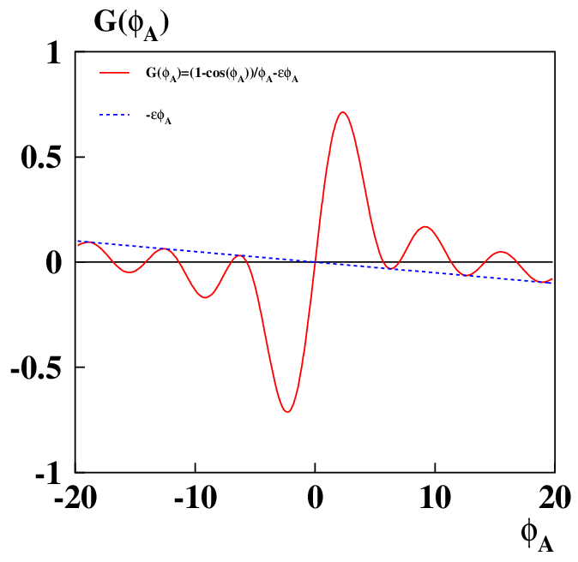
Equation for A_{N}, P_{N} and (ρ₀₀-1/3)
P_{N} ≈ C(√s) F(p_{T}, A)[G(φ_{A}) – σG(φ_{B}) ], (1)
G(ϕ_{A}) = [1 – cos ϕ_{A}]/ϕ_{A} + εφ_{A}, is a result of the spin precession and S-G force (2)
were φ_{A}, φ_{B} – are the integral “spin precession angles” in the fragmentation regions of the projectile A and the target B, respectively. ε = -0.00497 ± 0.00009.
φ_{A} = ω⁰_{A}y_{A}, φ_{B} = ω⁰_{B}y_{B} ;
ω⁰_{A(B)} = g_{s}α_{s}ν_{A(B)} S₀(gª_{Q} – 2)/(M_{Q} cρ²) ;
y_{A} = x_{A} – (E₀/√s + f₀ )[1 + cosθ_{cm} ] + a₀[1 – cosθ_{cm} ]
y_{B} = x_{B} – (E₀/√s + f₀ )[1 – cosθ_{cm} ] + a₀[1 + cosθ_{cm} ]
x_{A} = (x_{R}+x_{F})/2, x_{B}= (x_{R}-x_{F})/2 - scaling variables.
Max at φ_{A}=2.3
Min at φ_{A}=-2.3
ν_{A(B)} - effective contributions of the spectator quarks to the field Bª.
5

Slide 6
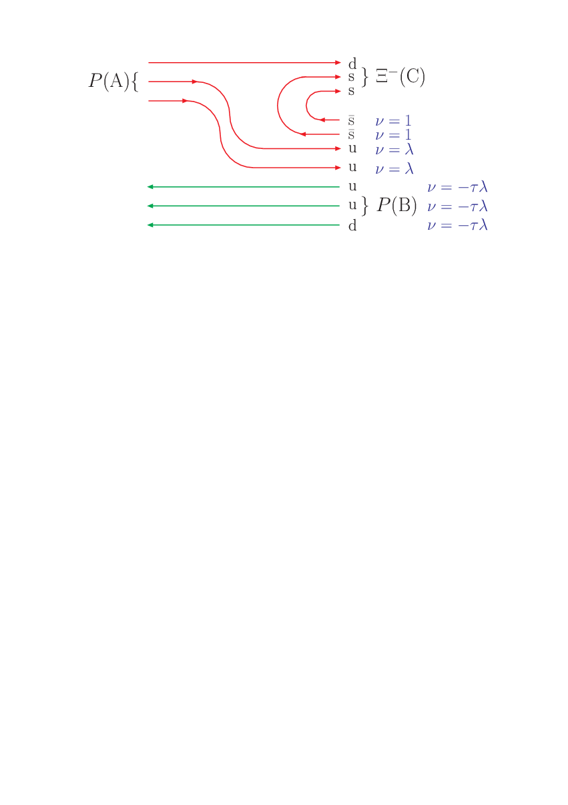
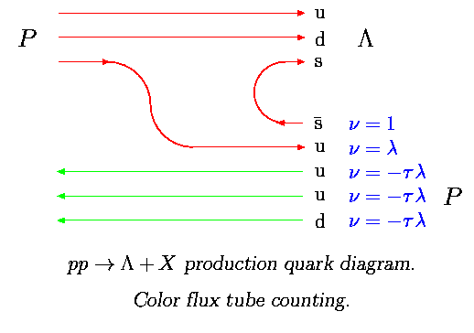
Quark counting rules for the p + p → Ξ⁻ + X
ν_{A}= 2 + 2λ – 3τ λ (3)
ν_{B}= 3λ - 2τ(λ+1) (4) where global parameters for 81 reactions are:
λ = −0.1363±0.0003, τ = 0.0267±0.0005.
SPECTATORS
For comparison is shown a quark flow in reaction p + p → Λ + X.
The effective number of quarks is:
ν_{A}= 1 + λ – 3τ λ (5)
ν_{B}= 3λ - τ(λ+1) (6)
So, in case of reaction p + p → Ξ⁻ + X
ν_{A} is approximately two times higher, than in case of p + p → Λ + X. As a result, P_{N}(x_{F}) should oscillates with approximately two times higher frequency for p + p → Ξ⁻ + X reaction.
6
Notes:
SPIN2010
6V.V.Abramov, IHEP, Protvino, Russia

Slide 7
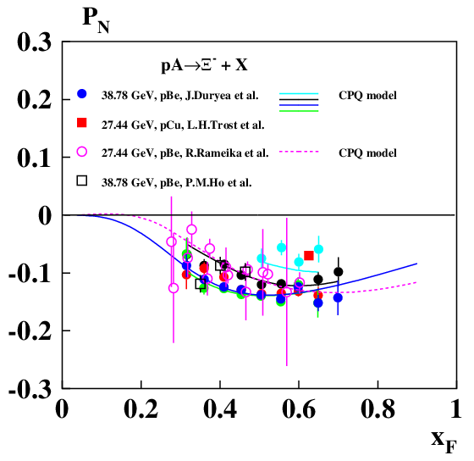
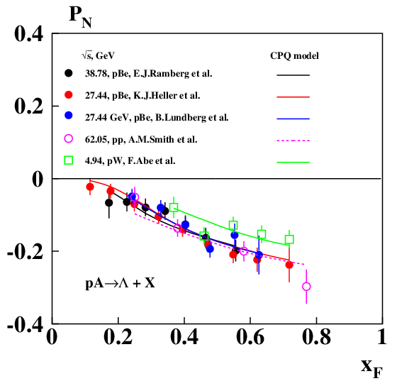
The existing data for the p + A → Ξ⁻ + X reaction
We can see, that P_{N}(x_{F}) for the p + A → Ξ⁻ + X reaction is not monotonic (it oscillates) , while in case of the p + A → Λ + X reaction it increases almost linearly up to x_{F} ≈ 0.75. This is in agreement with the CPQ model predictions, shown by curves.
7
Notes:
SPIN2010
7V.V.Abramov, IHEP, Protvino, Russia

Slide 8
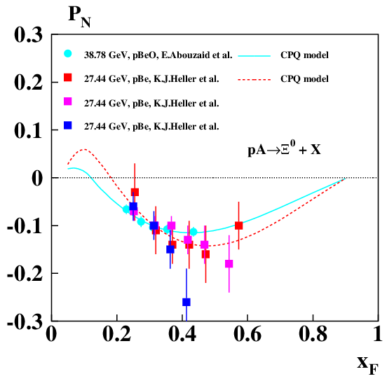
The existing data for the p + A → Ξ⁰ + X reaction
P_{N}(x_{F}) for the p + A → Ξ⁰ + X reaction looks similar (it oscillates) , as in case of the p + A → Ξ⁻ + X reaction. The magnitude of P_{N}(x_{F}) is near its maximum near x_{F} ≈ 0.6. This is also in agreement with the CPQ model predictions, shown by curves.
8
Notes:
SPIN2010
8V.V.Abramov, IHEP, Protvino, Russia

Slide 9
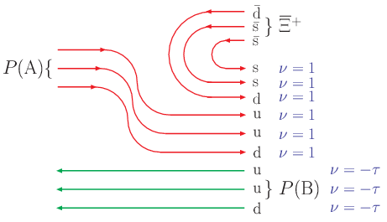

Quark flow diagrams for the cascade antihyperon production
In case of ͡Ξ⁺ and ͡Ξ⁰ production in pA-collisions the quark flow diagrams look similar. But constituent masses of u and d are different.
Six spectator quarks interact with each of active valence quark of antihyperon and create a very strong chomomagnetic field.
Large values of ν_{A}= 6 – 3τ and ν_{B}= 3 - 6τ lead to a very high quark spin precession frequency and the corresponding high oscillation frequency ω⁰_{A(B)} for P_{N}(x_{F}), which is proportional to ν_{A} or ν_{B}.
9
Notes:
SPIN2010
9V.V.Abramov, IHEP, Protvino, Russia

Slide 10
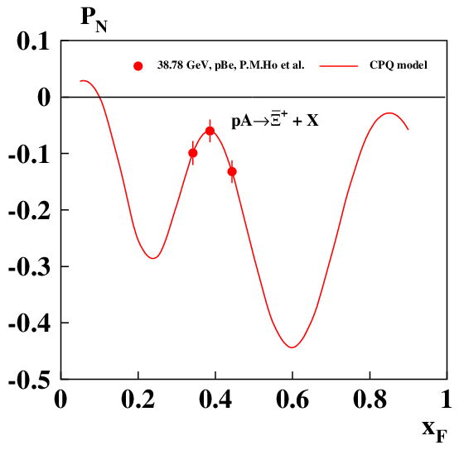
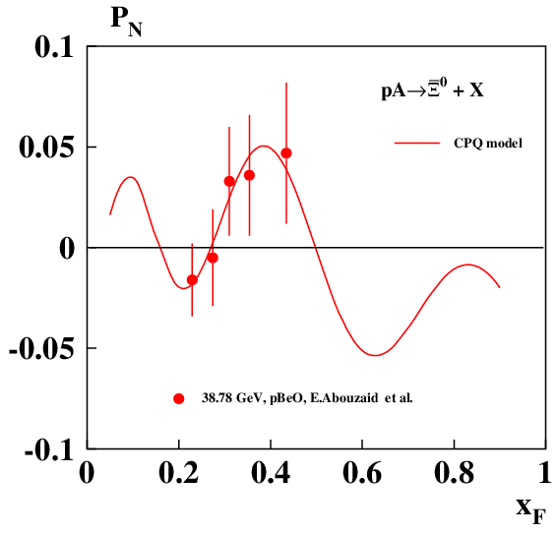
The data for cascade antihyperon polarization
We can see, that P_{N}(x_{F}) for the cascade antihyperon production in pA-collisions is not monotonic (it oscillates) with higher frequency, than in case of the corresponding hyperons. The CPQ model agrees with data and predicts several maxima and minima of P_{N}(x_{F}). This is the main signature of the CPQ model.
10
Notes:
SPIN2010
10V.V.Abramov, IHEP, Protvino, Russia

Slide 11
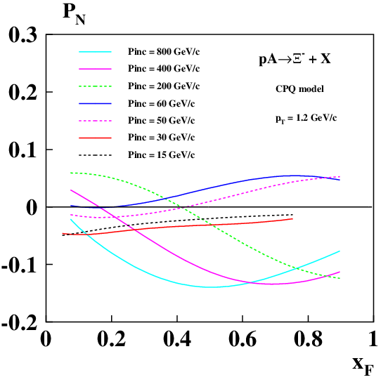
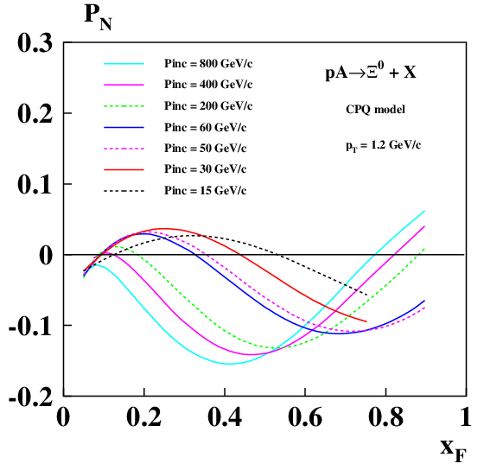
Predictions for the cascade hyperon polarization
Calculations of P_{N}(x_{F}) for the p + A → Ξ⁻ + X and p + A → Ξ⁰ + X reactions are shown above for p_{T} = 1.2 GeV/c (near maxima of |P_{N}(x_{F},p_{T})|). In order to reveal P_{N}(x_{F}) oscillation, measurements have to be performed in a wide range of x_{F}. When beam momentum increases, the value of P_{N}(x_{F}) can reach significant negative value near -0.14. Positive P_{N}(x_{F}) are expected at some values of x_{F}.
11
Notes:
SPIN2010
11V.V.Abramov, IHEP, Protvino, Russia

Slide 12
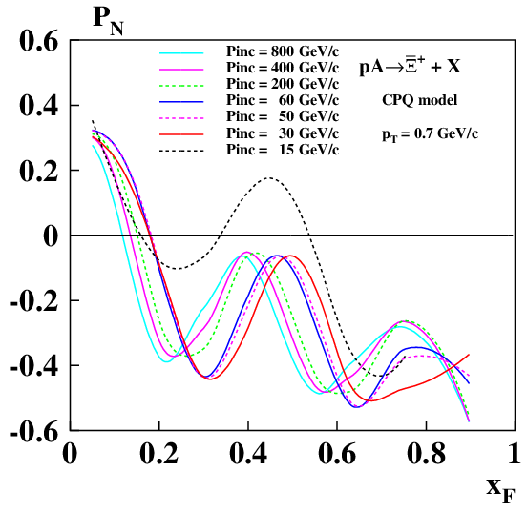
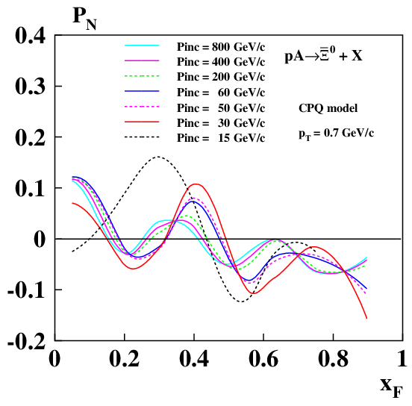
Predictions for the cascade antihyperon polarization
Calculations of P_{N}(x_{F}) for the p + A → ͡Ξ⁺ + X and p + A → ͡Ξ⁰ + X reactions are shown above for p_{T} = 0.7 GeV/c (near maxima of |P_{N}(x_{F},p_{T})|). In order to reveal the P_{N}(x_{F}) oscillation, measurements have to be performed in a wide range of x_{F}. When beam momentum increases, the position of peaks for P_{N}(x_{F}) moves to a smaller x_{F}. Oscillation of P_{N}(x_{F}) is a major CPQ model prediction, related to a quark spin precession in a strong chromomagnetic field in the interaction region.
12
Notes:
SPIN2010
12V.V.Abramov, IHEP, Protvino, Russia

Slide 13
References to the Chromo-magnetic polarization of quarks model
[1] V.V. Abramov, Phys. At. Nucl. 72 (2009) 1872.
[2] V.V. Abramov, J. Phys. Conf. Ser. 938 (2017) 012038.
[3] V.V. Abramov, J. Phys. Conf. Ser. 678 (2016) 012039.
[4] V.V. Abramov, Phys. Part. Nucl. 45 (2014) 62.
[5] V.V. Abramov, J. Phys. Conf. Ser. 295 (2011) 012086.
[6] V.V.Abramov, Proc. of the XIV Advanced Research Workshop on High Energy Spin Physics (DSPIN-11), edited by A.V. Efremov and S.V. Goloskokov (Dubna, 2012) p. 21-26.
[7] V.V.Abramov, Proc. of the XIII Advanced Research Workshop on High Energy Spin Physics (DSPIN-09), edited by A.V. Efremov and S.V. Goloskokov (Dubna, 2010) p. 25-28. e-Print: arXiv:0910.1216 [hep-ph].
13

Slide 14
References to the experimental data
Cascade hyperon polarization:
[1] J. Duryea et al., Phys. Rev. Lett. 67 (1991) 1193.
[2] L.H.Trost et al., Phys. Rev. D 40 (1989) 1703.
[3] R. Rameika et al., Phys. Rev. D 33 (1986) 3172.
[4] P.M. Ho et al., Phys. Rev. Lett. 65 (1990) 1713.
[5] E. Abouzaid et al., Phys. Rev. D 75 (2007) 012005.
[6] K.J. Heller et al., Phys. Rev. Lett. 51 (1983) 2025.
Lambda polarization:
[7] E.J. Ramberg et al., Phys. Lett. B 338 (1994) 403.
[8] K.J. Heller et al., Phys. Rev. Lett. 41 (1978) 607.
[9] B. Lundberg et al., Phys. Rev. D 40 (1989) 3557.
[10] A.M.Smith et al., Phys. Lett. B 185 (1987) 209.
[11] F. Abe et al., Phys. Rev. D 34 (1986) 1950.
14

Slide 15
Conclusions
1) The existing data for cascade hyperon and antihyperon P_{N}(x_{F}) indicate a non-monotonic (oscillating) behavior as a function of x_{F}. This feature of the data is explained and reproduced in the framework of chromomagnetic polarization of quark (CPQ) model. P_{N}(x_{F}) oscillation is a main signature of the CPQ model.
2) The P_{N}(x_{F}) oscillation is expected in the CPQ model due to a constituent quark spin precession in a strong circular transverse chromomagnetic field, which exists for a short time in the interaction region of colliding nucleons.
3) The frequency of P_{N}(x_{F}) oscillation is proportional to a number of spectator quarks (antiquarks), ν_{A} and ν_{B}, with weights, determined by color factor (λ) and direction of motion parameter (τ) of spectator quarks in the c.m.s. of reaction.
4) Quark flow diagrams can be used to estimate the effective numbers of spectator quarks, ν_{A} and ν_{B}, which are functions of global model parameters, and, in addition, depend on atomic weights of colliding particles and kinematical variables (at very high energy).
5) Predictions of the CPQ model can be checked in the experiments SPASCHARM (IHEP), SPD (JINR), STAR and PHENIX (BNL).
15

Slide 16
BACKUP SLIDES
16

Slide 17
Equations for A_{N}, P_{N} and (ρ₀₀-1/3)
P_{N} ≈ C(√s) F(p_{T}, A)[G(φ_{A}) – σG(φ_{B}) ], (3)
G(ϕ_{A}) = [1 – cos ϕ_{A}]/ϕ_{A} + εφ_{A}, spin precession and S-G force (4)
C (√s) = v₀/[(1 - E_{R}/√s )²+δ_{R}²]^{1/2}, spin precession vs E_{Q} (5)
F(p_{T},A) ={1 - exp[-(p_{T}/p⁰_{T})^{2.5} ]}(1 -α_{A} lnA), color form factor (6)
v₀ = -D_{r} gª_{Q} ξ⁰_{y} /2(gª_{Q} –2 ), magnitude of A_{N} and P_{N} (7)
φ_{A} = ω⁰_{A}y_{A}, φ_{B} = ω⁰_{B}y_{B} , integral “precession angles” (8)
y_{A} = x_{A} – (E₀/√s + f₀ )[1 + cosθ_{cm} ] + a₀[1 – cosθ_{cm} ], (9)
y_{B} = x_{B} – (E₀/√s + f₀ )[1 – cosθ_{cm} ] + a₀[1 + cosθ_{cm} ], (10)
x_{A} = (x_{R}+x_{F})/2, x_{B}= (x_{R}-x_{F})/2. scaling variables (11)
ω⁰_{A(B)} = g_{s}α_{s}ν_{A(B)} S₀(gª_{Q} – 2)/(M_{Q} cρ²), ε = -0.00497 ± 0.00009. (12) ν_{A(B)} - effective contributions of the spectator quarks to the field Bª.
17

Slide 18
Studies performed over the past 35 years have shown that there are significant spin effects in the inclusive processes at energies from a few GeV up to hundreds of GeV in the c.m.s.
Object of the study - single-spin processes:
A↑ +B → C + X (single-spin asymmetry A_{N}(√s,p_{T},x_{F})) (1)
The presence of large (> 10%) spin effects can not be explained within the framework of QCD perturbation theory:
A_{N} ~ P_{N} ~ α_{s}m_{q}/p_{T} ≈ 0.1%. (2)
Further experimental studies and a global analysis of all available information on single-spin processes are needed. These studies will reveal regularities in the behavior of the polarization data, including the dependence on atomic weights of colliding particles.
18

Slide 19
Chromo-magnetic polarization of quarks (CPQ) model
1) After initial color charge-exchange longitudinal chromoelectric field Eª and circular transverse chromomagnetic field Bª are generated.
2) Single-spin asymmetry is due to the Stern-Gerlach force acting on a quark in inhomogeneous transverse circular chromomagnetic field.
3) Quark spin precession in the color fields leads to the oscillation of A_{N} (x_{F}) and P_{N} (x_{F}) in case of strong field, and to their approximate linear dependence on x_{F} in the case of weak color field.
4) Quark flow diagrams and quark counting rules (QCR) describe the contributions of quarks and antiquarks to the effective color field. Contributions of quarks and antiquarks are linear functions of their numbers with weights determined by the color factors C_{F}(qq) and C_{F}(qq̃). [1] V.V. Abramov, Phys. At. Nucl. 72 (2009) 1872.
19

Slide 20
Quark spin precession in the color field
dξ/dt ≈ a[ξ Bª] (F-T-BMT-equation) (4)
a = g_{s}(gª_{Q} – 2 + 2M_{Q}/E_{Q})/2M_{Q} (5)
Quark masses M_{U} ≈ M_{D} ≈ 0.3 GeV, E_{Q} – quark energy in c.m.
Δμª_{Q} =(gª_{Q}-2)/2 (quark anomalous chromomagnetic moment).
Due to the spontaneous breaking of chiral symmetry appear the ΔM_{Q}(q) ≈ 0.3 GeV and Δμª_{Q}(q) of the constituent quarks.
In the instanton model: Δμª_{Q} (0) ≈ –0.4 (N. Kochelev);
Δμª_{Q} (0) ≈ –1.6 (D. Diakonov).
Model-dependent (CPQ) estimate of Δμª_{Q} for u,d,s,c,b-quarks are obtained from the global analysis of polarization data:
Δμª_{Q} (u,c) = -0.4839±0.0017, q=+2/3;
Δμª_{Q} (d,s,b) ≈ √(2/3) Δμª_{Q}(u,c), q=-1/3.
20

Slide 21
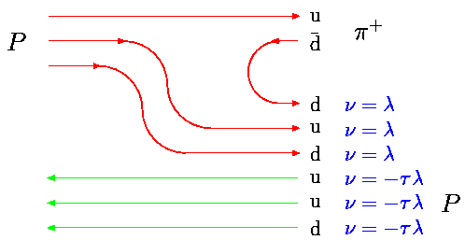
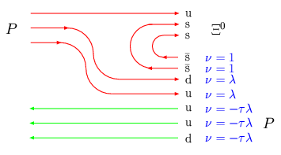
Quark counting rules for ν_{A} (A + B → C + X)
SPECTATORS
∫Eª ~ ∫Bª ~ ν_{A}= [3λ - 3τ λ] <0;
∫Eª ~ ∫Bª ~ ν_{A}=[2 + 2λ - 3τ λ] >0
A_{N} ~ P_{U}ν_{A}(gª_{U} - 2)/2M_{U} > 0;
P_{N} ~ ν_{A}(gª_{S} -2)/2M_{S} < 0.
qq, q̃q̃ -SU(3)_{c} antitriplet, weight ν = λ; C_{F} = 2/3 – color factor
qq̃, q̃q -SU(3)_{c} singlet, weight ν = 1. C_{F} = 4/3 – color factor
S.P. Baranov, Phys. Rev. D54, 3228 (1996). |ψ|² ~ (C_{F}α_{S})³. (16)
λ = −|ψ_{qq}(0)|² /|ψ_{q} _{q}̃(0)|² ≈ 1-e^{1/8} ≈ -0.1332 color factor (17)
λ = −0.1363±0.0003, τ = 0.0267±0.0012, fit for 81 reactions.
21
Notes:
SPIN2010
21V.V.Abramov, IHEP, Protvino, Russia

Slide 22
Model parameters (global and local)
m_{s} = 98±2 MeV; 2) m_{c} = 1264±17 MeV; 3) Δμª_{u} = -0.4839±0.0017;
4) ΔM_{u} = 0.2665±0.0012; 5) ΔM_{d} = 0.3033±0.0013; 6) ΔM_{s} = 0.3703±0.0020;
7) τ = 0.0267 ±0.0005; 8) λ = -0.1363 ±0.0003; 9) ε = -0.00497±0.00009;
W₀=275.6 ±1.3 GeV; 11) P_{N} = 84.7 ± 0.4 GeV; 12) m_{r} = 0.3573±0.0016 GeV;
n_{q} = 4.671±0.018; 14) A_{a} = 10.35±0.55; 15) A_{b}= 0.3084±0.0012;
A_{T} = 59.6±5.8; 17) δ_{R} = 0.2907±0.0026; 18) a_{f} = 3.092±0.047;
V_{T} = 0.1437±0.062; 20) p_{m} = 0.152±0.038 GeV; 21) a₈₁ = 1.622±0.050;
22) a₅₆ = 0.4220±0.0013 GeV; 23) E₀ = -83.8±0.4 GeV; 23) a₅₁=0.0236±0.0015;
25) E_{c} = 0.000511±0.000003; 26) a₄₁=0.1428±0.0013; 27) η = -1.761±1.18;
W₀ ≈ m_{p}²/m_{q}≈255±24 GeV; m_{q}≈(m_{u}+m_{d})/2≈3.45±0.33MeV; λ ≈1-exp(1/8)≈-0.133;
22
Notes:
SPIN2010
22V.V.Abramov, IHEP, Protvino, Russia

Slide 23
Global Data Analysis: A_{N}
Inclusive reactions, in which was measured single-spin asymmetry in hadron-hadron collisions ( 26 reactions).
№ | Reaction | № | Reaction | № | Reaction
1 2 3 4 5 6 7 8 9 | p↑ p(A) → π⁺ p↑ p(A) → π⁻ p↑ p → π⁰ p↑ p(A) → K⁺ p↑ p(A) → K⁻ p↑ p → K⁰_{S} p↑ p(A) → n p↑ p(A) → p p↑ A → p̃ | 10 11 12 13 14 15 16 17 18 | p↑ A → J/ψ↑ p↑ p → η d↑ A → π⁺ d↑ A → π⁻ p̃↑ p → π⁺ p̃↑ p → π⁻ p̃↑ p → π⁰ p̃↑ p → η p̃ d↑ → π⁰ | 19 20 21 22 23 24 25 26 | π⁺ p↑ → π⁺ π⁻ p↑ → π⁻ π⁻ p↑ → π⁰ π⁻ d↑ → π⁰ K⁻ d↑ → π⁰ K⁻ p↑ → π⁰ π⁻ p↑ → η p̃ p↑ → π⁰
23

Slide 24
Global Data Analysis: P_{N}
Inclusive reactions, in which was measured hyperon polarization in hadron-hadron collisions ( 31 reactions).
№ | Reaction | № | Reaction | № | Reaction
27 28 29 30 31 32 33 34 35 36 | p p(A) → Λ↑ p A → Ξ–↑ p A → Ξ^{0↑} p A → Σ^{+↑} p p → p↑ p A → Σ–↑ p A → Ω–↑ Σ– A → Λ↑ p A → Σ^{0↑} Λ A → Ω–↑ | 37 38 39 40 41 42 43 44 45 46 47 | Σ– A → Σ^{+↑} Σ– A → Ξ–↑ p A → Λ̃↑ Σ– A → Λ̃↑ p A → Ξ̃^{+↑} p A → Ξ̃^{0↑} p A → Σ̃–↑ p̃ A → Λ̃↑ A₁+A₂ → Λ↑ Au+Au → Λ^{↑(Glob)} Au+Au → Λ̃^{↑(GloB)} | 48 49 50 51 52 53 54 55 56 57 | K– p → Λ↑ K– A → Ξ–↑ π– A → Ξ–↑ π⁺ p → Λ↑ K⁺ p → Λ↑ π– p → Λ↑ K⁺ p →Λ̃↑ π– p → Λ̃↑ K⁻ p →Λ̃↑ π– A → Ξ̃^{+↑}
24

Slide 25
Global Data Analysis: A_{N}, P_{N}, ρ₀₀
Other inclusive reactions, in which was measured vector meson polarization and lepton induced reactions ( 24 reactions).
№ | Reaction | № | Reaction | № | Reaction
58 59 60 61 62 63 64 65 66 | p A → J/ψ↑ p̃ A → J/ψ↑ p A → Ү(1S)↑ p A → Ү(2S)↑ p p → Ү(1S)^{↑(λ̃)} p p → Ү(2S)^{↑(λ̃)} p p → Ү(3S)^{↑(λ̃)} p̃ p → Ү(1S)↑ p̃ p → Ү(2S)↑ | 67 68 69 70 71 72 | n A → K*(892)–↑ n A → K*(892)^{+↑} p p → φ(1020)↑ p̃ p → ρ(770)↑ AuAu→K̃*(892)^{0↑} AuAu→ φ(1020)↑ | 73 74 75 76 77 78 79 80 81 | e⁺ A → Λ↑ e⁺ A → Λ̃↑ e⁺ p↑ → π⁺ e⁺ p↑ → π– e⁺ p↑ → K⁺ e⁺ p↑ → K– μ– 6LiD↑ → h⁺ μ– 6LiD↑ → h⁻ ν_{μ} A → Λ↑
25

