Slide 1
The SPASCHARM experiment at U-70 accelerator of IHEP
V. Mochalov (IHEP, Protvino and MEPhI, Moscow)
on behalf of the SPASCHARM collaboration

Slide 2
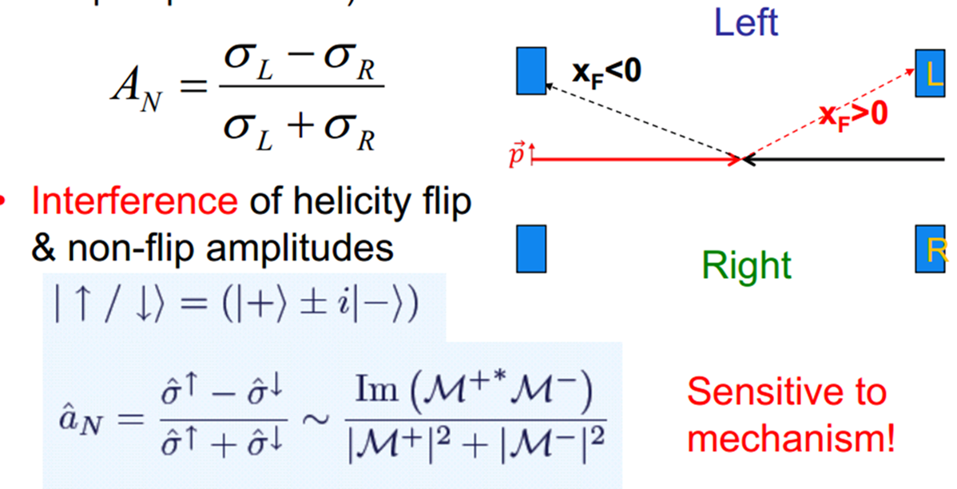
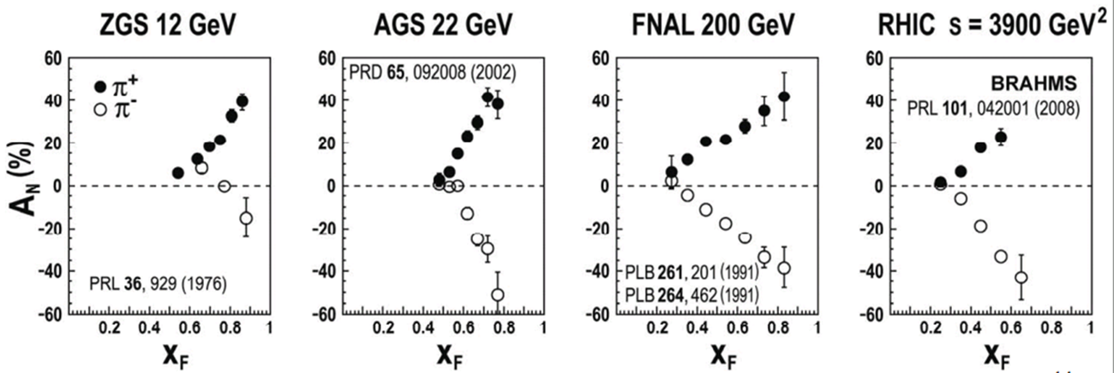
single-spin asymmetry

Slide 3
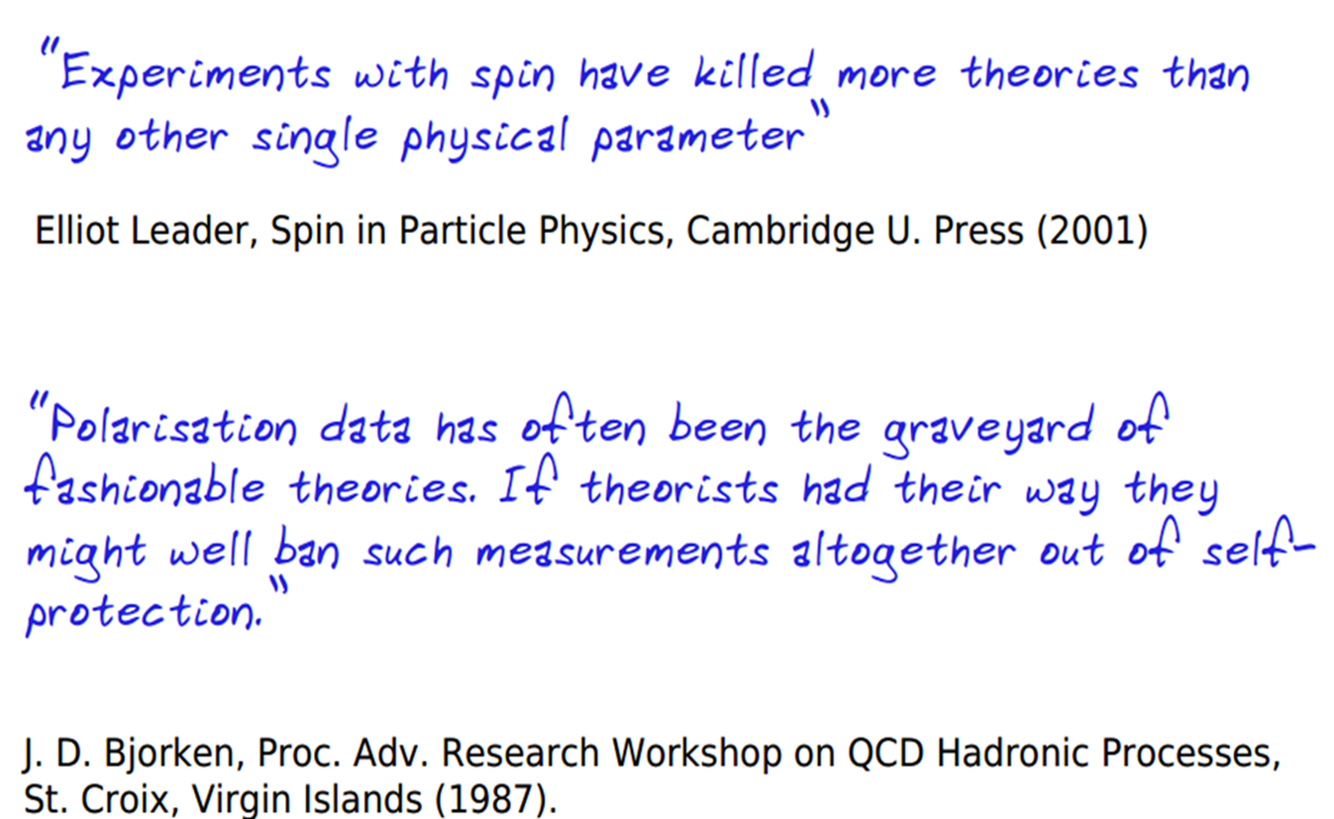
What we (don’t) know about spin in strong interaction
 | Expected | Эксперимент
Quark contribution into the proton spin | 1 | 1/3
Single-spin asymmetry in hadron interactions | < 1% | Up to 40%
Dependence of SSA on energy and transverse momentum | Decreased | Does not depend
Spin effects with antiprotons |  | Too few data
Contribution of gluons to proton spin | Unknown | Close to zero
Contribution of orbital momentum to proton spin | Unknown | There are no data

Slide 4
SPASCHARM Physics: stage 1
Single–spin asymmeties: inclusive and exclusive reactions, including elastic, of the light (u, d, s – quarks) hadrons in the beam fragmentation region with polarized beam or target
The hyperon and vector mesons polarization and depolarization
High-precision studies of spin effect dependences on kinematic variables (0<x_{F} <1, 0< p_{T}<2.5, 12<E_{Beam} <50 GeV), event multiplicity and atomic number with the wide acceptance SPASCHARM universal spectrometer
Double-spin asymmetry A_{LL} in charmonium production to study gluon polarization ΔG/G(x) at large x_{F}

Slide 5
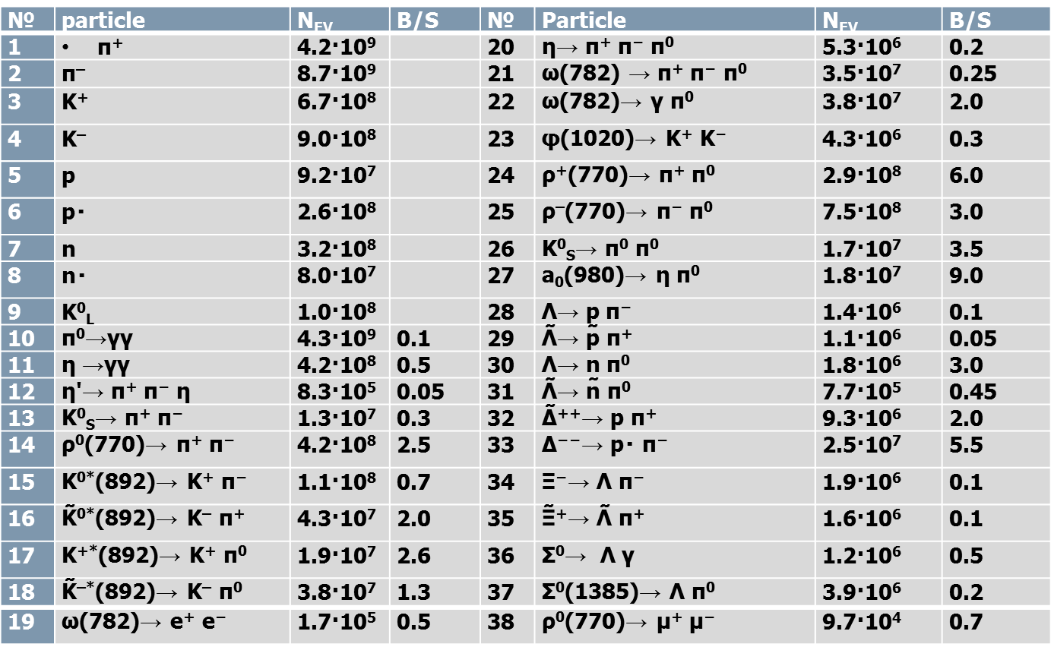
Inclusive statistics with π– -beam
More reactions with beam Kaons, antiprotons and protons

Slide 6
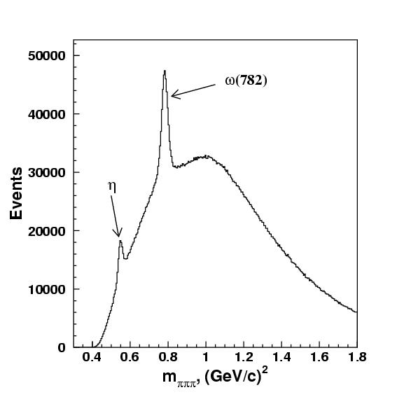
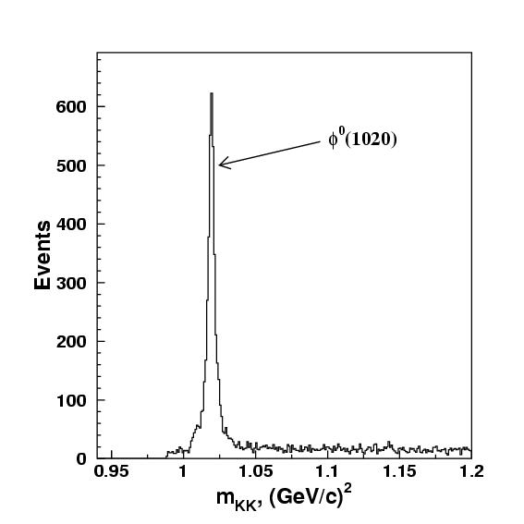
SPASCHARM simulation
Statistical errors for spin asymmetry measurement in the reactions
π⁻р↑→ ω(782)X, ρX, η’(958)X varies from 0.3 to 3% depending on kinematic interval
Accuracy in the reaction π⁻p↑→ f₂(1270) X is better, at ~(0.1÷1%)

Slide 7
SPASCHARM physics: STAGE 2
Stage 2: polarized and un-polarized beams at un-polarized target:
Single-spin asymmetry А_{N} in J/ψ and χ₁/χ₂ inclusive production polarized proton beam. Expected statistics (conservative) for 40 days of data taking is:.
p (40 GeV) beam (10⁷ р/cycle): 20000 J/ψ and 2500 χ₁/χ₂ states.
Statistic error for J/Ψ asymmetry measurements is 7%
The cross-section ratio for χ₁/χ₂ production will be measured to determine the mechanism of charmonium production using pion and proton beams.
Stage 2: longitudinally polarized as beam as well as target:
Double-spin asymmetry А_{LL} measurements to study ΔG/G(x).
А_{NN} measurements for Drell-Yan pairs to study transverslity h(x). Simultaneously А_{NN} and A_{N} in J/ψ, χ₁/χ₂. production will be studied.
Double spin asymmetry measurements in various reaction channels

Slide 8
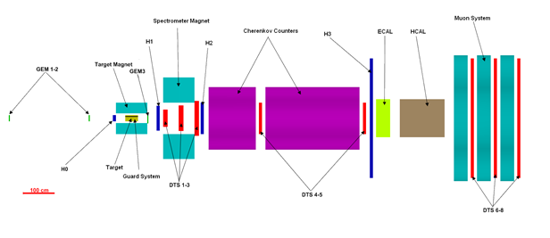
SPASCHARM Setup – multipurpose detector
JINR Polarized frozen target, full azimuth coverage

Slide 9
Detector description
Tracking system ΔP/P=0.4% at 10 GeV/c:
Spectrometer magnet (1.5 Tm Field maximum), full aperture 250x500 mrad,
GEM station – on-board electronics required, working with MEPhI on development and production
5 thin-wall drift tube chamber stations, 3 stations have been commissioned, one to be commissioned this Fall
Particle identification
Cherenkov 1: pions above 3 GeV/c, kaons above 11 GeV/c,
Cherenkov 2: pions above 6 GeV/c and kaons above 23 GeV/c,
Hodoscopes as TOF (p/K-separation up to 2.5 GeV, K/pi up to 1.5 GeV) – R&D.

Slide 10
DETECTOR 2
Calorimetry:
Lead-glass calorimeter (720 of 3.8x3.8x21 cm³ cells)
Fine-segmented lead-scintillator electromagnetic calorimeter (shashlyk-type): σ(E)/E=1.3⊕2.8/sqrt(E), 5.5x5.5 cm cell size (Area covered 2x3 m²) R&D completed
Compensated lead-scintillator hadron-calorimeter (sandwich, 7 int. length, resolution about 50%/sqrt(E))
Beam detectors: 3 Scintillation hodoscopes, 1 fiber hodoscope will be ready by Spring 2017
New DAQ with parallel readout: Expected – up to 50 kEv per 2 sec cycle, Achieved – 10 kEv per 0.8 sec. cycle

Slide 11
GOALS for 2016 and 2017
2016 fall – commission of Chamber 4, adjusting of polarized target magnet, test data taking with “pions” (without Cherenkov counters) - 4 stations of DT stations, EMC: single-spin asymmetry in production of h+, h-, ρ(770), ω(782), η/(958), f₀(980), a₀(980), f₂(1270).omega, delta isobars
2017 spring – data taking with “pions”, test prototype of Chamber 5
2017 fall – addition of one Cherenkov counter in order to select kaons and reconstruct ϕ-meson
2016-2020 – Preparation of the polarized beam channel

Slide 12
SPASCHARM polarized beam option
Polarized proton and antiproton beam channel is currently under development (3 Talks this Conference):
V. Rykov - Polarized proton and antiproton beams for the SPASCHARM experiment at U-70 accelerator (Thursday)
P. Semenov - Tagging system for the polarized beams at U-70 accelerator (Thursday)
A. Bogdanov - Beam polarimetry at the SPASCHARM experiment at IHEP U-70 accelerator (Tuesday)

Slide 13
Conclusions
New experiment SPASCHARM, devoted to systematic study of polarization phenomena in hadron-hadron interactions, is under commisioning
Detection of charged and neutral particles in the final state in a wide solid angle will allow to explore dozens of reactions (spin PDG) using various beams and targets
A special feature of the experiment is the simultaneous measurements of various spin-dependent physics observables (SSA, polarization of hyperons, spin density matrix elements for vector mesons, spin transfer parameters)

Slide 14
Backup slides

Slide 15
stage 1 physics
Systematic study of spin effects for the hadrons built from light (u,d,s) quarks:
Single-spin asymmetry in the fragmentation region of unpolarized beam particles
Exclusive meson production with registration the both neutral and charged particle. An expected asymmetry 30-40%
Asymmetry in the reaction π⁻p↑→ a₀(980)n->η(550)π⁰n will be measured for the first timeI
Inclusive reactions
Hyperon(?) and vector-meson study
Single spin effects with polarized proton and antiproton beams

Slide 16
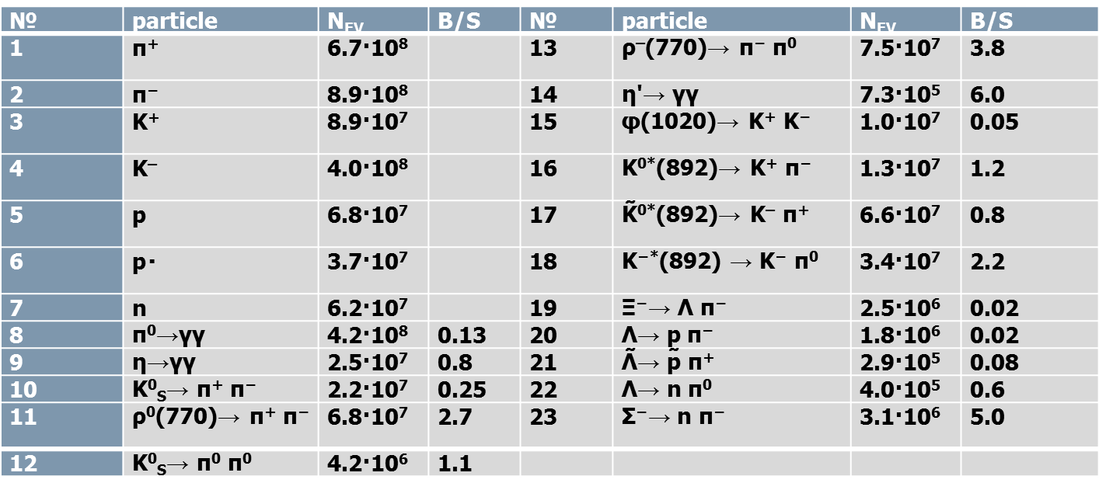
SPASCHARM with К– -beam and antiprotons
№ | частица | N_{EV} | S/B | № | частица | N_{EV} | S/B
1 | π⁺ | 2.1·10⁸ |  | 7 | n | 1.6·10⁷
2 | π⁻ | 2.6·10⁸ |  | 8 | ñ | 1.4·10⁸
3 | K⁺ | 1.7·10⁷ |  | 9 | Λ̃→ p̃ π⁺ | 2.1·10⁶ | 10
4 | K– | 2.2·10⁷ |  | 10 | Λ̃→ ñ π⁰ | 1.1·10⁶ | 0.13
5 | p | 1.6·10⁷ |  | 11 | Δ̃⁻⁻→ p̃ π⁻ | 4.2·10⁷ | 0.14
6 | p̃ | 1.8·10⁸ |  | 12 | Ξ⁻→ Λ π⁻ | 1.0·10⁵ | 10

Slide 17
Registered x_{F} →(x₁,x₂)

Slide 18
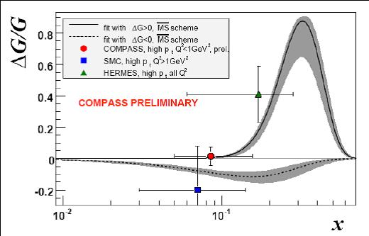
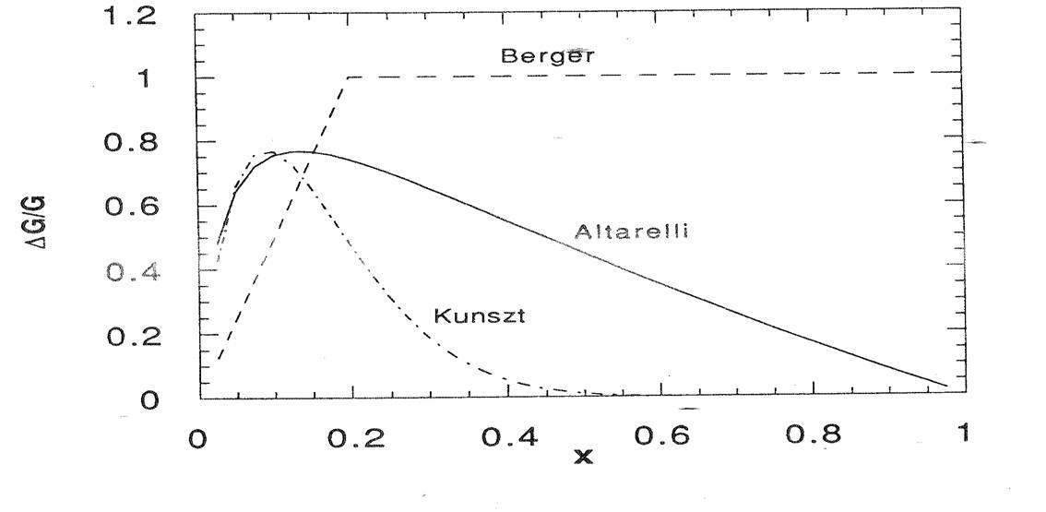
Theoretical expectations of А_{LL} in charmonium production.
Theoretical predictions of A_{LL} mainly depend on two assumptions :
gluon polarization ∆G/G and
charmonium production mechanism which defines Â_{LL} at the parton level (in parton-parton interaction)
In the proposed experiment х ~0.3, where ∆G/G predicted in different theoretical models is in the range between 0.15 and 1.
Different models give different predictions for A_{LL} :
[Doncheski, Robinet] – gluon fusion: A_{LL} = -24% for χ₂ and -18% for J/Ψ
[Contogoris] – color evaporation:
A_{LL}= +(18-42)% for both χ₂ and J/Ψ
COMPASS analysis (hep-ex/0609038)

Slide 19
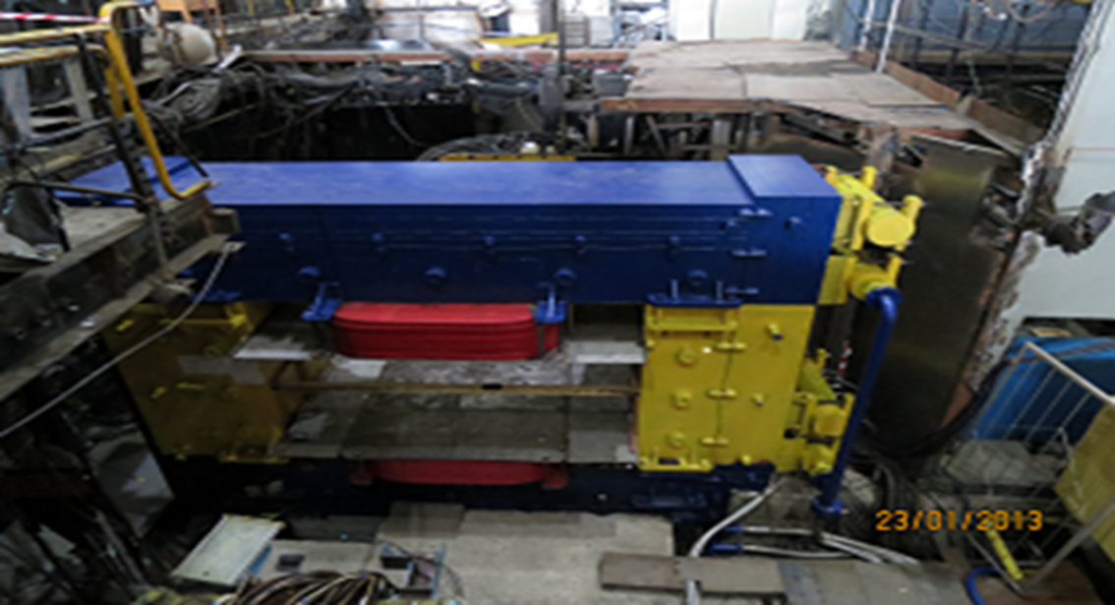

Slide 20
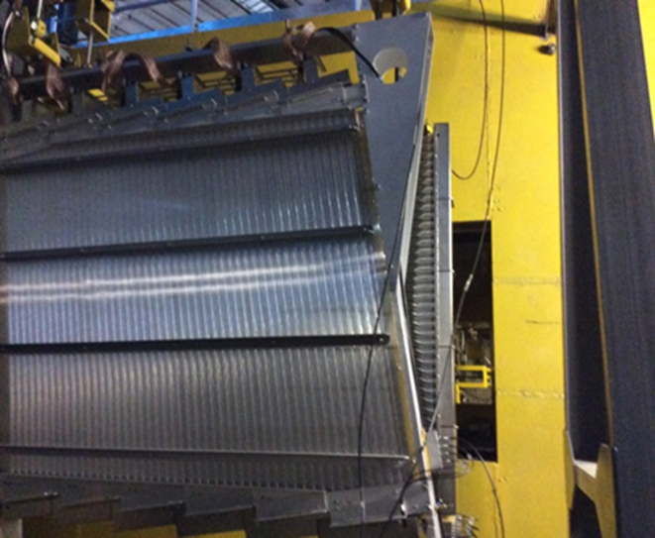
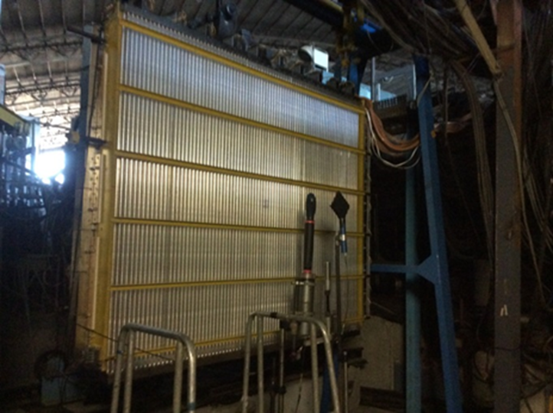

Slide 21
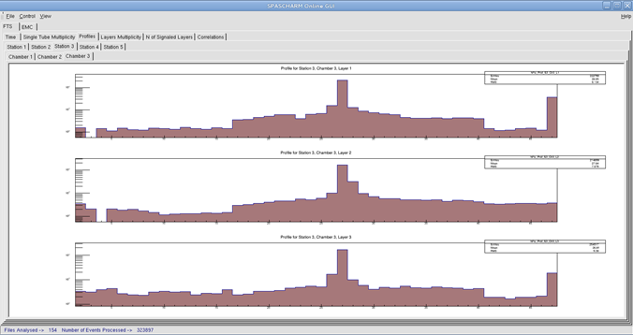
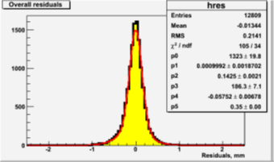
ON-line beam distributions profiles

Slide 22
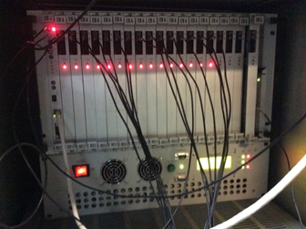
New data acquisition
New DAQ with parallel electronics readout:
New ADC crate (see picture) – 6-20 ms/event
New TDC crate 30-50 ms/event
New registers for the beam hodoscopes
Achieved rate: 10000 event/0.8 sec
Expected – up to 50 kEv/cycle (factor 2.5 -2 sec. exposition time, factor 2 –ADC improvement – was done after beam tests)

