Slide 1
Г. Д. Алексеев (ЛЯП ОИЯИ)
«Статус работ по мюонной системе эксперимента ПАНДА»
* Краткий обзор системы :
- инженерное описание (под-системы, детекторы)
- оптимизация системы (мюоны от разных процессов)
- основные численные параметры
* Принцип действия:
- пробежная система как линейный «калориметр» мюонов
- пробежная система как грубый калориметр адронов (нейтроны ! )
- главная задача – подавление пионного фона
* Прототипы:
- полноразмерный (~2м х 4м)
- полномасштабный (10 тонн, ~4600 каналов считывания информации)
- предварительные результаты пучковых испытаний в ЦЕРН
* Текущее состояние дел:
- подготовка полномасштабного прототипа и модернизация пучка в ЦЕРН
- одобрение проекта в FAIR (принят -> сентябрь 2014 )

Slide 2
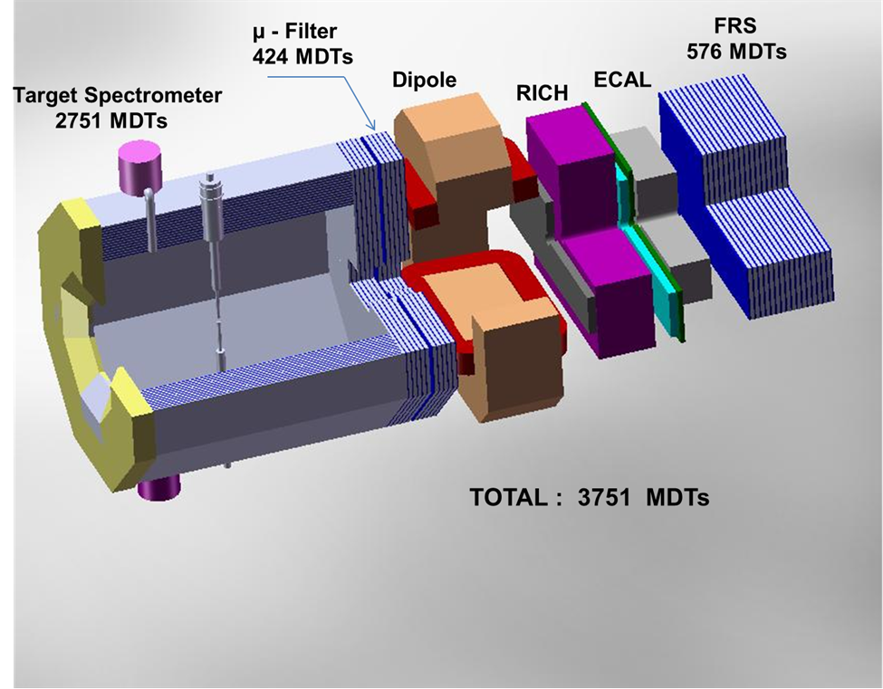
The layout of Muon System using the technique of Range System (with the number of MDT detectors for each particular subsystem)

Slide 3
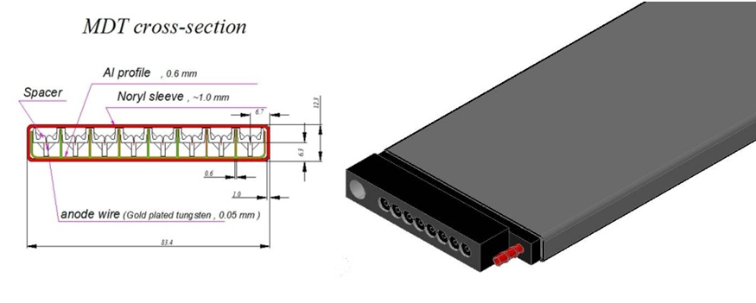
Mini Drift Tube cross section (left) and layout (right)

Slide 4
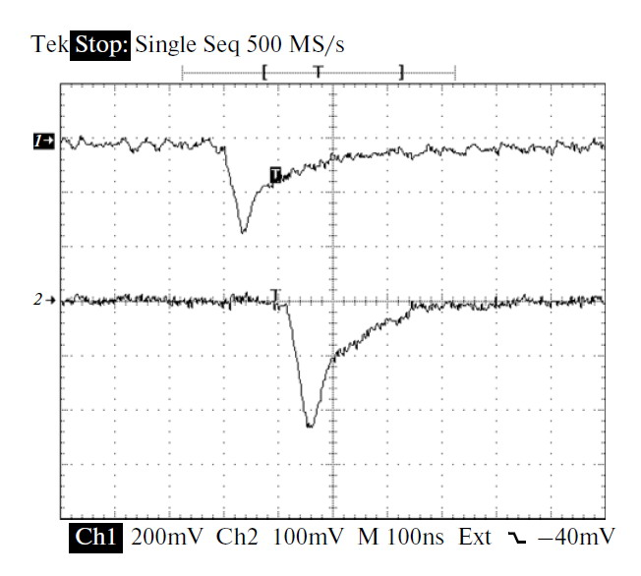
Oscillograms of single signals: from the anode wire (1)and the strip (2); the conversion factors are 60 and 480 mV/μA, respectively

Slide 5
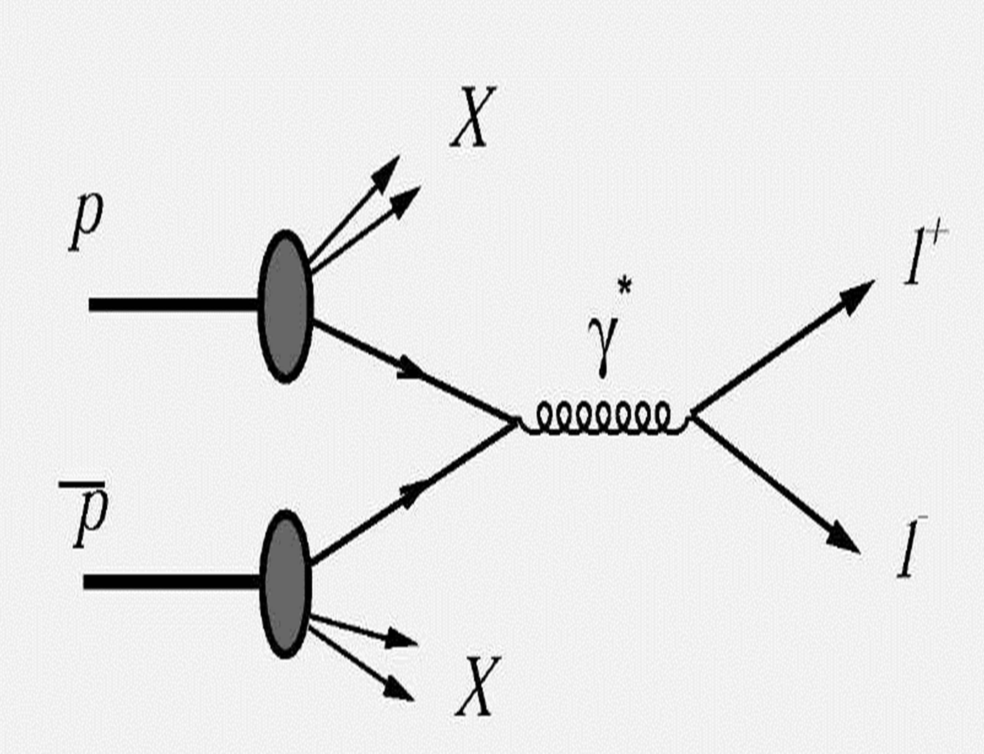
→l⁺l⁻ + X process - selected as benchmark process for design/tuning of PANDA Muon System

Slide 6
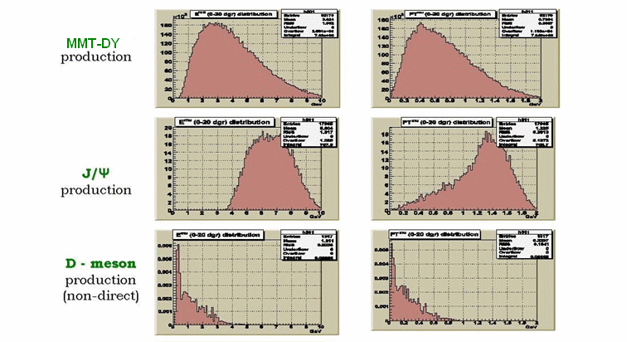
Muon momenta distributions for different processes in the sector 0°– 20° of polar angle

Slide 7
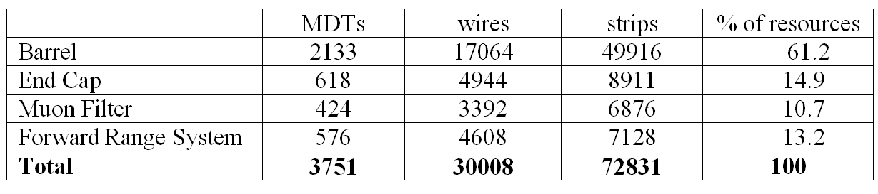
Basic numbers for Muon System instrumentation

Slide 8
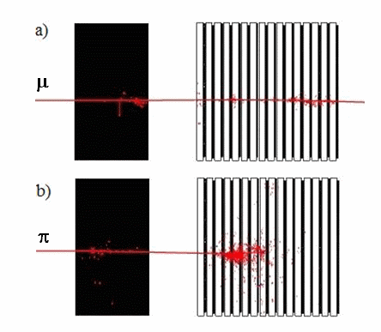
Response of FRS to muon (a) and pion (b) at 5 GeV (single event)
Ecal /shashlik Forward Range System

Slide 9
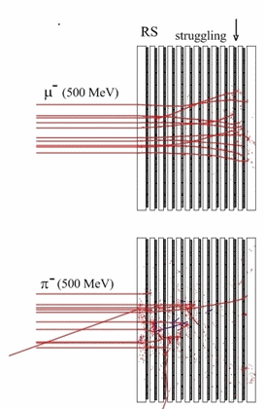
RS response (Target Spectrometer Barrel structure) to muons and pions with initial kinetic energy of 500 MeV; MC sample for 20 events is shown for demonstration

Slide 10
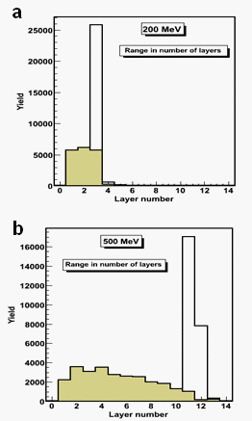
Distributions of particle range in RS for muon and pion beams (dashed area) with initial kinetic beam energy of 200 MeV (a) and 500 MeV (b)
.

Slide 11
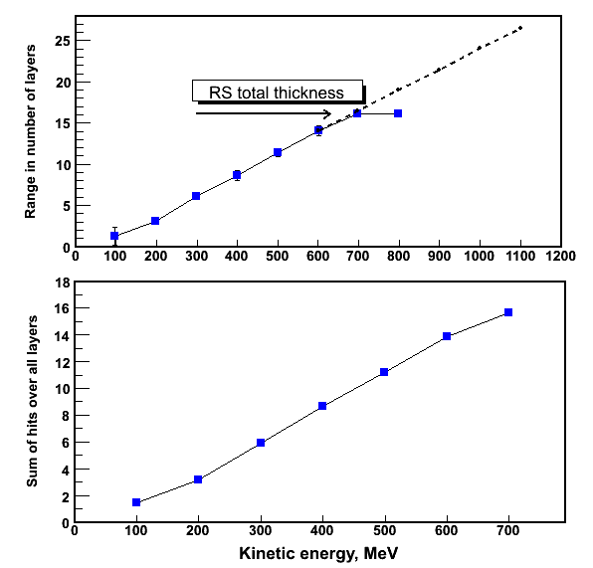
Muon range in number of layers(top) and the average number of hits (bottom) in RS as a function of initial kinetic energy

Slide 12
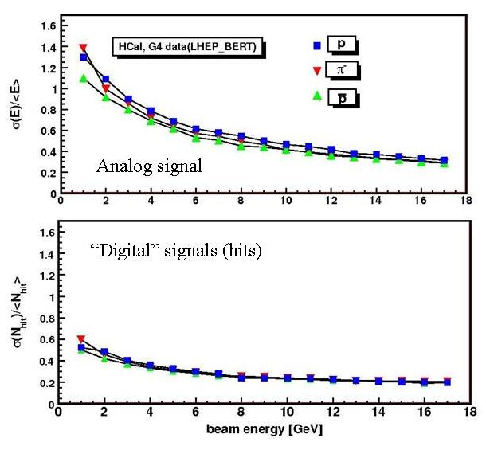
RS energy resolution for hadrons in different readout modes

Slide 13
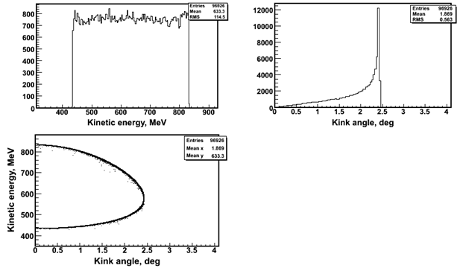
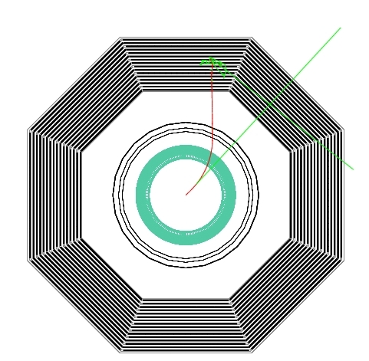
Suppression of fake muons from π→µν decay
Demonstration of π→µν decay in the Inner detector of PANDA setup: decay muon (red) stops in the RS while neutrino (green) leaves the volume
The kinetic energy spectrum, kink angle distribution and the kinetic energy versus angle correlation plot for muons produced in π(800 MeV)→µν decay

Slide 14
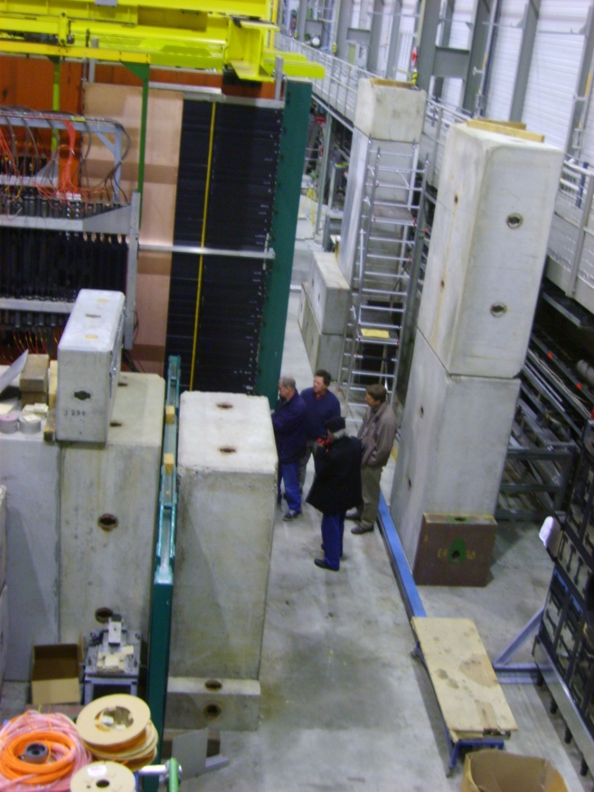
Full Scale (2 x 4 m²) prototype in work position at CERN/COMPASS – study of long strips readout

Slide 15
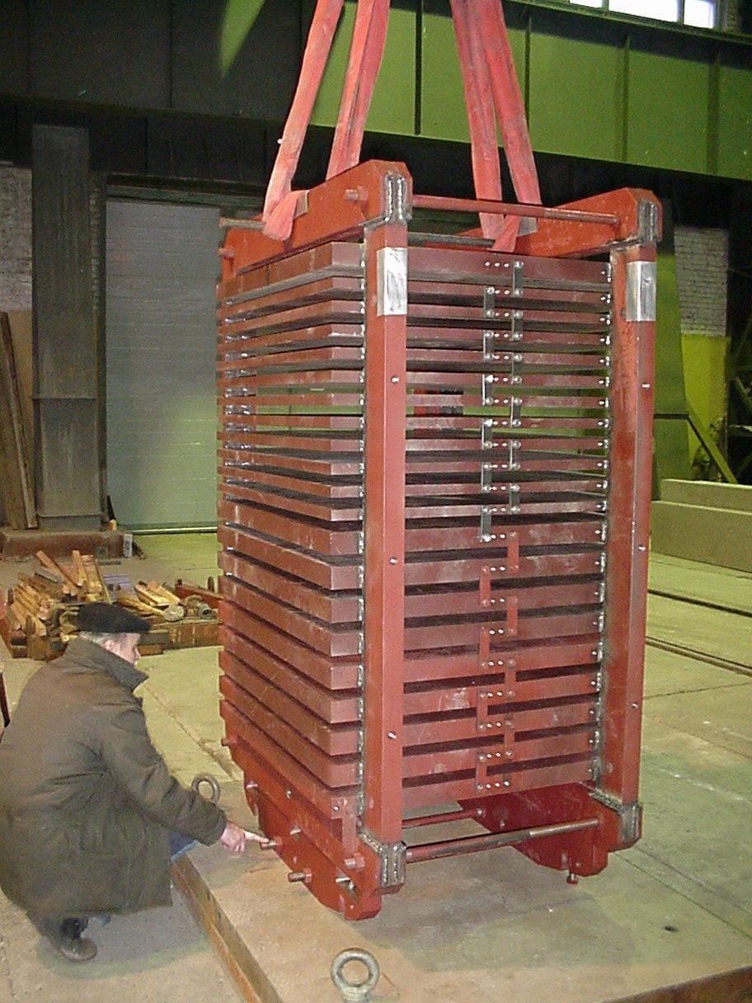
Range System prototype (Fe absorber and support structure) in Dubna in vertical position (for further tests with cosmic at CERN)

Slide 16
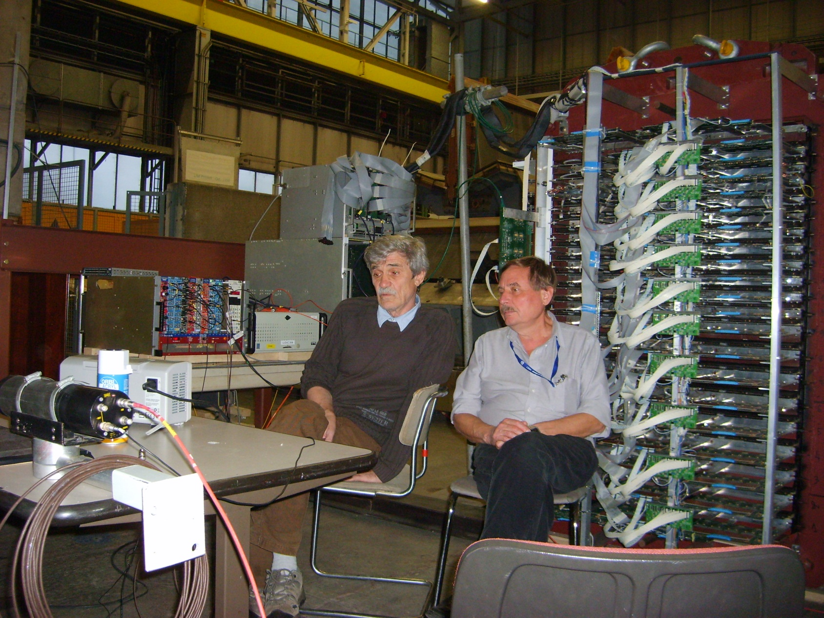
Assembly of RSP
Debugging and adjustment of DAQ on cosmic; RSP is fully equipped with A2DB-32, ADB-32 , Asum-96 and QTC cards
VME/6U crate, MWDB cards
VME/9U DAQ crate
NIM/trigger crate

Slide 17
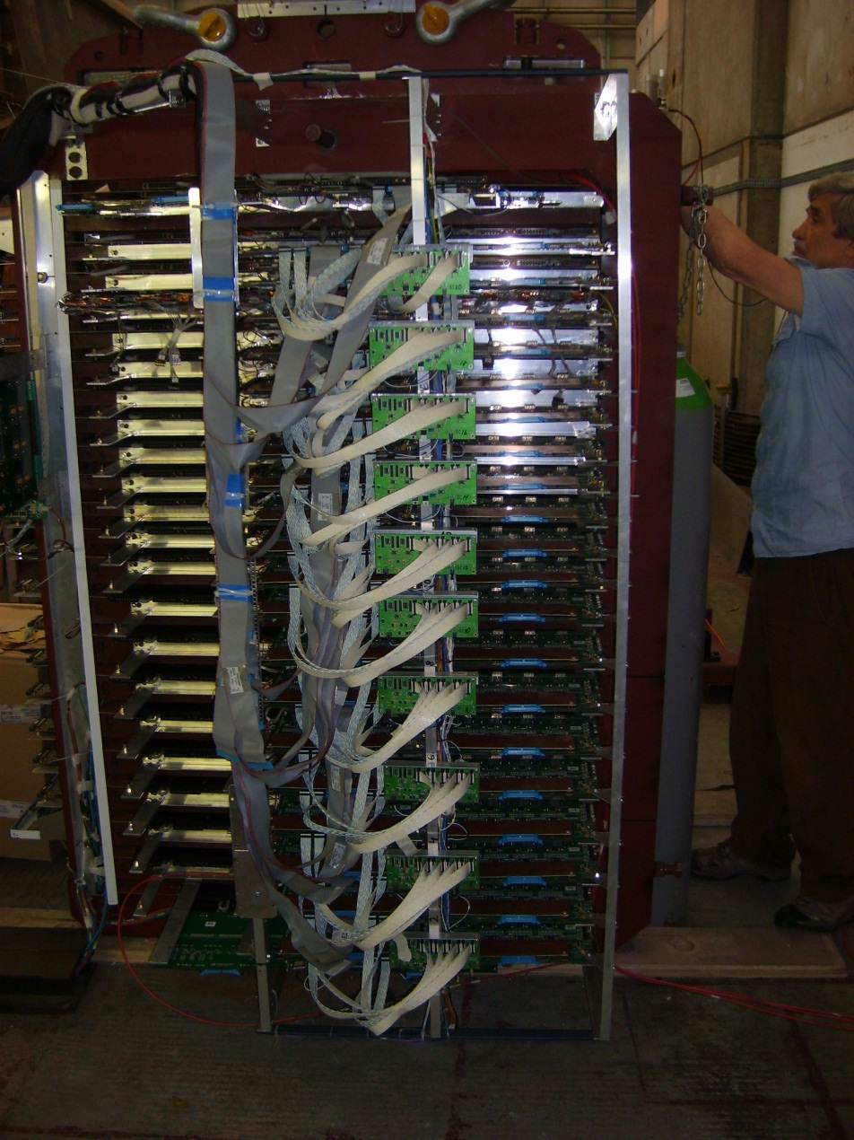
Assembly of RSP
Restricted set (32 wires x 20 planes) of wire R/O is left for final DAQ configuration
Restricted set of wire R/O (32 wires x 20 planes)

Slide 18
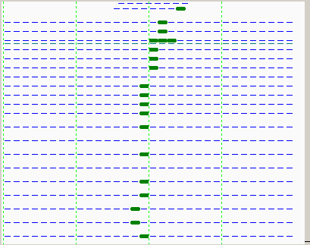
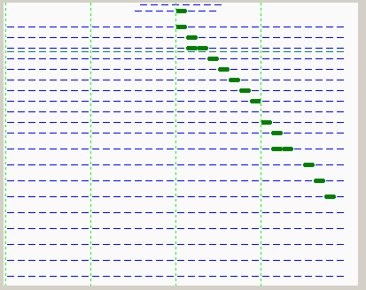
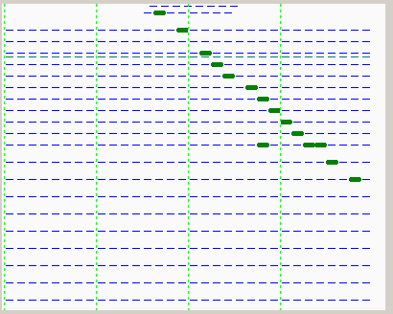
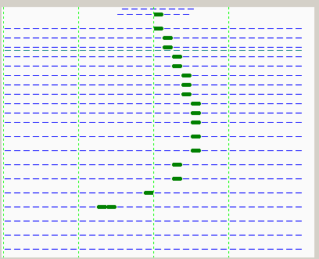
COSMIC MUONS
Trigger: S3 (20x20cm²) & S4 (60x20 cm²) on top of RSP
32 cm
~150 cm

Slide 19
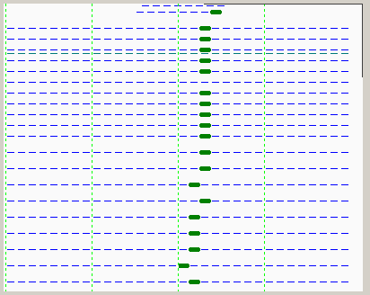
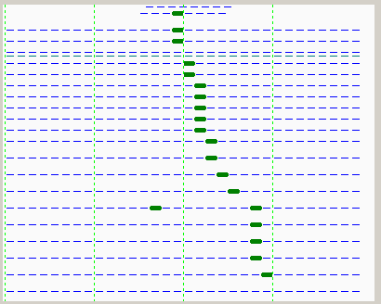
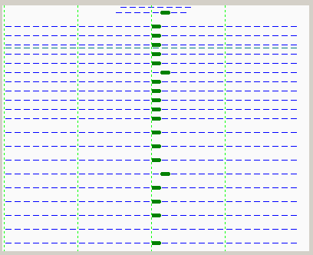
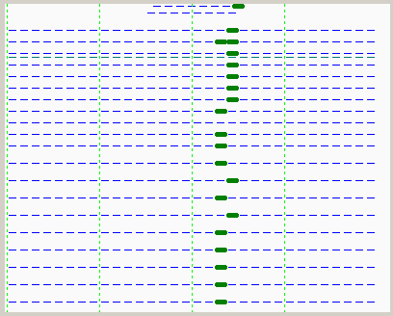
COSMIC MUONS
Trigger: S3 (20x20cm²) on top & S4 (60x20 cm²) on bottom of RSP
Barrel
FRS
EC+MF

Slide 20
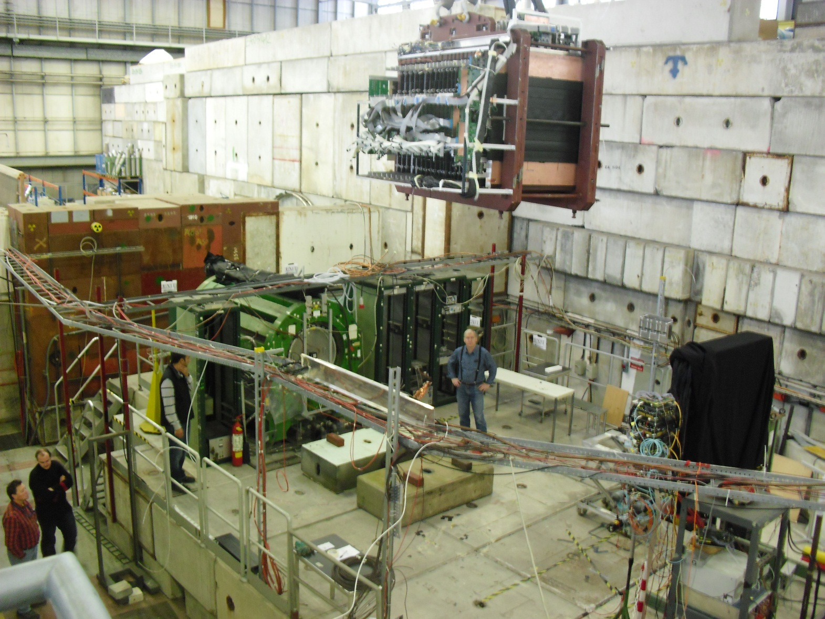
Placement of the RSP in T9 beam zone

Slide 21
Table of conditions for written events
P[Gev/c] | Trigger | Composition | N of events | file # , Comments
Spectrum | S3*S4 | cosmic | 635 | f39, S3 & S4 on RSP top
Spectrum | S3*S4 | cosmic | 8375 | f41,S3 on top & S4 on bottom
0.5 | S1*S2 | - (e,μ,π) | 6575 | f85, strips on
0.5 | S1*S2 | + (e,μ,π,p) | 27374 | f83, strips on
1 | S1*S2 | + (e,μ,π,p) | 3087 | f65
1 | S1*S2*vetoC1 | + (μ,π,p) | 90 000 | f68
2 | S1*S2 | + (e,μ,π,p) | 3161 | f80, strips on
2 | S1*S2+Pb | + (μ,π,p) | 1087 | f81, 2.5 cm Pb brick in beam, strips on
3 | S1*S2 | + (e,μ,π,p) | 11766 | f77
3 | S1*S2*C2 | + (e,μ) | 3283 | f78
3 | S1*S2*C2+Pb | + (μ) | 299 | f79, 2.5 cm Pb brick in beam, strips on
5 | S1*S2 | + (e,μ,π,p) | 9702 | f56
5 | S1*S2*C1*C2 | + (e) | 2181 | f57
5 | S1*S2*C1*C2 | + (e,μ) | 1217 | f58
5 | S1*S2*C1*C2 | + (e,μ) | 200 000 | f59
5 | S1*S2 | + (e,μ,π,p) | 6407 | f69, strips on
5 | S1*S2*C2 | + (e,μ) | 3201 | f70, strips on
5 | S1*S2*C2 | + (e,μ) | 13266 | f71, strips on
7 | S1*S2 | + (e,μ,π,p) | 11940 | f75, strips on
7 | S1*S2*C2 | + (e,μ) | 3492 | f76, strips on
10 | S1*S2 | + (e,μ,π,p) | 9899 | f72, strips on
10 | S1*S2*C2 | + (e,μ) | 1213 | f73, strips on
10 | S3*S4 | + (e,μ,π,p) | 7405 | f74, beam + halo, strips on

Slide 22
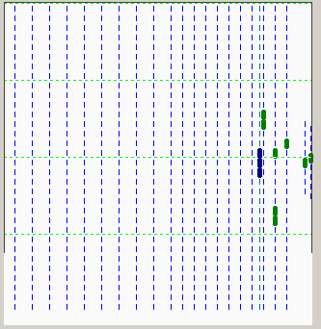
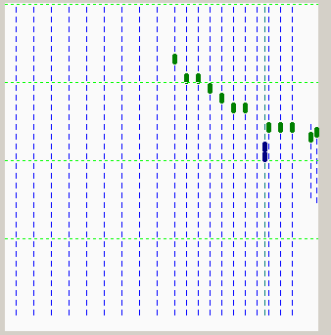
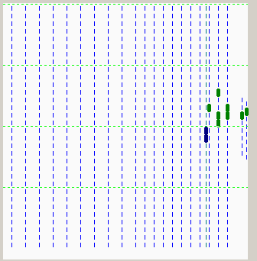
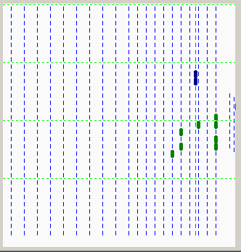
BEAM: e,µ,π,p
0,5 GeV/c, trigger: S1 (Ø 11,5 cm) & S2 (Ø 3,5 cm)
(here and below fired wires are given in green and strips – in blue, strip board is turned by 90 deg.)
µ
?
?
?

Slide 23
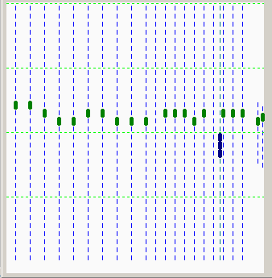
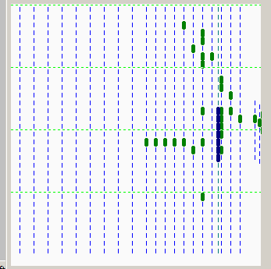
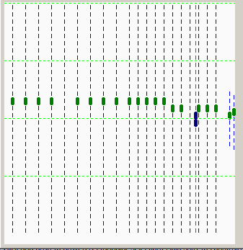
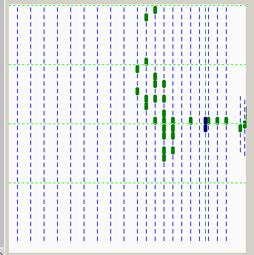
BEAM: e,µ,π,p
3 GeV/c, trigger: S1 (Ø 11,5 cm) & S2 (Ø 3,5 cm)
µ
h
µ
h

Slide 24
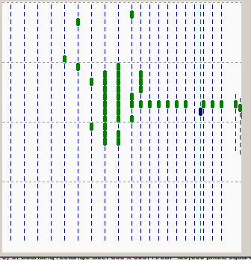
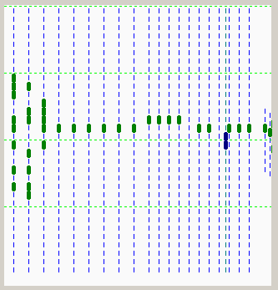
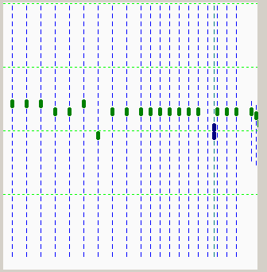
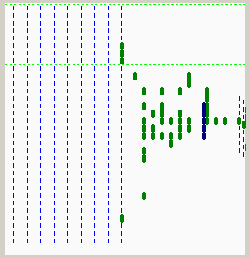
BEAM: e,µ,π,p
7 GeV/c, trigger: S1 (Ø 11,5 cm) & S2 (Ø 3,5 cm)
h
h?
µ
e?

Slide 25
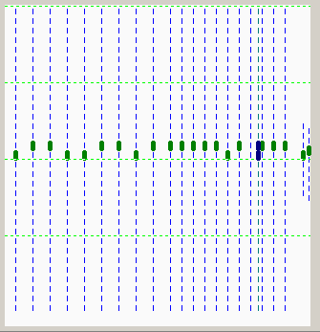
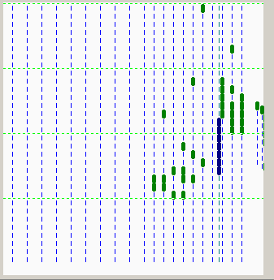
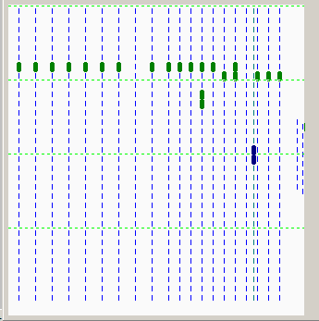
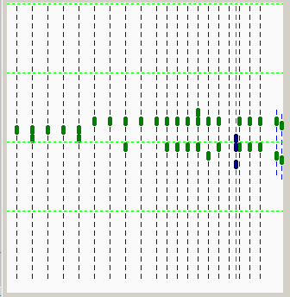
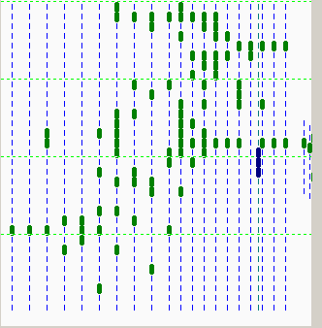
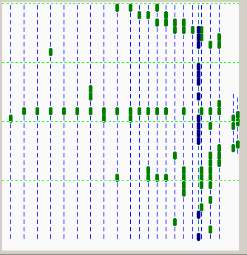
BEAM: e,µ,π,p
10 GeV/c, trigger: S3 & S4 (beam + halo)
halo µ
µ
e
halo h
halo µ ?
µ
h
µ
halo µ
halo h

Slide 26
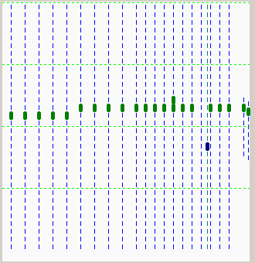
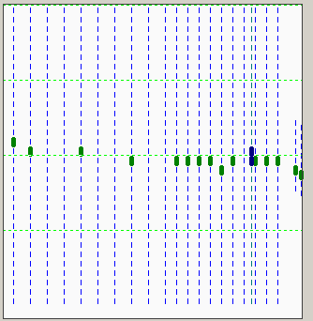
DAQ R/O gate ~ 1.3 µs
10 GeV BEAM
Example of two superimposed muon tracks disentangled with timing information
run F74, event #164
full event
beam muon Δt ~ 1000ns
halo muon

Slide 27
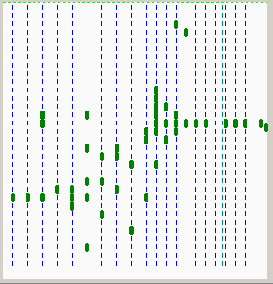
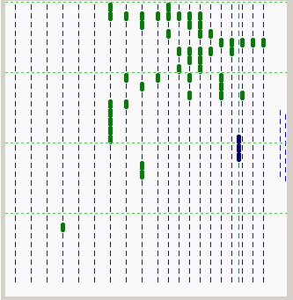
DAQ R/O gate ~ 1.3 µs
10 GeV BEAM
Example of two superimposed hadrons disentangled with timing information
run F74, event #272
full event
beam hadron Δt ~300ns
halo hadron

Slide 28
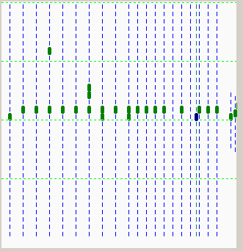
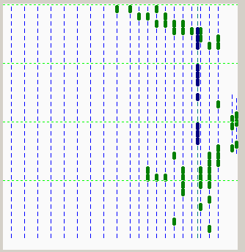
10 GeV BEAM
Example of few superimposed particles disentangled with timing information
run F74, event #560
full event
beam muon Δt ~ 1050ns
halo particle(s) ?
DAQ R/O gate ~ 1.3 µs

Slide 29


Assumed upgrades to T9 beam line for π/μ separation < 1-2 GeV/c:
S1,S2 time-of-flight scintillator counters based at ~ 20 m to each other, pressurized Cherenkov counter C3, magnetic analysis of incoming muon momenta with ~ +/- 1% accuracy

Slide 30
Статус мюонной системы на сегодня
Прототипы:
- полномасштабный - дооборудование дополнительными
экранами всех (22) детектирующих плоскостей, подключение
цифровой электроники (4600 каналов), начало тестирования
- с декабря 2014
- полноразмерный (~2м х 4м) – смонтирован в ЦЕРН на
установке COMPASS, дооборудование дополнительным
экраном и стриповой электроникой, начало тестирования – с марта 2015
Статус проекта:
- первый запрос финансирования в Росатом – 2008
- первое представление проекта – июнь 2011, Протвино
- принятие проекта коллаборацией – сентябрь 2012, Париж
- положительная рекомендация рефери – июль 2014, ЦЕРН
- одобрение FAIR Council – проект принят,сентябрь 2014, FAIR

Slide 31
Backup slides

Slide 32

An efficiency of π/μ separation by range in RS: primary particles - for those events in which only primary muons and pions passing through RS are taken into account; all - all particles, no event selection (combined MC setup -> ECal+Coil+RS)

Slide 33


Full Scale Prototype at CERN
Skeleton view of the Full Scale prototype package with crossed MDTs and strips with corresponding readout electronic cards
FSP position in the COMPASS experimental area; the prototype is marked with white dashed rectangle.

Slide 34

RS Prototype equipped with detecting planes and electronics

Slide 35

RS prototype equipped with FE analog and digital electronics
(4600 channels of wire and strip R/O)

Slide 36
T9 beam particles ID
C1,C2,C3 - Cherenkov gas threshold counters with
variable pressure up to 2, 3.5 and 60 bar (CO₂) .
TOF - time of flight plastic scintillator system (L=21.4m)
with resolution ~ 100ps (scintillator - BC408,
PMT - Hamamatsu R5946).
P[Gev/c] | 0.5 | 1.0 | 1.5 | 2.0 | 2.5 | 3.0 | ≥3.5
C1 | e | e | e | e | e | e | e+µ
C2 | e | e | e | e | e+µ | e+µ | e+µ+π
C3 | e | e+µ e+µ+π | e+µ e+µ+π | e+µ e+µ+π | e+µ+π | e+µ+π | e
TOF | e,µ,π,p | e,µ,π,p | p | p | p | p | p

Slide 37

PANDA Collaboration Meeting, Protvino 9 June 2011
G.Alexeev (for muon group)

